Slide 1

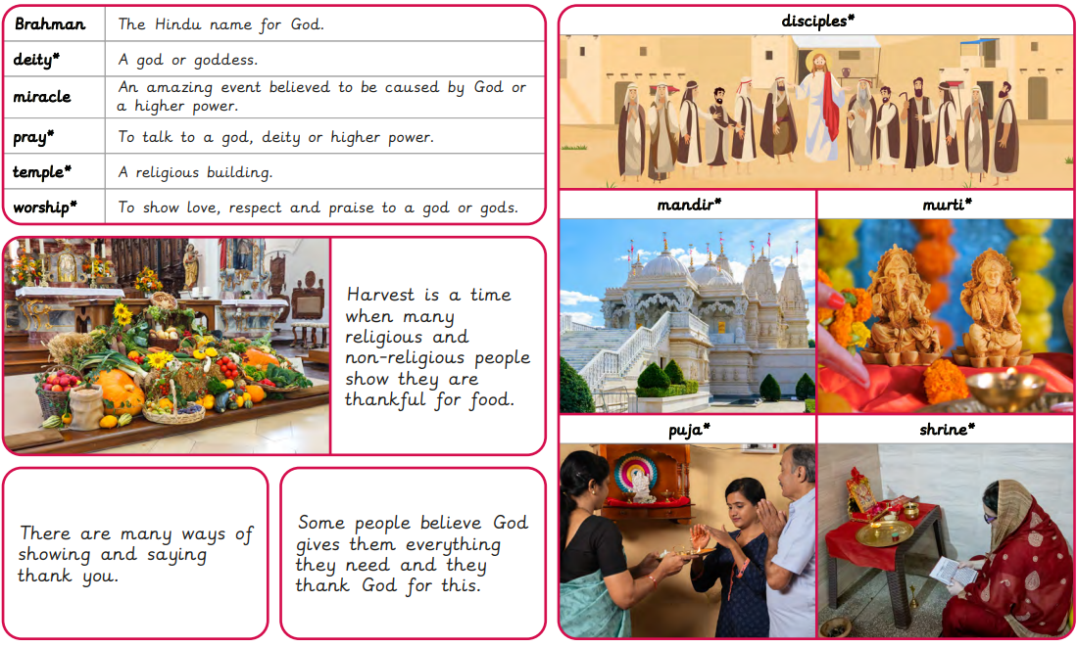
Rotherhithe Primary- Year 2
Topic: Why do we need to give thanks?
What I should already know
Why do people care for others? How might Muslim people show it is important to care for others? Is giving always the same? What can we learn about caring for others from stories? Why might some Humanists choose to care for others? What inspires some people to care for others?
What will learn in this unit?
To identify how and why some people say thank you by reflecting on personal experience. To recognise how and why some people celebrate harvest by examining what they say and do. To identify why some Hindus and Christians feel thankful to God by exploring stories. To describe how and why some Hindus express gratitude to God by exploring puja. To identify how some Hindus and Christians thank God by examining what they do. To explore music to understand how some Christians thank God.
What I will learn next
What are candles? Who were Rama and Sita? How are candles used during Diwali? How are candles used during Advent? What do candles symbolise at Hanukkah? Why do some people use candles? What can light mean at Christmas?

Slide 2
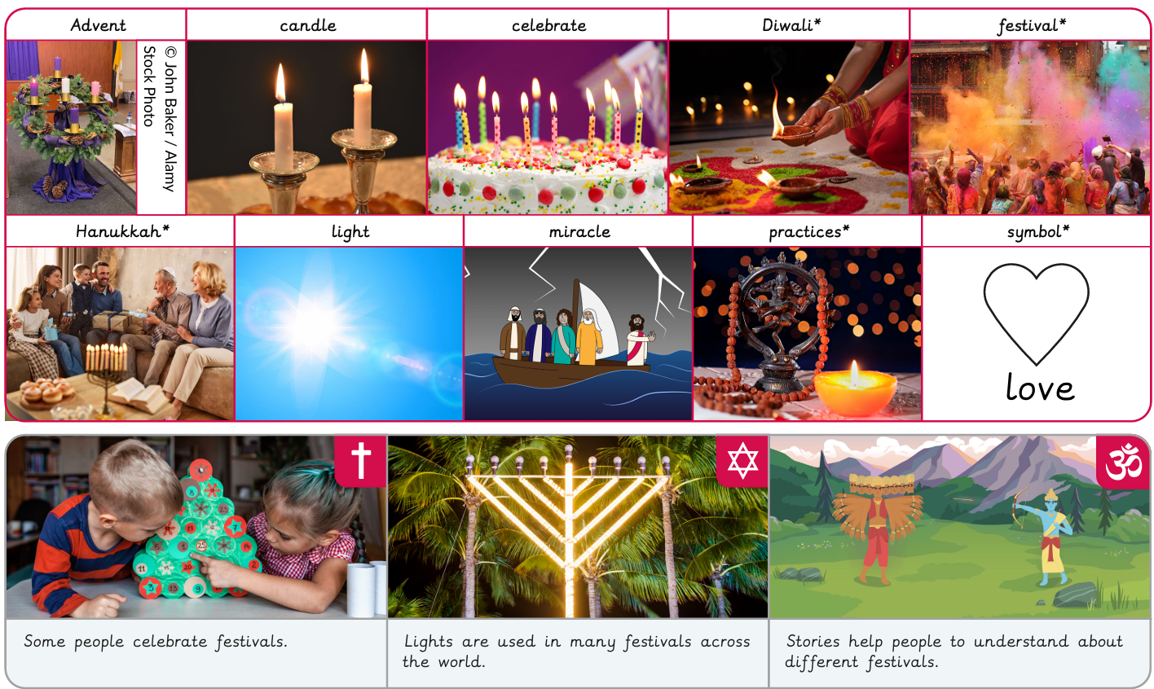
Rotherhithe Primary- Year 2
Topic: Why is light important to people?
What I should already know
How and why do some people show thanks? Why is harvest an important time for giving thanks? How and why do some people thank God? How can puja express thanks? How do some people thank God? How do some Christians use music to express gratitude?
What will learn in this unit?
To explore why light is used in special ways by thinking about light and darkness. To explain why lights are important in the story of Rama and Sita. To explore Diwali by comparing the different ways it is celebrated. To explore how some Christians celebrate Advent. To understand why candles are used during Hanukkah. To discover how light is used to celebrate by exploring different festivals.
What I will learn next
How can we tell Jesus is special to some people? Why might some people think Guru Nanak is special? How do religious stories show some people are special? How do we know that Krishna is special to some people? What can a story tell us about why Muhammad is special to some people? Why might some people believe Jesus continued to be special when he grew up?

Slide 3
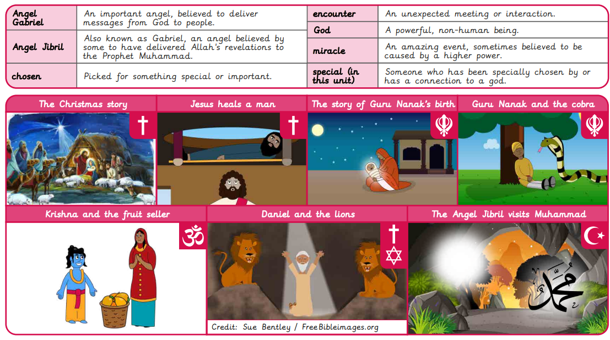
Rotherhithe Primary- Year 2
Topic: How do we know some people have a special connection to God?
What I should already know
What are candles? Who were Rama and Sita? How are candles used during Diwali? How are candles used during Advent? What do candles symbolise at Hanukkah? Why do some people use candles?
What will learn in this unit?
To identify how the Christmas story shows that Jesus is special to some people. To investigate why some people believe Guru Nanak was special by exploring a story. To explore how some stories show beliefs about special people. To understand that some people believe Krishna is special by exploring a Hindu story. To recognise why Muhammad is special to many people by exploring a story. To recognise why many Christians believe Jesus was a special adult by investigating a story.
What I will learn next
What characteristics did some prophets have? How might it feel to be a prophet? What promises do some people believe God made to some prophets? How do we know that Muhammad was the last prophet in the Muslim worldview? Why is Jesus important to some religious people? Why might some Sikhs believe Guru Nanak is special?

Slide 4
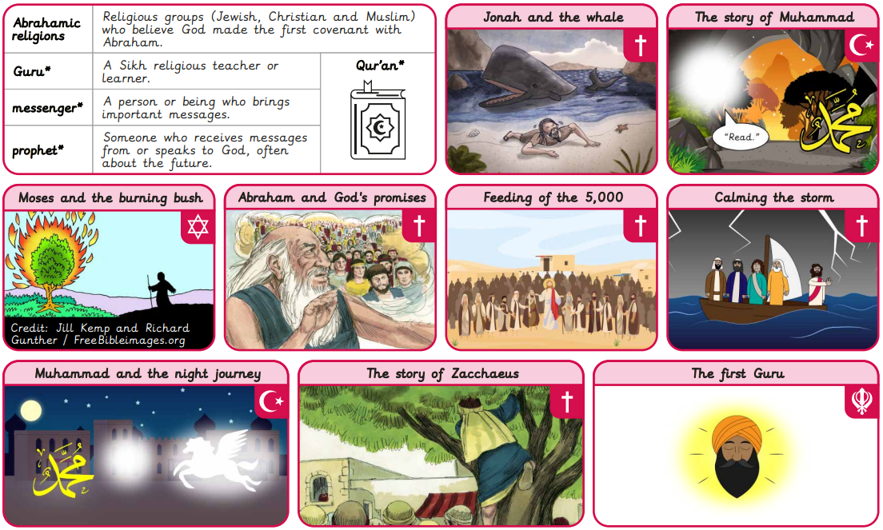
Rotherhithe Primary- Year 2
Topic: What is a prophet?
What I should already know
How can we tell Jesus is special to some people? Why might some people think Guru Nanak is special? How do religious stories show some people are special? How do we know that Krishna is special to some people? What can a story tell us about why Muhammad is special to some people? Why might some people believe Jesus continued to be special when he grew up?
What will learn in this unit?
To identify the characteristics of a prophet by exploring a story. To investigate stories about people’s responses to being a prophet. To explore the promises made to some prophets in stories and scriptures. To investigate the role of Muhammad using stories and scripture. To explore the role of Jesus in different worldviews using stories and scripture. To explain the importance of Guru Nanak for many Sikhs by looking at key events and teachings.
What I will learn next
Why do some people talk to God? What can prayer mean? How do some people use their bodies in prayer? What do some people use to help them pray? How do some Hindu people pray? Where do prayers come from?

Slide 5
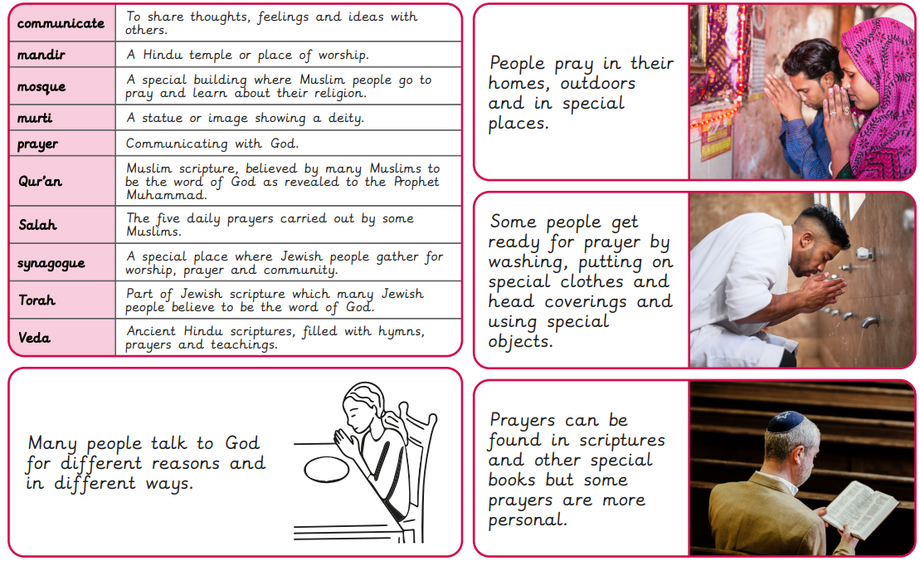
Rotherhithe Primary- Year 2
Topic: How do some people talk to God?
What I should already know
What characteristics did some prophets have? How might it feel to be a prophet? What promises do some people believe God made to some prophets? How do we know that Muhammad was the last prophet in the Muslim worldview? Why is Jesus important to some religious people? Why might some Sikhs believe Guru Nanak is special?
What will learn in this unit?
To consider why some people might choose to talk to God. To investigate ways some people pray. To recognise how different people use their bodies to pray by exploring practices. To understand why some people use special objects and clothing during prayer. To explore Hindu prayer practices and the significance of special objects. To explore where some prayers come from.
What I will learn next
Why do some Muslim people pray in a mosque? What can Orthodox churches suggest about some Christians’ beliefs? What can we learn by exploring different Christian places of worship? Why do some Jewish people go to a synagogue? Why do some Sikh people visit a gurdwara? What makes a place important to believers?

Slide 6
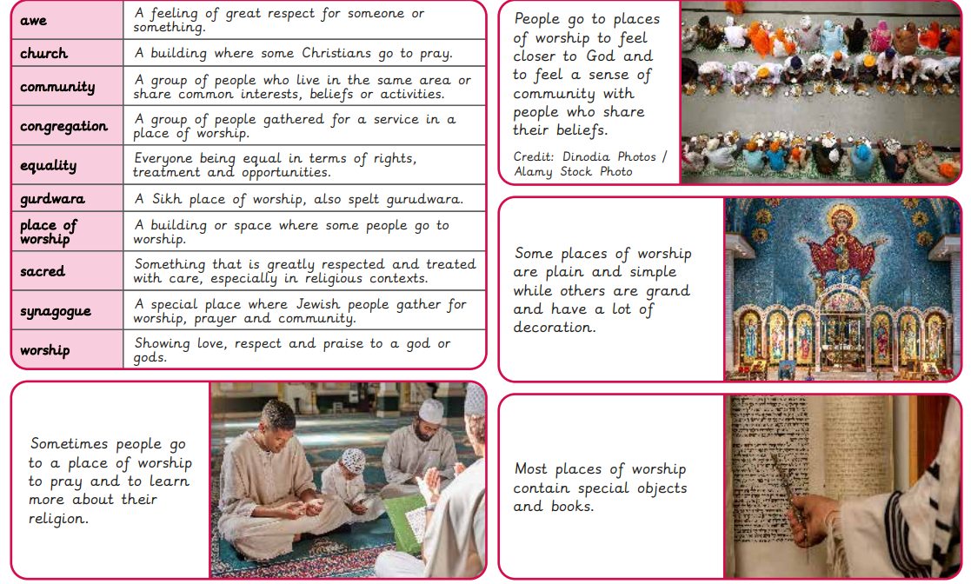
Rotherhithe Primary- Year 2
Topic: Where do some people talk to God?
What I should already know
Why do some people talk to God? What can prayer mean? How do some people use their bodies in prayer? What do some people use to help them pray? How do some Hindu people pray? Where do prayers come from?
What will learn in this unit?
To explore how Muslims pray both individually and in a mosque. To describe and explain the features of an Orthodox Christian church. To compare different Christian places of worship. To explore the importance of the synagogue to some Jewish people by identifying features that help them pray. To discuss why a gurdwara is a special place for some Sikh people by discovering the importance of its different features. To find out why different places are important to people because of their beliefs.
What I will learn next
What is special about being human? What is a soul and do we all have one? What do some people think makes us human? What is spirituality? What do some Buddhists do to focus on their inner self? Does anyone know what makes us human?

