Slide 1

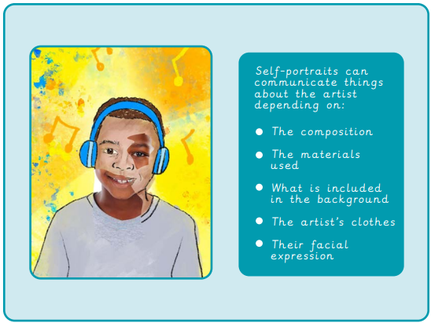
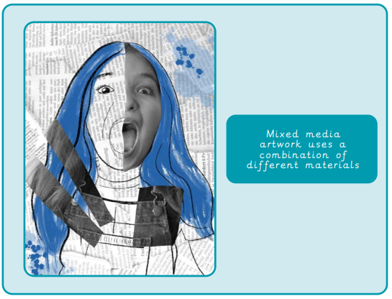
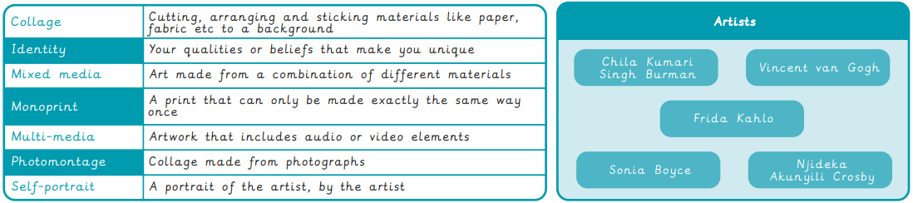
Year 5 Painting and Mixed Media – Portraits
What I already know:
I can use familiar shapes to create simple 3D drawings and describe the shapes used.
I can draw a simple design with consideration for how its shape could be cut from soap.
I can transfer a drawn idea successfully to a soap carving.
I can make informed choices about their use of tools.
I can bend wire to follow a simple template, adding details for stability and aesthetics.
I can create a shadow sculpture using block lettering in the style of Sokari Douglas Camp.
I can explore different ways to join materials to create a 3D outcome, making considered choices about the placement of materials.
What I will learn now:
I can mix a tint and a shade by adding
black or white.
I can use tints and shades of a colour to create a 3D effect when painting.
I can apply paint using different techniques eg. stippling, dabbing, washing.
I can choose suitable painting tools.
I can arrange objects to create a still life composition.
I can plan a painting by drawing first.
I can organise painting equipment independently, making choices about tools and materials.
What I will learn next:
I can use sketchbooks to research and present information.
I can develop ideas into a plan for a final piece.
I can make a personal response to the artwork of another artist.
I can use different methods to analyse artwork such as drama, discussion and questioning.

Slide 2
