Slide 1

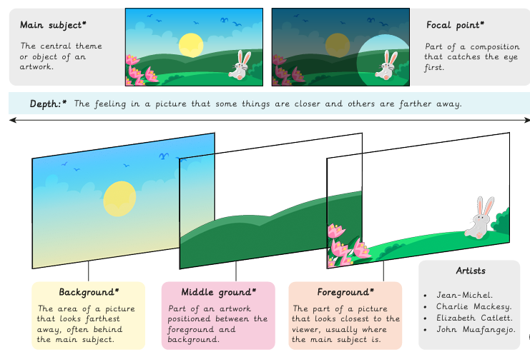
Year 5 Drawing – Depth, emotion & movement
Key Vocabulary
What I already know:
Use pencils of different grades to shade and add tone.
Hold a pencil with varying pressure to create different marks.
Use observation and sketch objects quickly.
Draw objects in proportion to each other.
Use charcoal and a rubber to draw tone.
Use scissors and paper as a method to ‘draw’.
Make choices about arranging cut elements to create a composition. Create a wax resist background.
Use different tools to scratch into a painted surface to add contrast and pattern.
Choose a section of a drawing to recreate as a print.
Create a monoprint.
What I will learn now:
Use various types of lines to emphasise emotion or draw attention.
Describe how artists have shown emotion.
Describe how artists have created an effective composition using a focal point and balance.
Use colour and line to convey emotion or movement in sketches.
Design a print, considering the composition carefully.
Use a combination of marks to create tone and depth.
Describe how artists use tone to show depth in their artwork.
Create an effective printing plate.
Reflect and improve sketchbook experiments and final work.

Slide 2
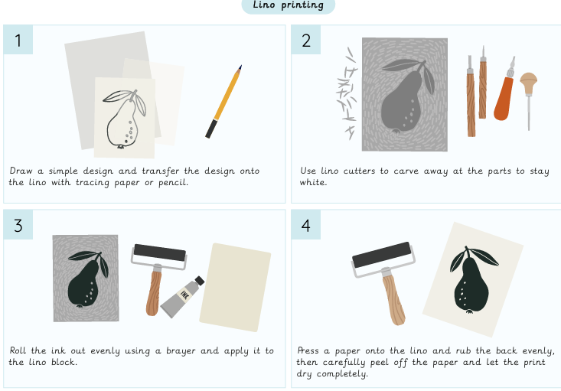
What I will learn next:
Use symbolism as a way to create imagery.
Combine imagery into unique compositions.
Achieve the tonal technique called chiaroscuro.
Make handmade tools to draw with.
Use charcoal to create chiaroscuro effects.

