Slide 1

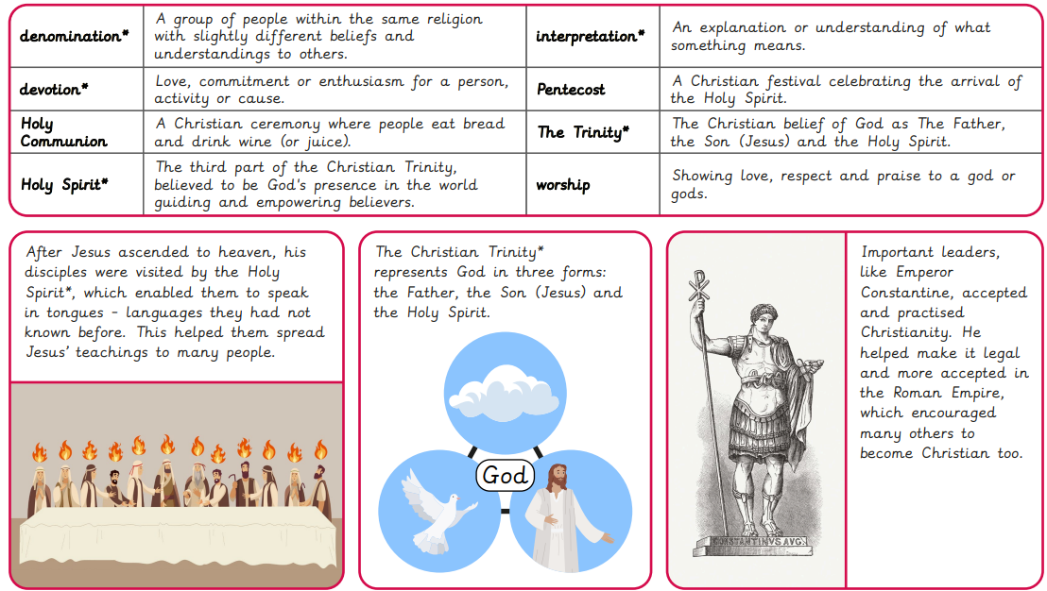
Rotherhithe Primary- Year 5
Why doesn't Christianity always look the same?
What I should already know
What came before written scripture? How has Biblical Hebrew evolved? Is all Arabic the same? Should prayers be said in their ‘original’ languages? How important are translations of religious scripture? Why does some religious scripture contain artwork?
What will learn in this unit?
To investigate how a religion can begin by exploring the story of Pentecost and the start of the Christian church. To explore the impact of historical figures on the development of Christian beliefs and practices. To find out how Christianity has changed over time by learning about how different groups (denominations) have formed. To explain how different interpretations of the Bible lead to different Christian beliefs about the Holy Spirit. To compare how Christians show their beliefs by looking at how different denominations practise. To investigate how religions can change by exploring how Christianity continues to develop in the world today.
What I will learn next
What does freedom look like? How have beliefs been challenged in the past? How can light represent standing up for what you believe in? What can inspire people to stand up for their beliefs? Should we celebrate Bonfire Night? How can we stand up for what we believe in?
Notes:
Autumn 1

Slide 2
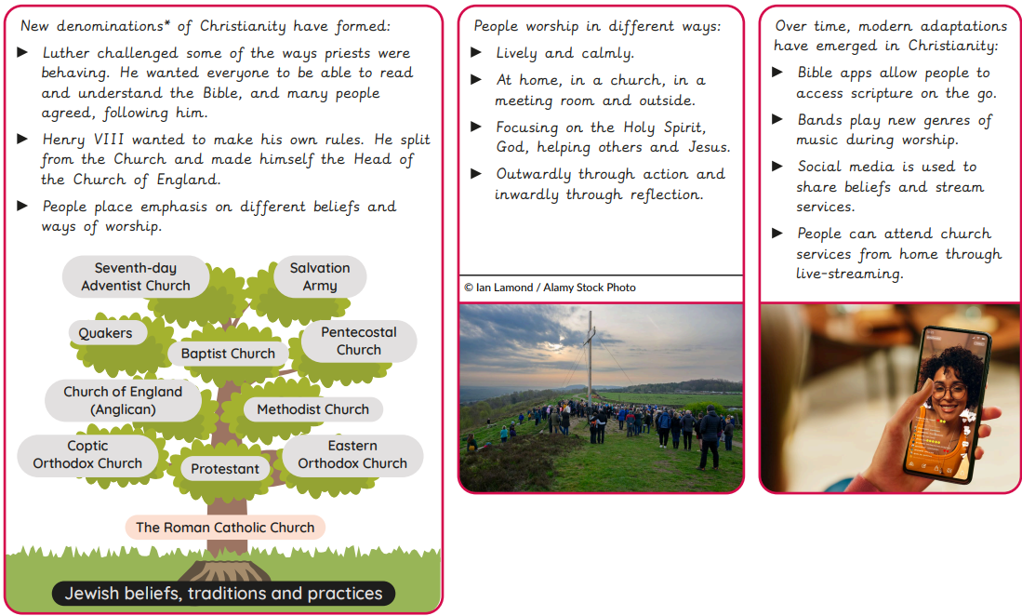
Notes:
Autumn 1 (page 2)

Slide 3
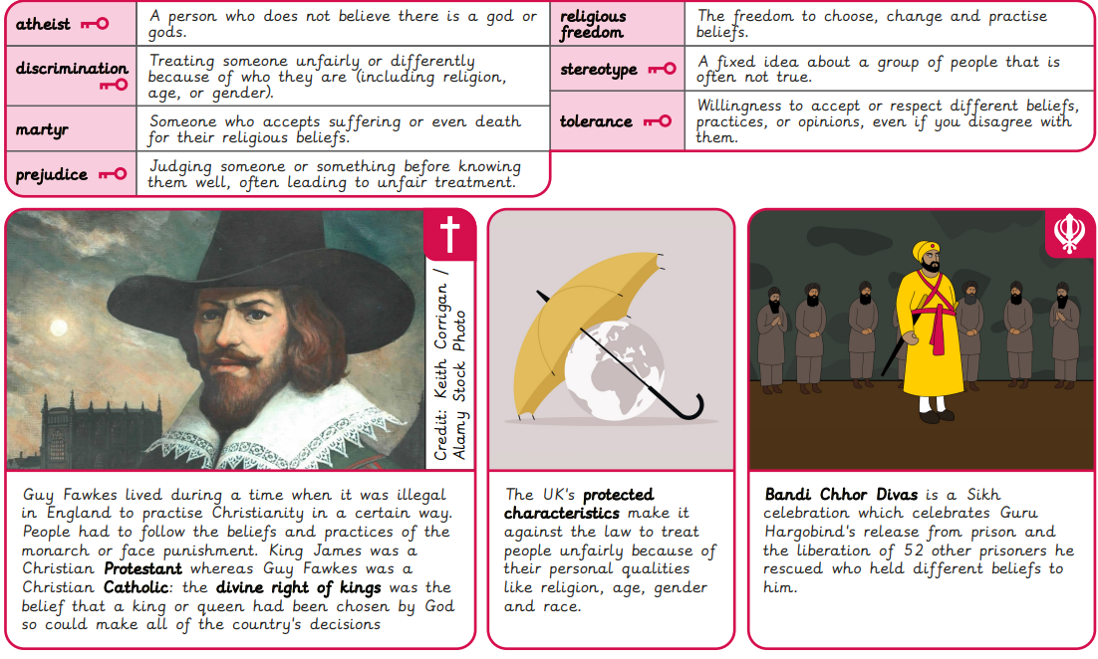
Rotherhithe Primary- Year 5
Why do people have to stand up for what they believe in?
What I should already know
How did Christianity begin? How have some significant people influenced Christian practices? Why are there different denominations? How is the Bible interpreted differently? How do different denominations practise? How is Christianity changing?
What will learn in this unit?
To recognise the importance of religious freedom by interpreting news reports. To consider the challenges some religious figures faced by looking at Jewish, Christian and Sikh stories. To explain why Bandi Chhor Divas is celebrated by many Sikhs. To consider how the meaning of festivals can differ by exploring the origin of Bonfire Night. To explore why people stand up for their beliefs using a variety of modern-day scenarios. To explain how and why people stand up for what they believe in.
What I will learn next
Why do some people believe in a soul? How do some people make up for bad deeds? If there’s a heaven, what might it be like? What is the purpose of a funeral? How do people seek forgiveness in their lives? How do some people remember those that have died?
Notes:
Autumn 2

Slide 4
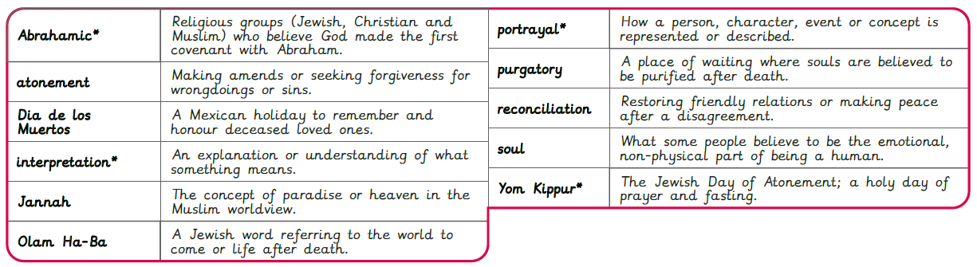
Rotherhithe Primary- Year 5
What happens when we die? (Part 1)
What I should already know
What does freedom look like? How have beliefs been challenged in the past? How can light represent standing up for what you believe in? What can inspire people to stand up for their beliefs? Should we celebrate Bonfire Night? How can we stand up for what we believe in?
What will learn in this unit?
To recognise the significance of the soul in people’s beliefs about the afterlife and its role in Abrahamic worldviews. To explore some Jewish beliefs about death through the concept of purgatory. To explore Muslim beliefs about the afterlife by investigating sources. To explain what funerals can mean in different worldviews. To explore the role of forgiveness for some people in different worldviews. To recognise the significance of Dia de los Muertos for some Catholic people.
What I will learn next
If there is a soul, where does it go? What is samsara? How might someone reach moksha? How can people find comfort after death? What is nirvana? What does enlightenment look like?
Notes:
Spring 1

Slide 5
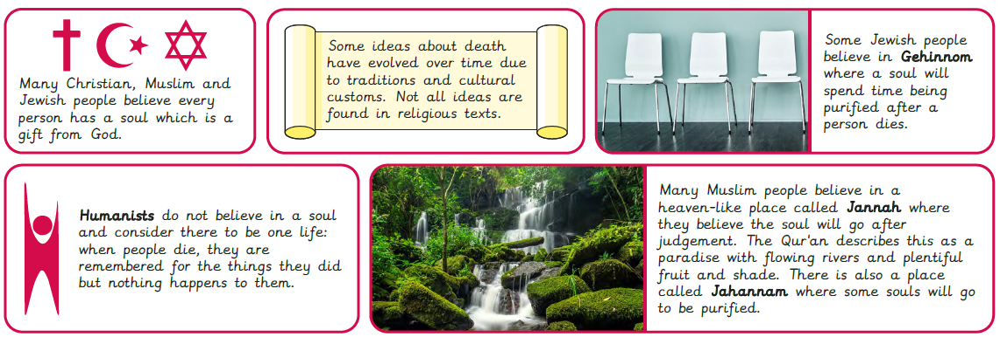
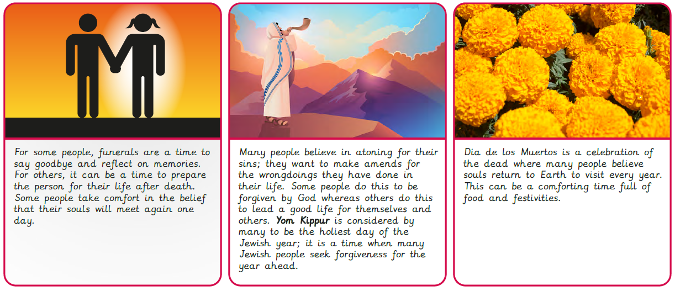
Notes:
Spring 1 (page 2)

Slide 6
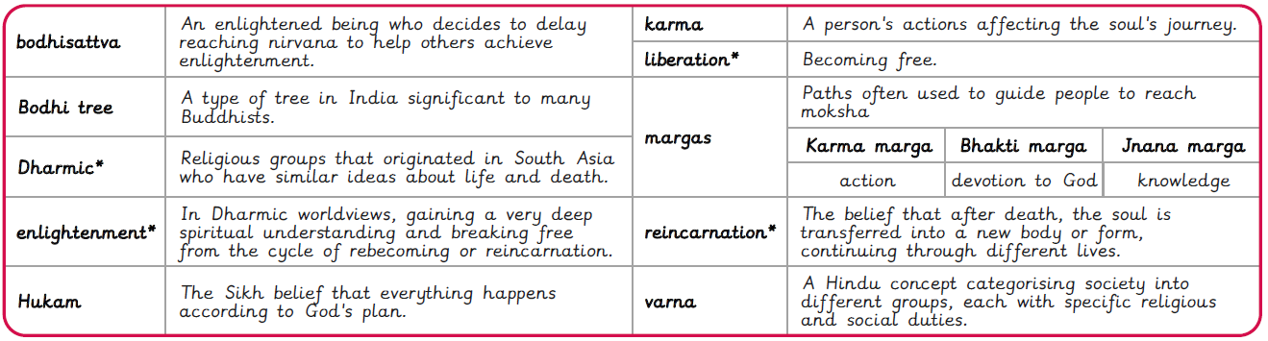
Rotherhithe Primary- Year 5
What happens when we die? (Part 2)
What I should already know
Why do some people believe in a soul? How do some people make up for bad deeds? If there’s a heaven, what might it be like? What is the purpose of a funeral? How do people seek forgiveness in their lives? How do some people remember those that have died?
What will learn in this unit?
To explain some Dharmic beliefs about the soul. To recognise beliefs about samsara and reincarnation in some Dharmic religions. To recognise factors that may contribute to someone breaking the cycle of reincarnation and samsara by exploring varnas. To describe how certain practices and traditions may help a Sikh person cope with the death of someone. To express ideas about enlightenment based on Buddhist beliefs. To express ideas about enlightenment based on Buddhist beliefs.
What I will learn next
How are laws created? How is a leader chosen? Where do religious laws come from? How did Guru Nanak choose a successor? When can someone become a leader? How can religious texts be leaders?
Notes:
Spring 2

Slide 7
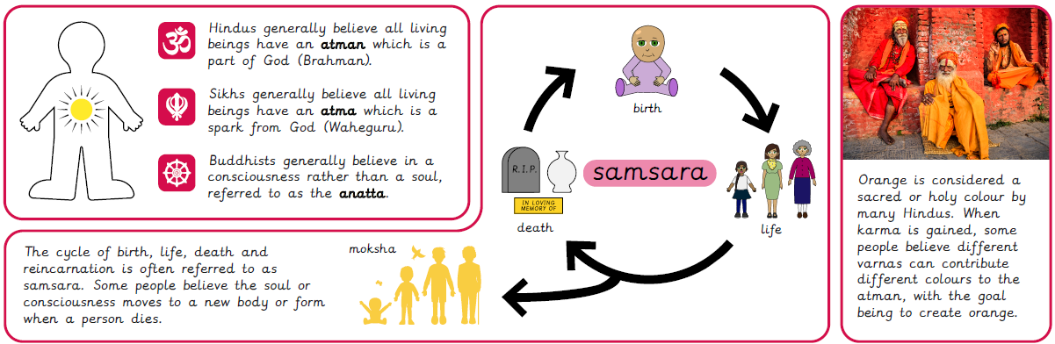
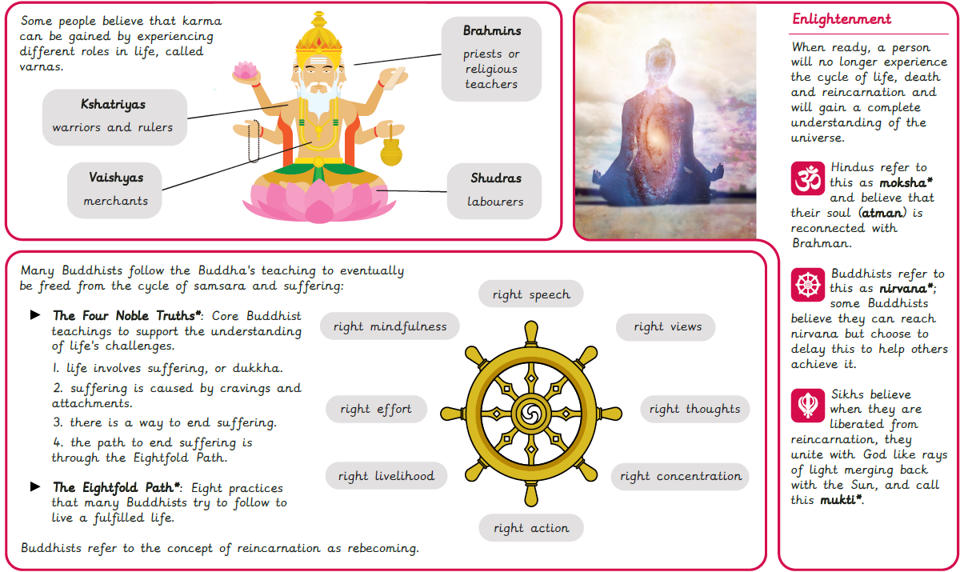
Notes:
Spring 2 (page 2)

Slide 8
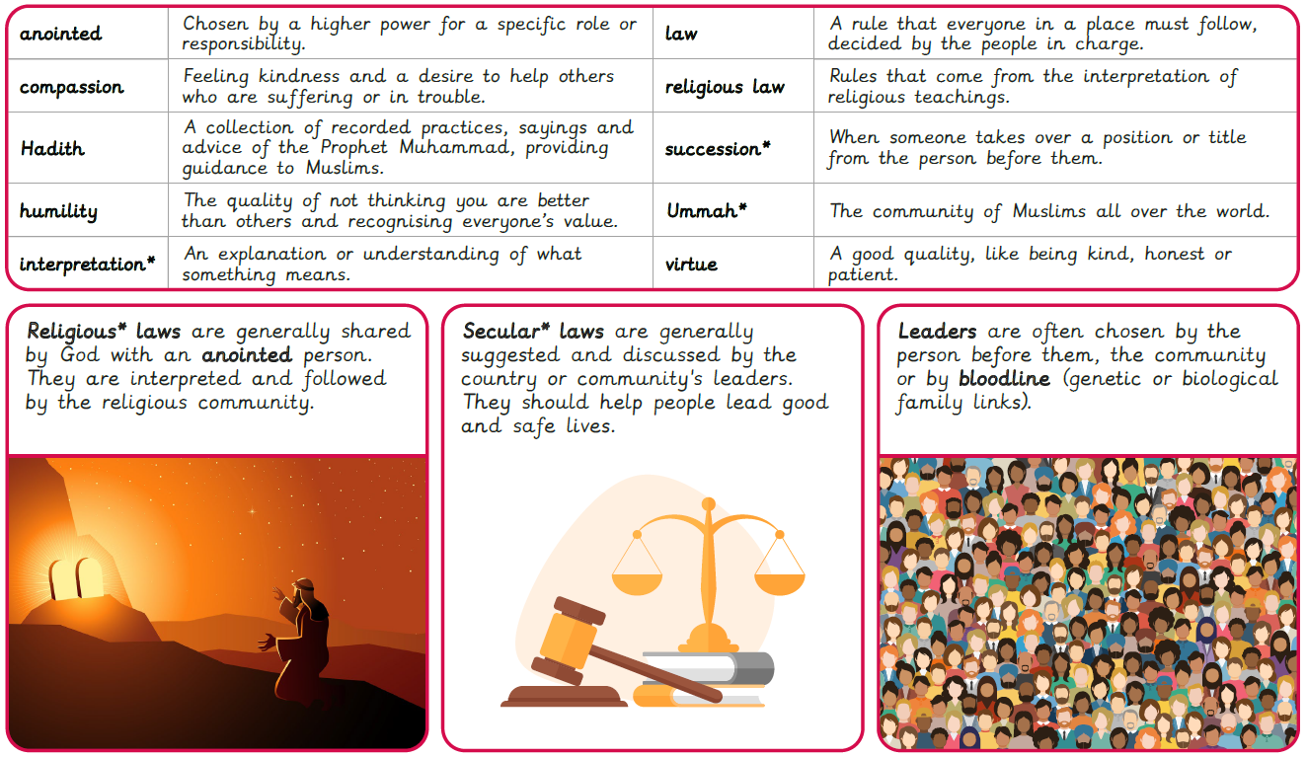
Rotherhithe Primary- Year 5
Who should get to be in charge?
What I should already know
If there is a soul, where does it go? What is samsara? How might someone reach moksha? How can people find comfort after death? What is nirvana? What does enlightenment look like?
What will learn in this unit?
To explore the creation of laws and teachings within communities. To recognise why there are different ideas about succession in the Muslim worldview. To explore how some religious laws are created in the Muslim worldview. To understand how Sikh Gurus were selected and the qualities valued in Sikh teachings. To explore leadership qualities through monarchs and religious leaders. To explain how the Guru Granth Sahib can be a guiding, living leader in the Sikh worldview.
What I will learn next
What can make a place significant? How can religious events make a place significant? What makes the Harmandir Sahib significant to many Sikhs? How can a river be a goddess? Can relics make a place significant? Who can visit significant places?
Notes:
Summer 1

Slide 9

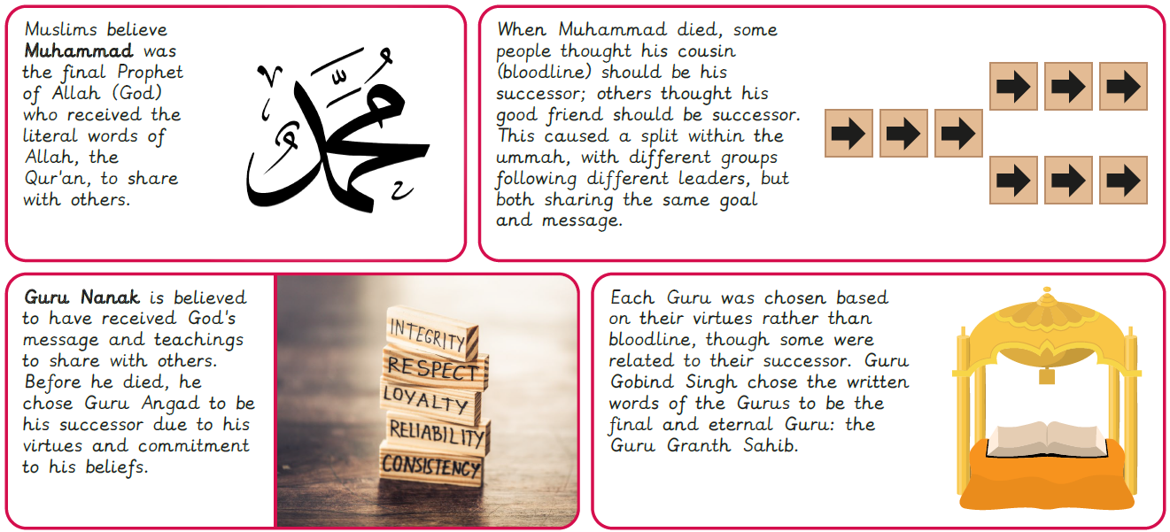
Notes:
Summer 2

Slide 10
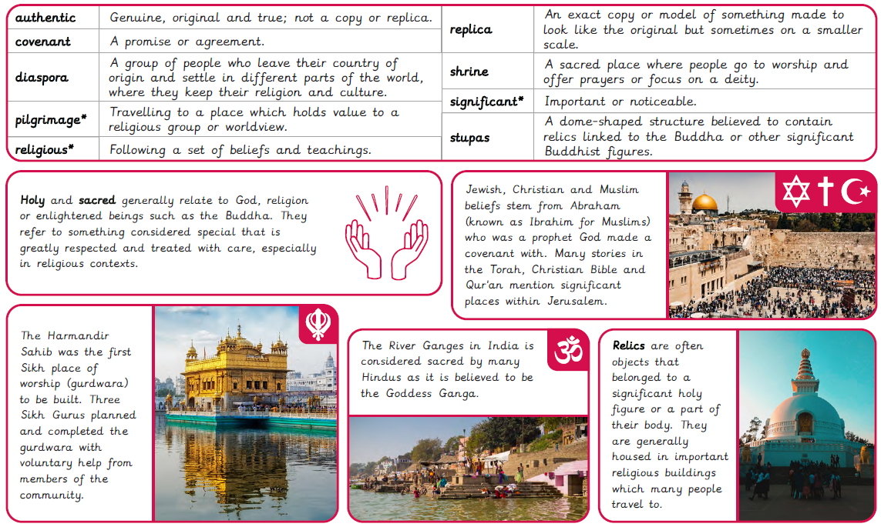
Rotherhithe Primary- Year 5
Why are some places in the world significant to believers?
What I should already know
How are laws created? How is a leader chosen? Where do religious laws come from? How did Guru Nanak choose a successor? When can someone become a leader? How can religious texts be leaders?
What will learn in this unit?
To consider whether height can make a place significant by exploring mountains. To identify the importance of Jerusalem to some Jewish, Christian and Muslim people. To identify examples of the Sikh Gurus’ teachings by exploring the Harmandir Sahib. To investigate the significance of the River Ganges for religious and non-religious people. To find out about beliefs by investigating relics. To evaluate who should have access to significant places.
What I will learn next
How do some religions believe in the same God?​ How might a Jewish person observe Shabbat?​ Why is Friday night dinner different?​ What can a head covering tell us about identity?​ Why might someone want to cover their hair?
Notes:
Summer 2

