Slide 1

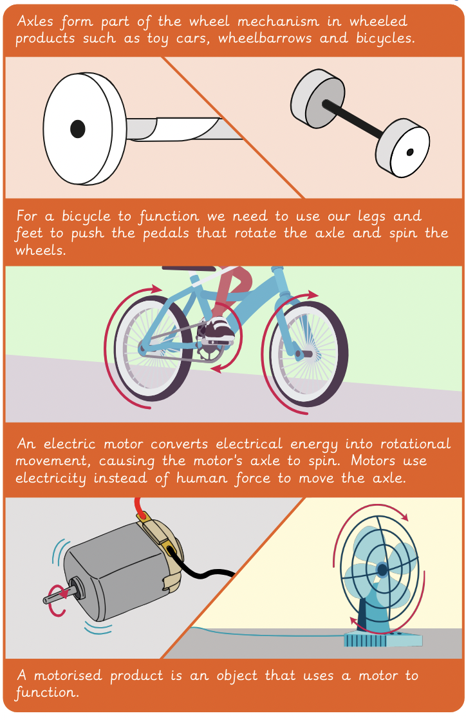
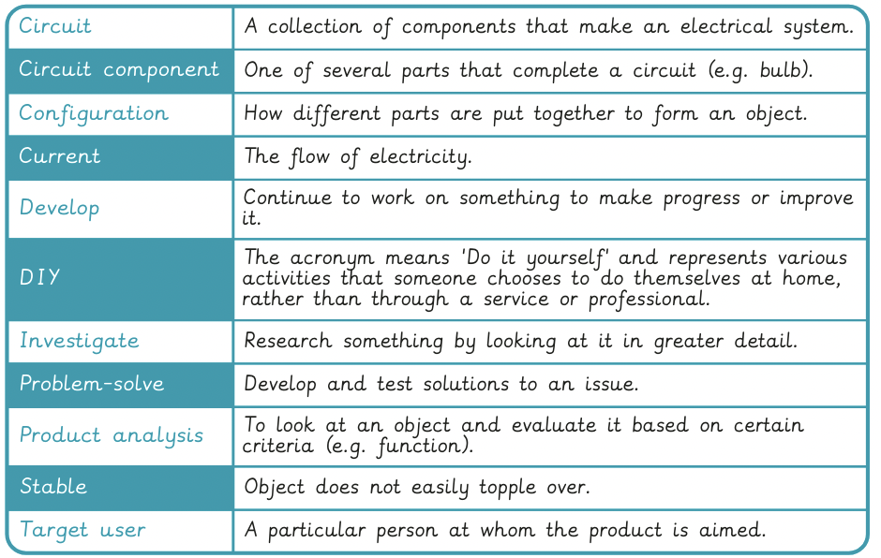
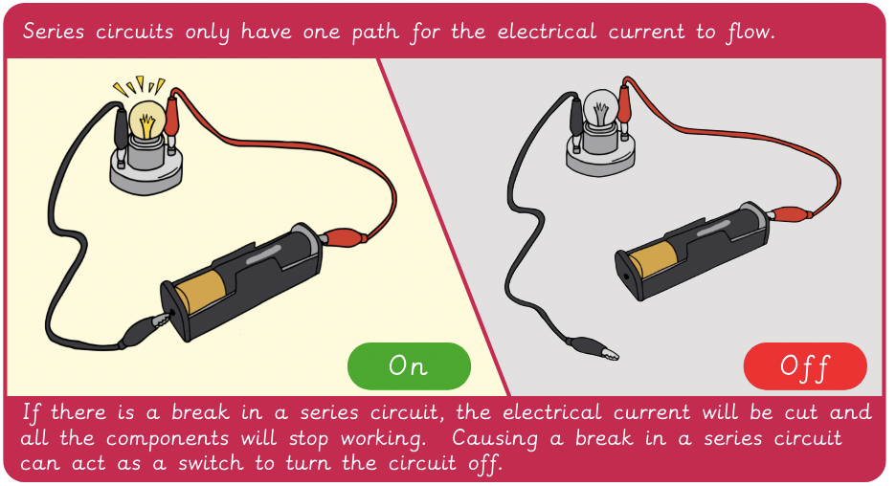
Vocabulary
Year 6 Electrical Systems – Doodlers
Key Facts
Check it out!

Slide 2
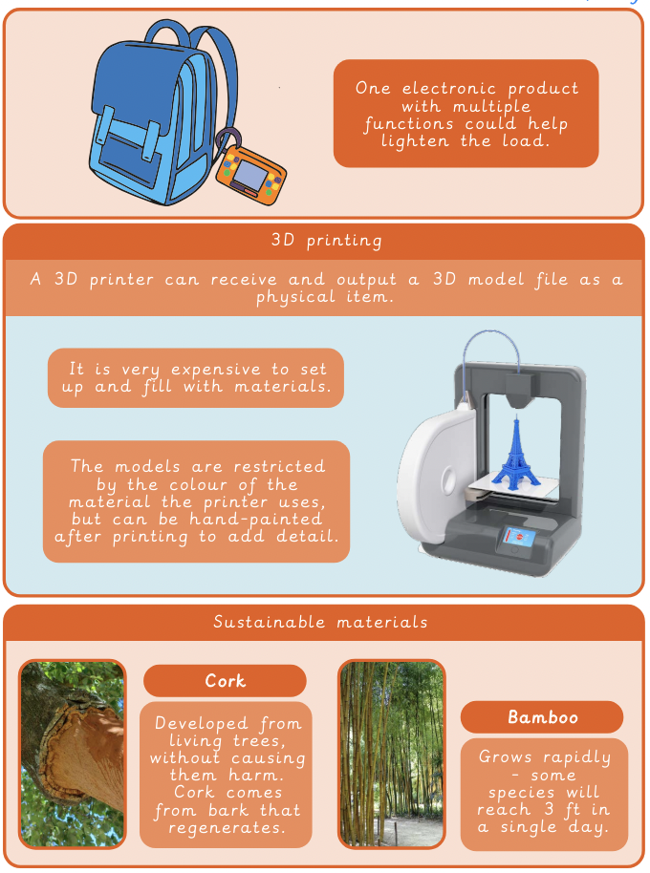
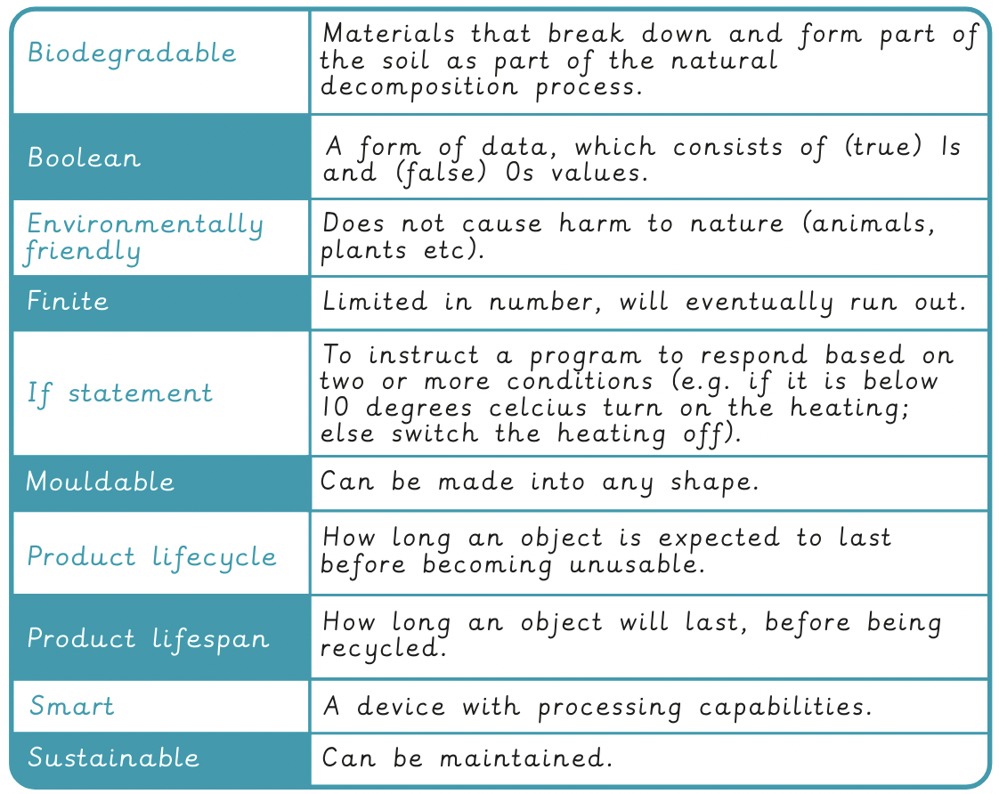
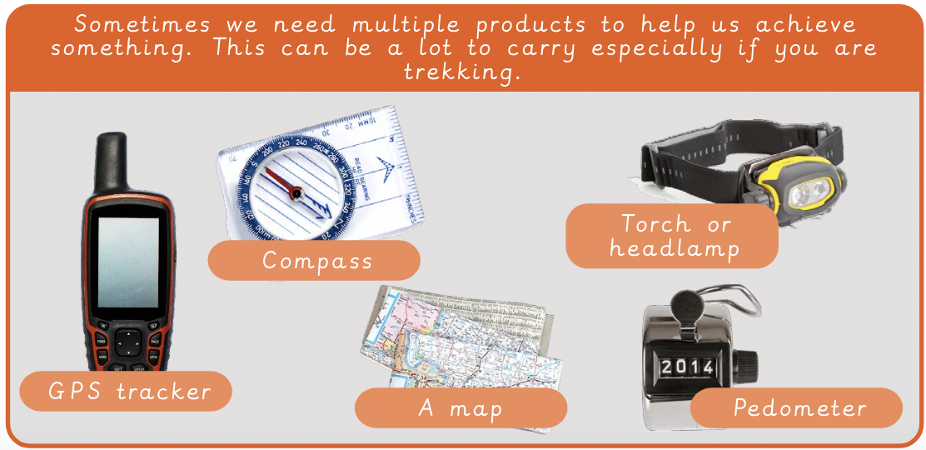
Vocabulary
Year 6 Digital World– Navigating the world
Key Facts

Slide 3

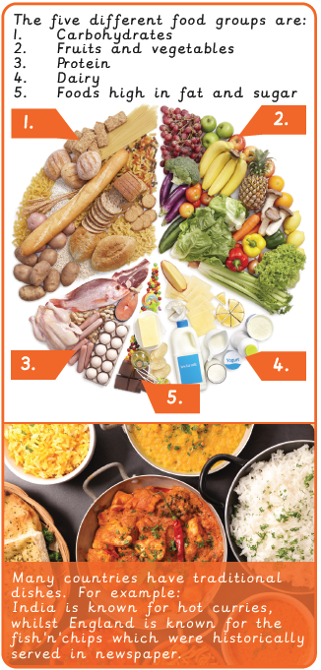
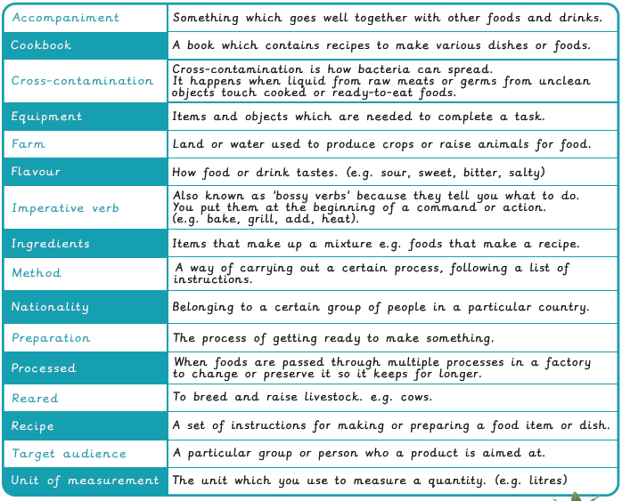


Vocabulary
Year 6 Food – Come dine with me
Key Facts
Did you know?

