Slide 1

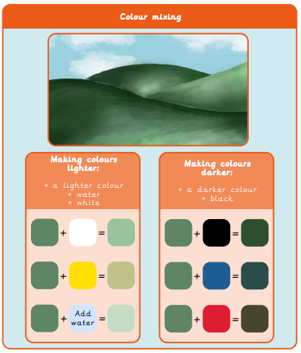
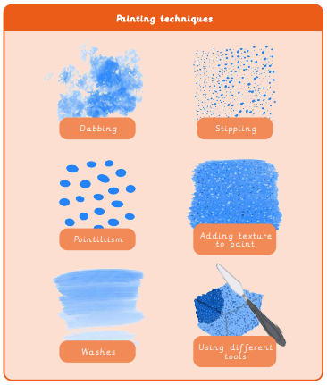
Year 4 Painting and Mixed Media – Light and Dark
What I already know:
I can mix a variety of shades of a secondary colour.
I can make choices about amounts of paint to use when mixing a particular colour.
I can match colours seen around me.
I can create texture using different painting tools.
I can make textured paper to use in a collage.
I can choose and shape collage materials eg cutting, tearing.
I can compose a collage, arranging and overlapping pieces for contrast and effect.
I can add painted detail to a collage to enhance/improve it.
What I will learn now:
I can mix a tint and a shade by adding
black or white.
I can use tints and shades of a colour to create a 3D effect when painting.
I can apply paint using different techniques eg. stippling, dabbing, washing.
I can choose suitable painting tools.
I can arrange objects to create a still life composition.
I can plan a painting by drawing first.
I can organise painting equipment independently, making choices about tools and materials.
What I will learn next:
I can use sketchbooks to research and present information.
I can develop ideas into a plan for a final piece.
I can make a personal response to the artwork of another artist.
I can use different methods to analyse artwork such as drama, discussion and questioning.

Slide 2
Dabbing
Stippling
Pointillism
Adding texture

Slide 3
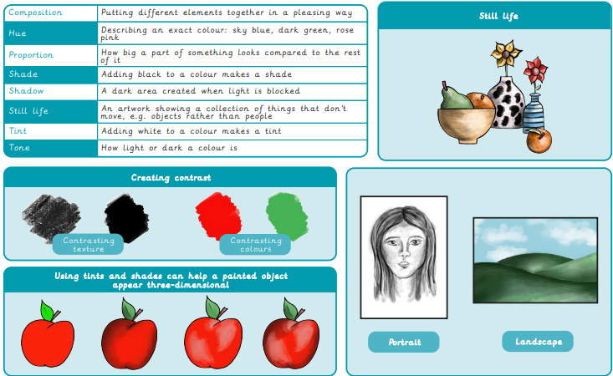
Vocabulary

Slide 4
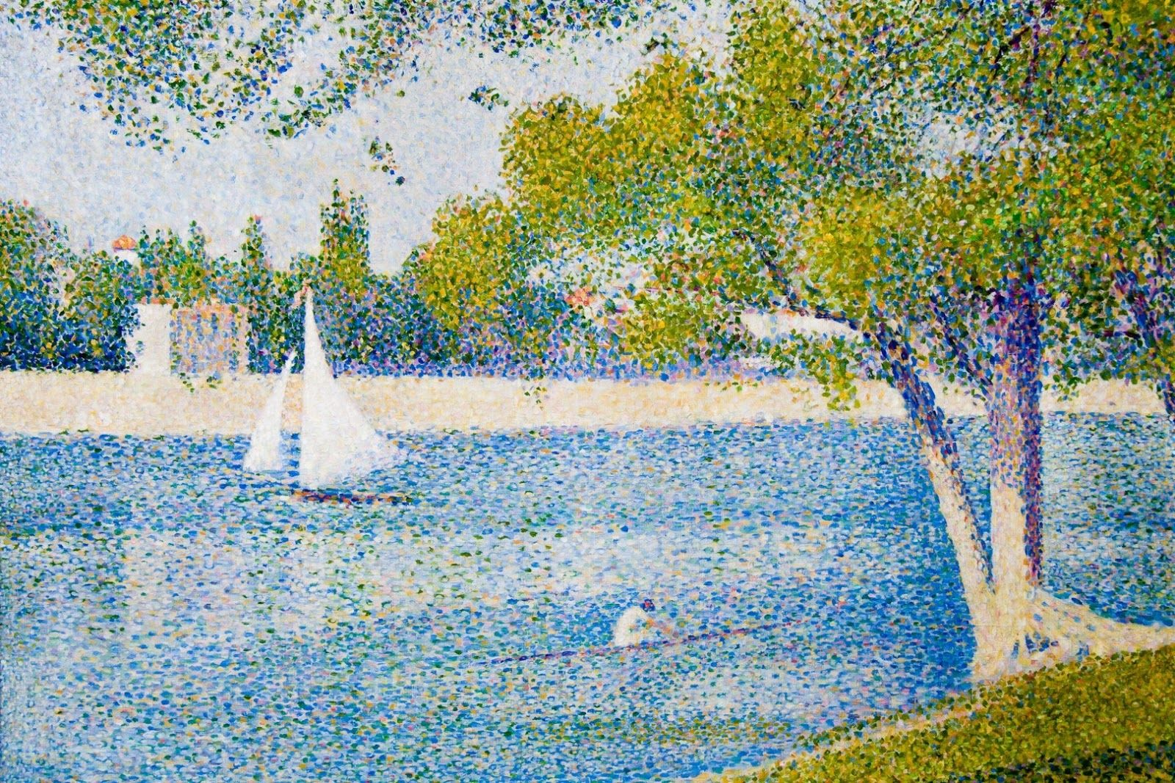
Georges Pierre Seurat - a French post-Impressionist artist

Slide 5
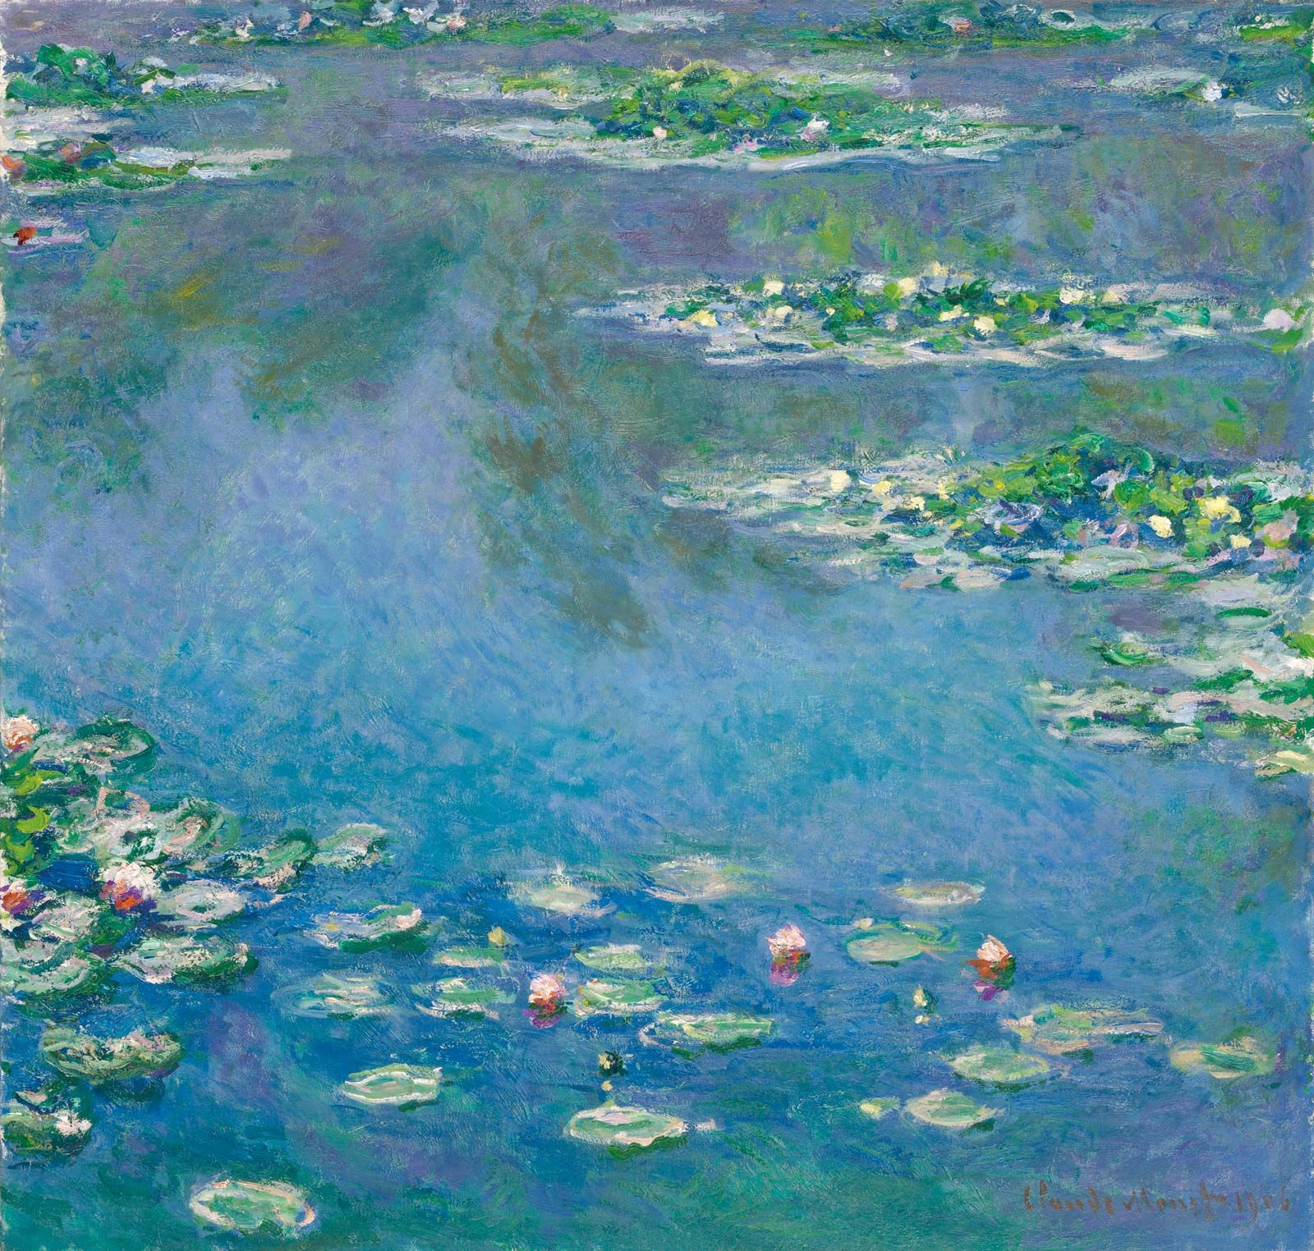
Claude Monet- a French Impressionist artist

Slide 6
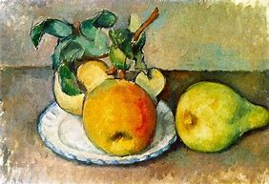
Paul Cézanne - a French Post-Impressionist painter

Slide 7
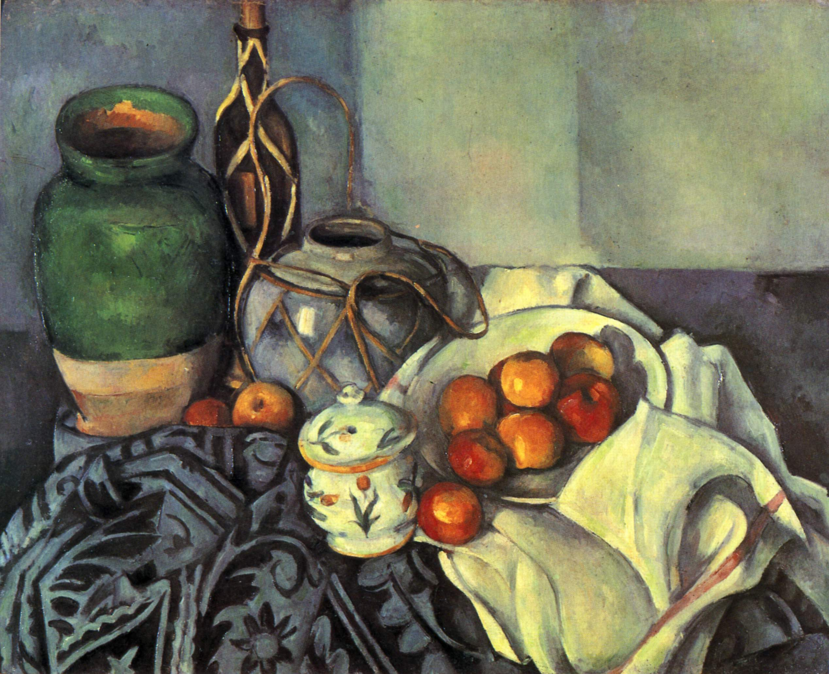
Paul Cézanne - a French Post-Impressionist painter

