Slide 1

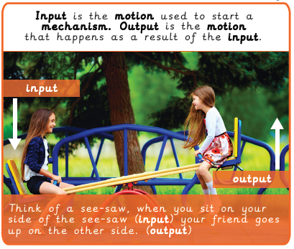
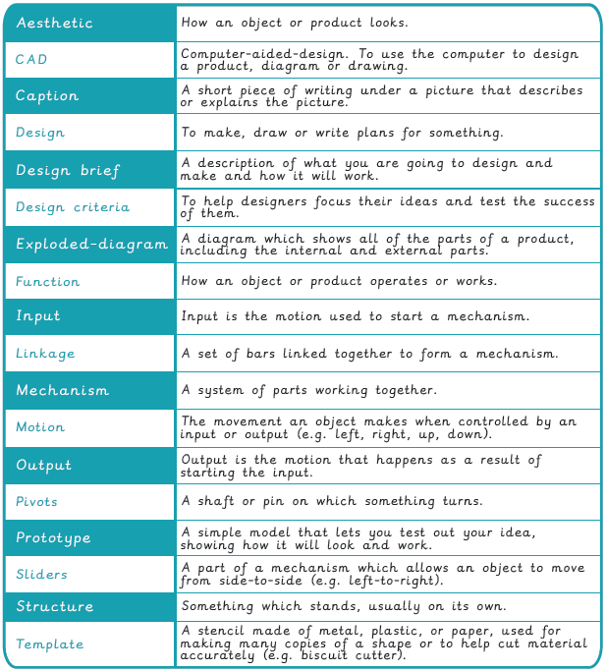

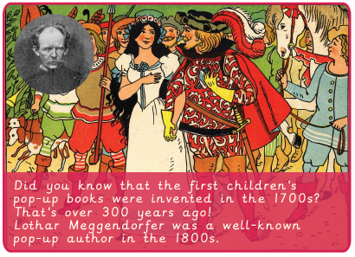
Vocabulary
Year 4 Mechanical Systems - Pop-up book
Key Facts

Slide 2
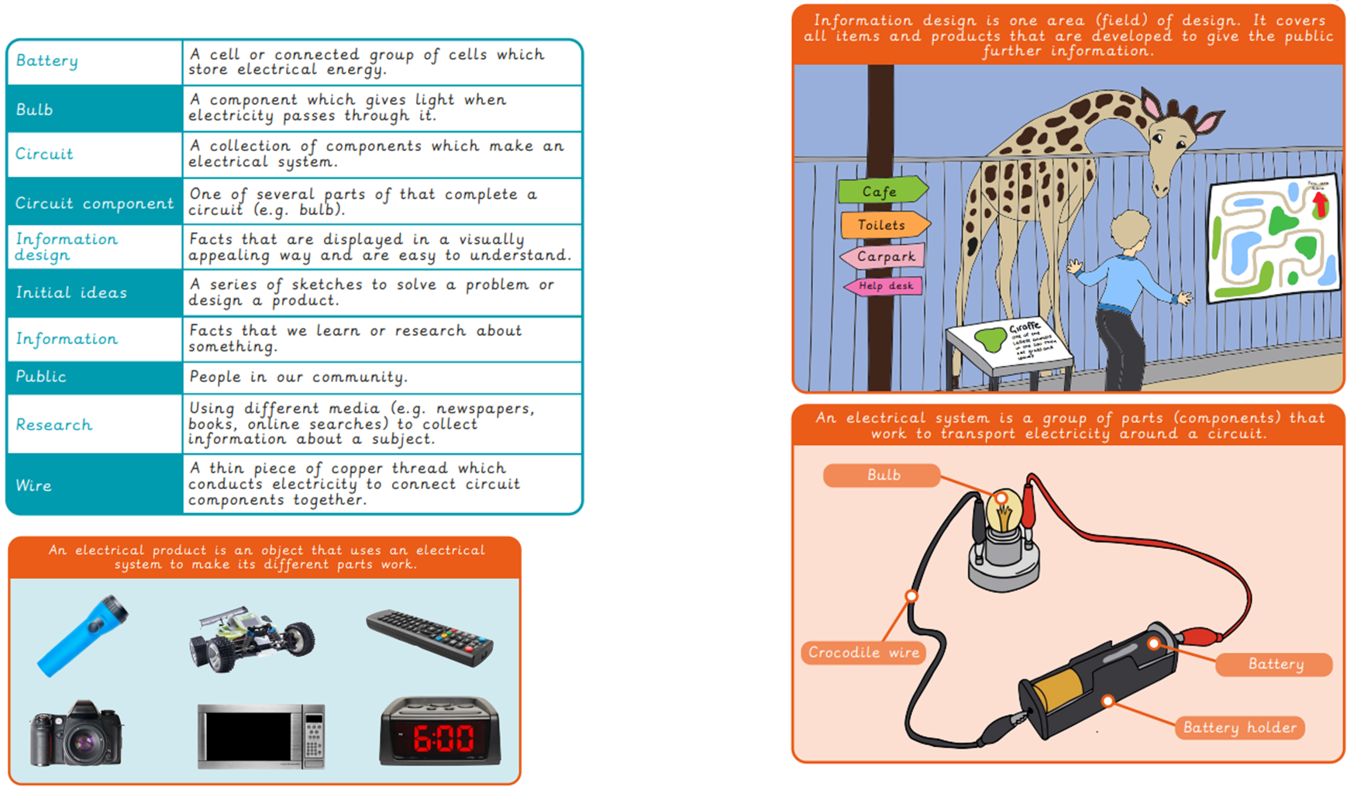
Vocabulary
Year 4 Electrical Systems – Torches
Key Facts

Slide 3
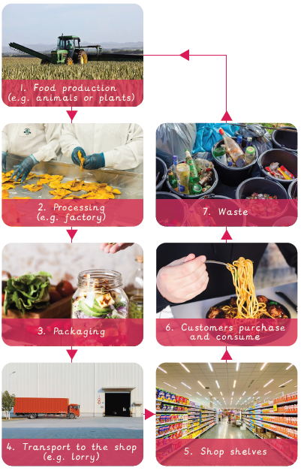
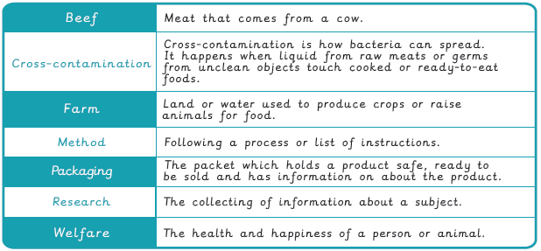
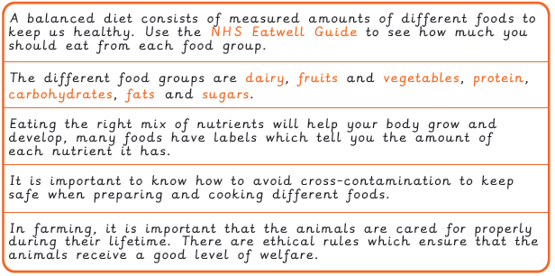
Vocabulary
Year 4 Food – What could be healthier?
The Farm to Fork Process
Key Facts

