Slide 1

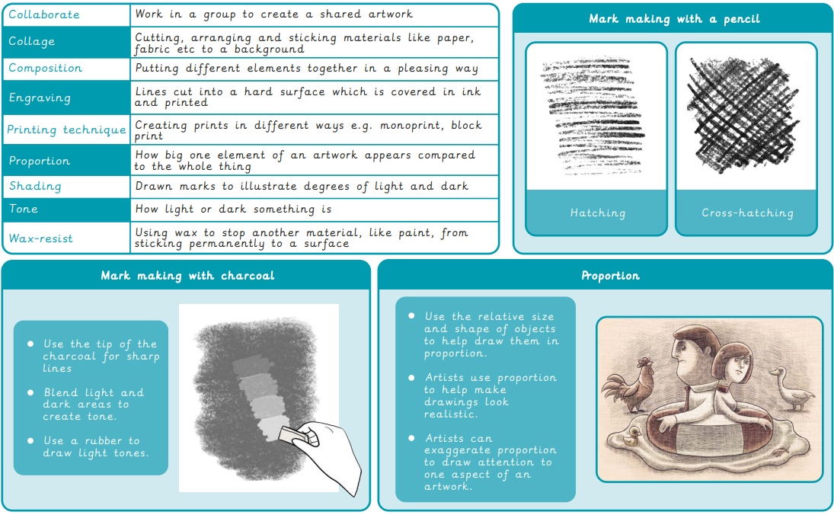
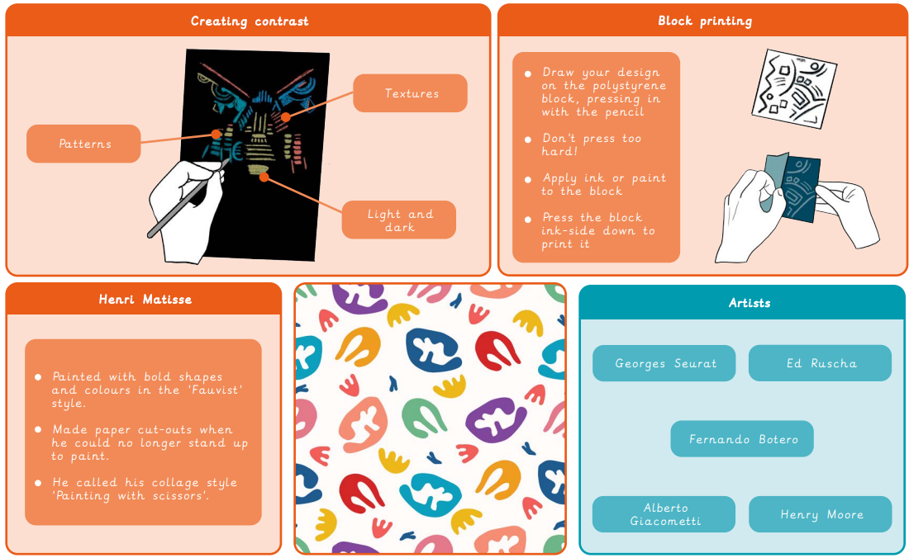
Year 4 Drawing – Power prints
What I already know:
Use shapes identified within objects as a method to draw.
Create tone by shading.
Make texture rubbings.
Create art from textured paper.
Hold and use a pencil to shade.
Tear and shape paper.
Use paper shapes to create a drawing.
Make careful observations to accurately draw an object.
Create abstract compositions to draw more expressively.
What I will learn now:
Use pencils of different grades to shade and add tone.
Hold a pencil with varying pressure to create different marks.
Use observation and sketch objects quickly.
Draw objects in proportion to each other.
Use charcoal and a rubber to draw tone.
Use scissors and paper as a method to ‘draw’.
Make choices about arranging cut elements to create a composition. Create a wax resist background.
Use different tools to scratch into a painted surface to add contrast and pattern.
Choose a section of a drawing to recreate as a print.
Create a monoprint.
What I will learn next:
Analyse an image that considers impact, audience and purpose.
Draw the same image in different ways with different materials and techniques.
Make a collagraph plate.
Make a collagraph print.
Develop drawn ideas for a print.
Combine techniques to create a final composition.
Decide what materials and tools to use based on experience and knowledge.

