Slide 1

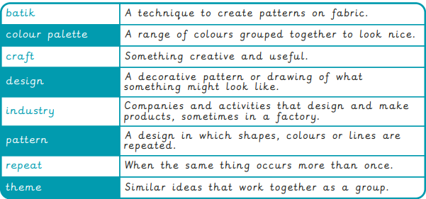
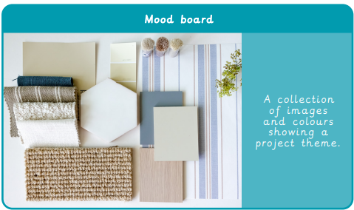
Year 4 Craft and Design: Fabric of Nature
What I will learn now:
I can escribe objects, images and sounds with relevant subject vocabulary.
I can create drawings that replicate a selected image.
I can select imagery and colours to create a mood board with a defined theme and colour palette.
I understand the work of William Morris, using subject vocabulary to describe his work and style.
I can create a pattern using drawing, taking inspiration from mood boards and initial research to develop it.
I can identify and explain where a pattern repeats.
I can follow instructions to create a repeating pattern, adding extra detail.
I understand different methods of creating printed fabric in creative industries.
I can use sketchbooks to evaluate patterns.
What I already know:
I can recognise and discuss the importance of Ancient Egyptian art.
I can choose a surface for drawing.
I can record colours, patterns and shapes through observational drawing.
I can choose and use tools and materials confidently.
I can create a selection of sketches that show idea exploration.
I can follow instructions with minimal support.
I can discuss and evaluate the process and outcome of my work.
What I will learn next:
I can sketch a house from first-hand or second-hand observation.
I can use basic shapes to place key features and form the composition, measuring to work out proportions.
I notice small details to incorporate into the drawing by observing.
I can select a section of my drawing that creates an interesting composition, with a variety of patterns, lines and texture.
I can follow steps to create a print with clear lines, with some smudging.
I can purposefully evaluate my work, demonstrating what went well and what could be improved.
I can create a building design based on a theme or set purpose.
I can draw a plan view or front elevation of their building, annotating the key features.
I can discuss Hundertwasser’s work and recognise his style.
I can create a factual presentation about Hundertwasser in a visually pleasing way.
I show understanding of what a monument is for by designing a monument that symbolises a person or event.
I can describe my monument and explain my choices.
I can give constructive feedback to others.

Slide 2
