Slide 1
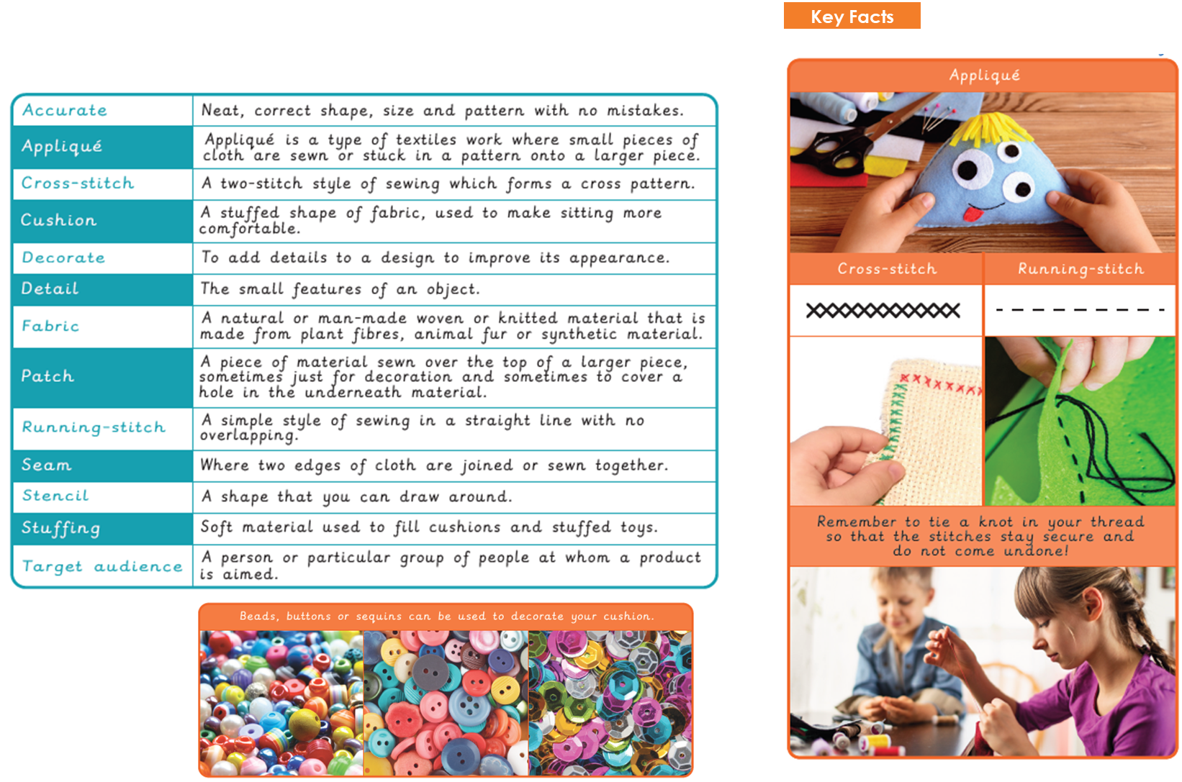

Vocabulary
Year 3 Textiles - Collars

Slide 2
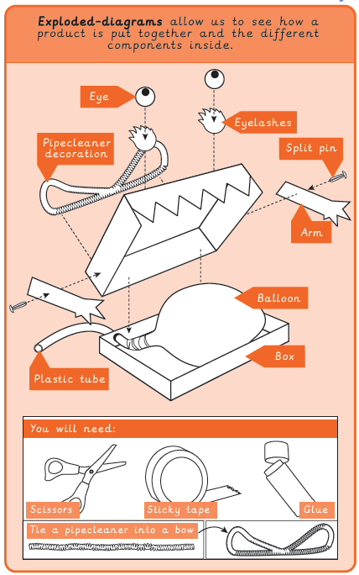
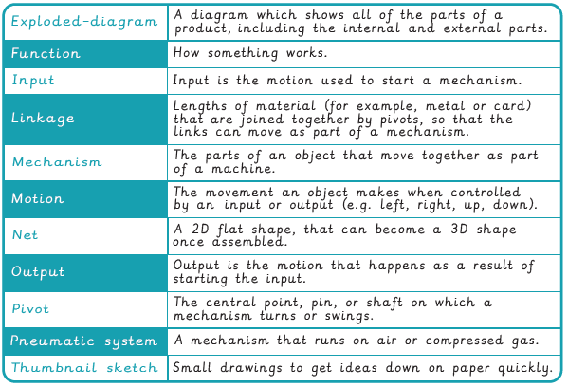
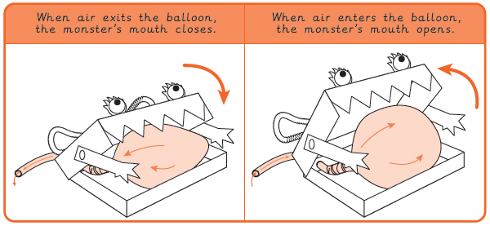
Vocabulary
Year 3 Mechanical Systems - Pneumatic Toys
Key Facts

Slide 3
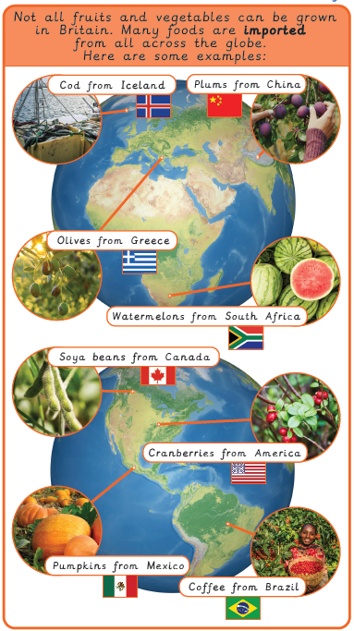
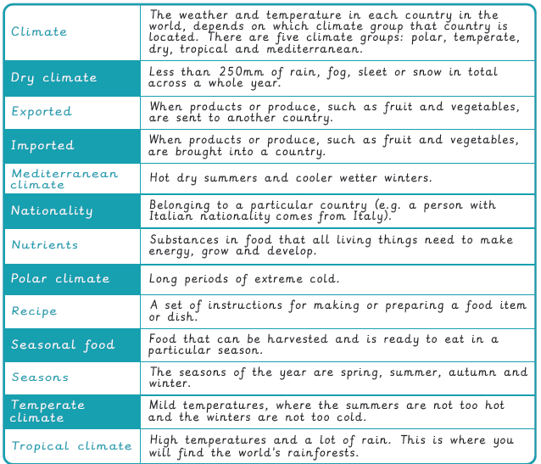
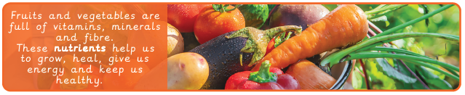
Vocabulary
Year 3 Food – Eating Seasonally
Key Facts

