Slide 1

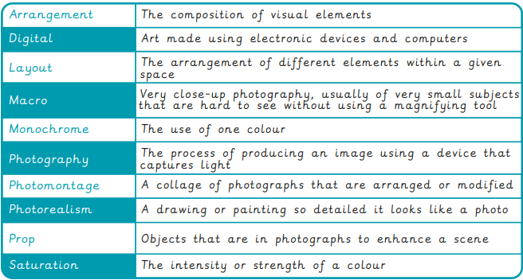
Year 6 Sculpture and 3D: Making memories
What I already know:
I can sketch a house from first-hand or second-hand observation.
I can use basic shapes to place key features and form the composition, measuring to work out proportions.
I notice small details to incorporate into the drawing by observing.
I can select a section of my drawing that creates an interesting composition, with a variety of patterns, lines and texture.
I can follow steps to create a print with clear lines, with some smudging.
I can draw a plan view or front elevation of their building, annotating the key features.
I can discuss Hundertwasser’s work and recognise his style.
I can create a factual presentation about Hundertwasser in a visually pleasing way.
I show understanding of what a monument is for by designing a monument that symbolises a person or event.
I can describe my monument and explain my choices.
I can give constructive feedback to others.
What I will learn now:
I can explain how a new image can be created using a combination of other images.
I understand what photomontage is and recognise how artists use photography.
I can use recording devices and available software with confidence.
I can demonstrate a confident understanding of Edward Weston’s style through my artistic choices.
I can discuss the features of a design, e.g. explaining what is effective about a composition.
I can select a suitable range of props, considering the design brief and their initial ideas.
I can take a portrait that is focused and appropriately framed.
I can draw an accurately measured grid, with some support, understanding how it can support with drawing.
I can use the grid to translate a photograph to a drawn image that is mostly correctly proportioned.
I can create a final painting or drawing with tonal differences that create a photo-realistic effect.
What I will learn next:
Use editing software to change their image, reflecting an artist’s style.
Choose a suitable painting and suggest appropriate ways to recreate it photographically with props.
Set up a composition and think about a space that will provide good lighting levels.
Create a final painting or drawing with tonal differences that create a photo-realistic effect.

Slide 2
