Slide 1

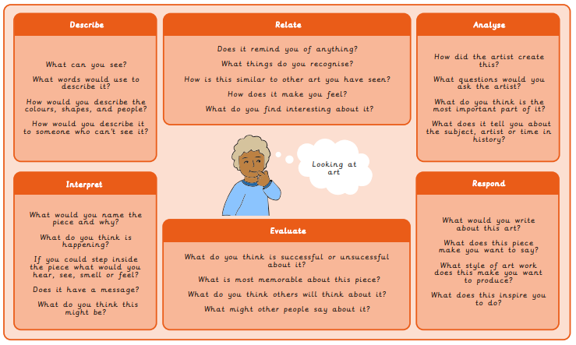
Year 6 Painting and Mixed Media – Colour Splash
What I already know:
I can mix a tint and a shade by adding
black or white.
I can use tints and shades of a colour to create a 3D effect when painting.
I can apply paint using different techniques eg. stippling, dabbing, washing.
I can choose suitable painting tools.
I can arrange objects to create a still life composition.
I can plan a painting by drawing first.
I can organise painting equipment independently, making choices about tools and materials.
What I will learn next:
I can use a range of techniques to record my observations in sketchbooks, journals and other media as a basis for exploring their ideas
I can use a range of techniques and media, including painting
I can increase my proficiency in the handling of different materials
I can analyse and evaluate my own work, and that of others, to strengthen the visual impact or applications of my work
I can discuss the history of art, craft, design and architecture, including periods, styles and major movements from ancient times up to the present day
What I will learn now:
I can use sketchbooks to research and present information.
I can develop ideas into a plan for a final piece.
I can make a personal response to the artwork of another artist.
I can use different methods to analyse artwork such as drama, discussion and questioning.

Slide 2
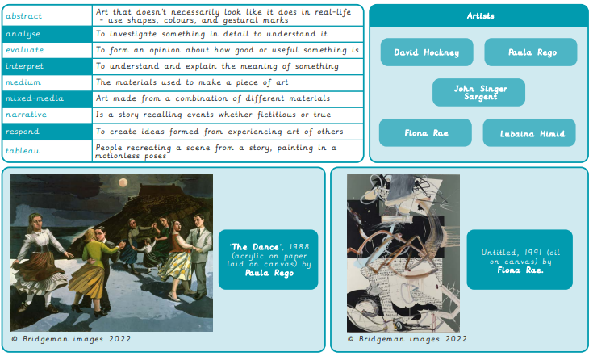
Vocabulary

