Slide 1










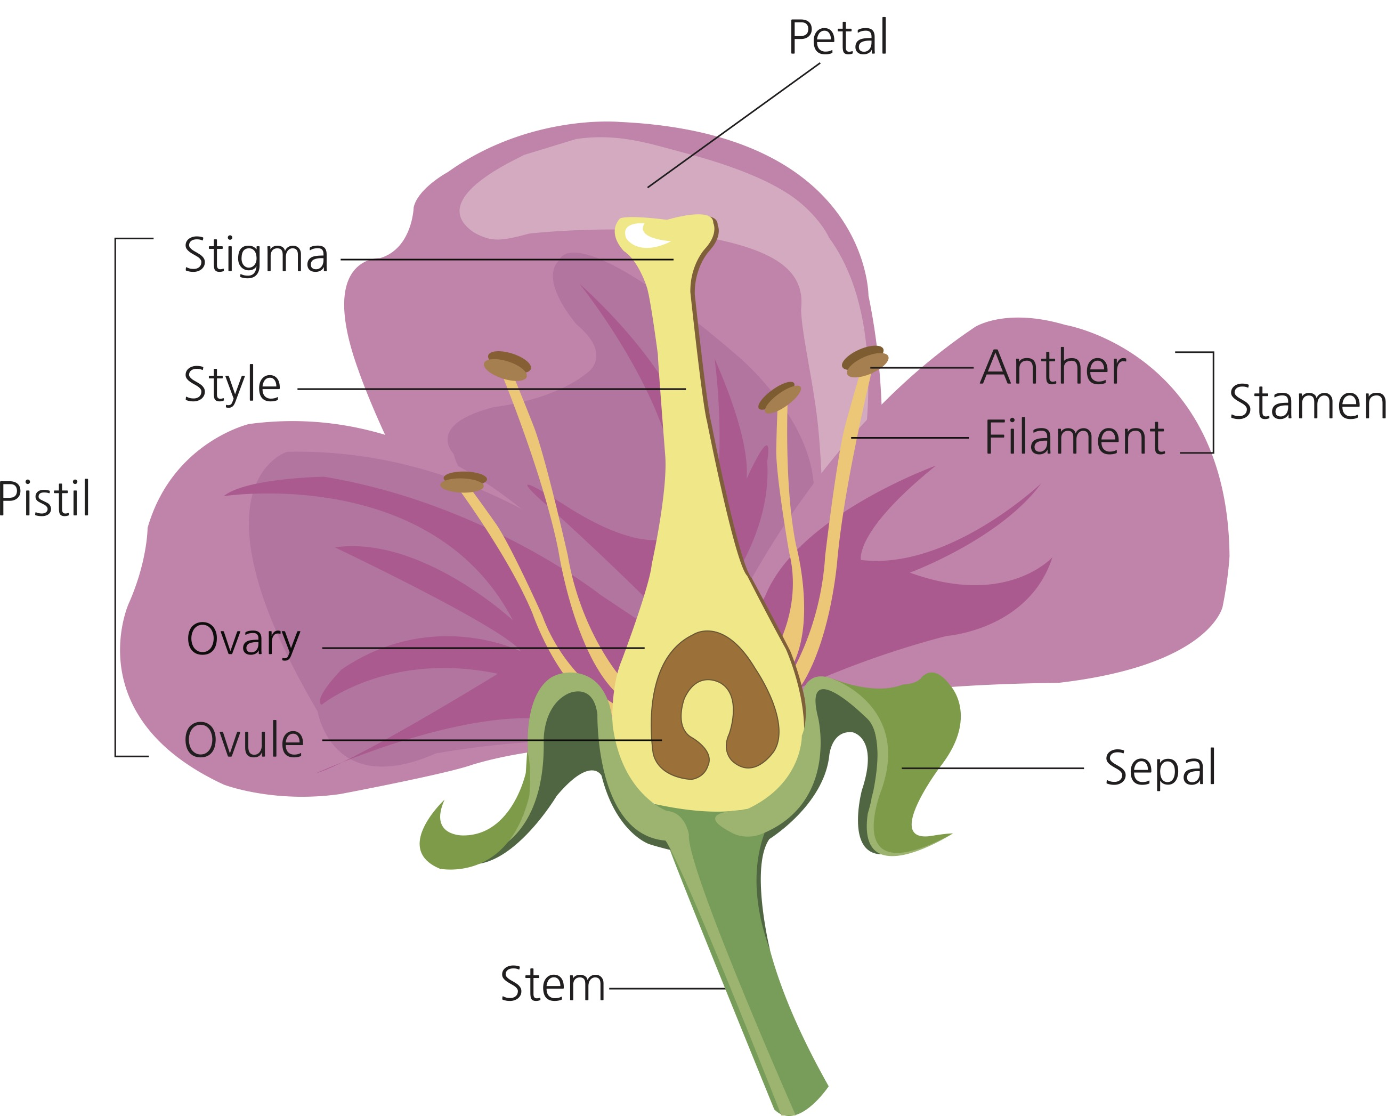
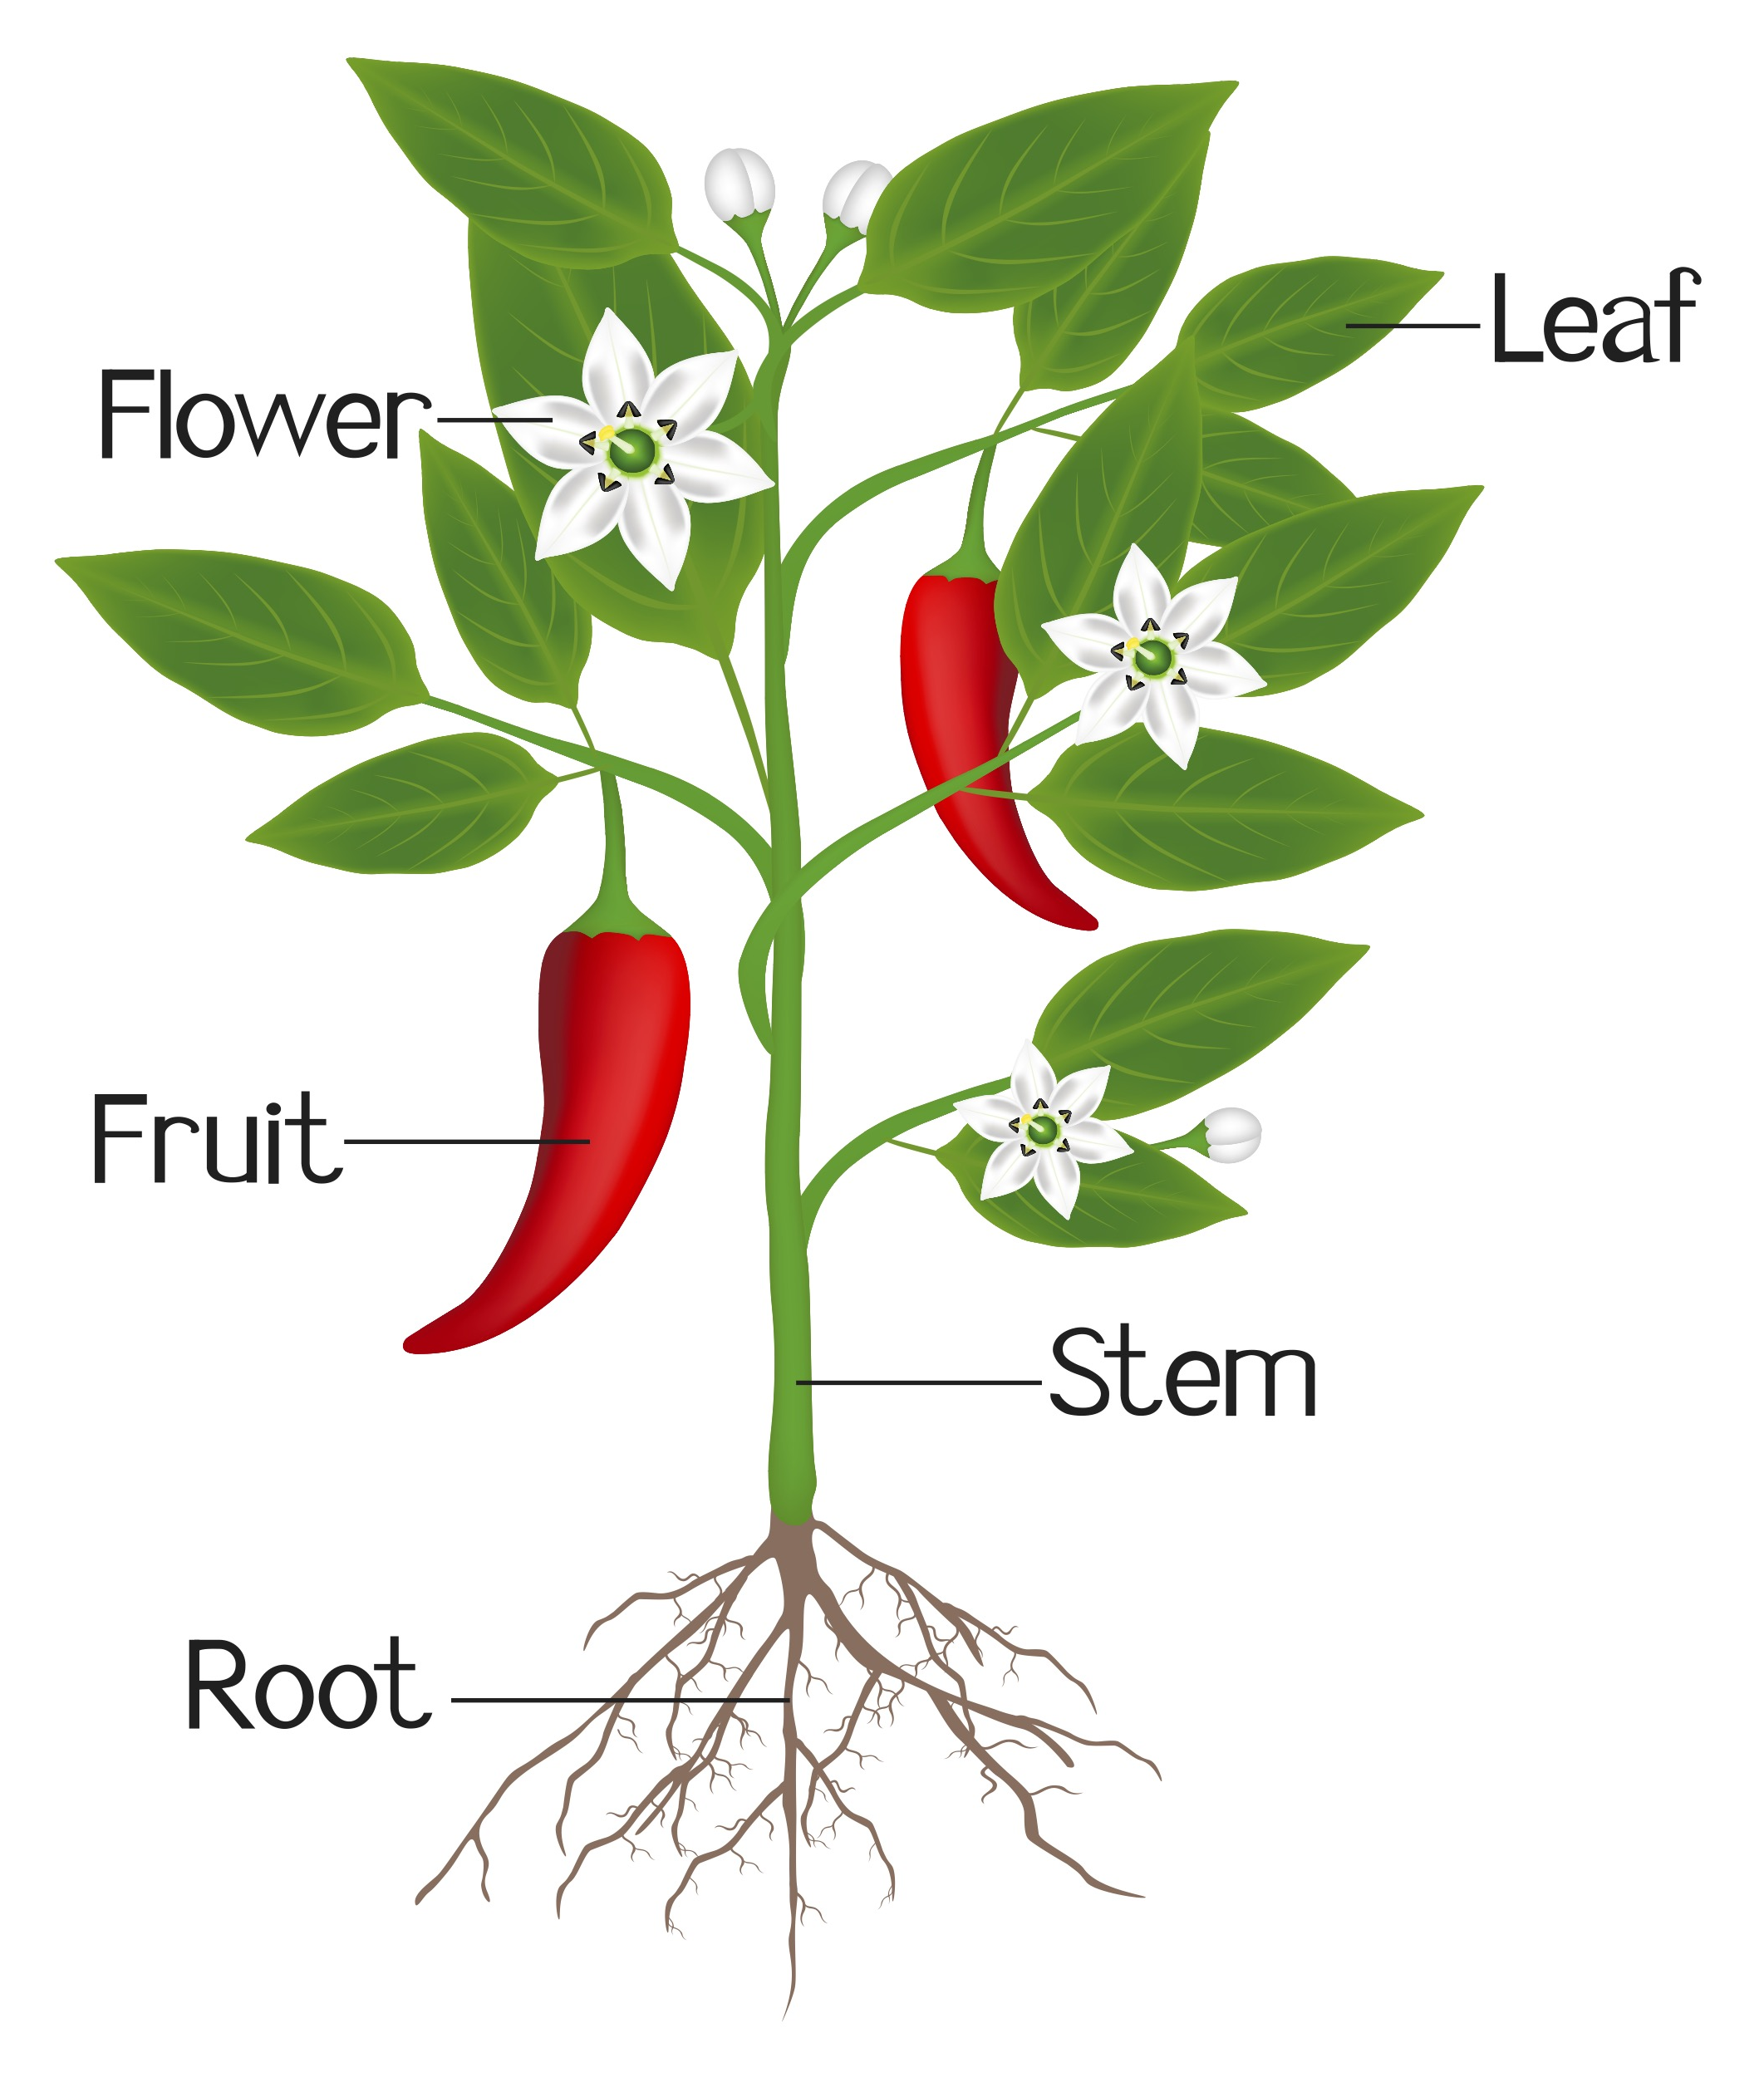
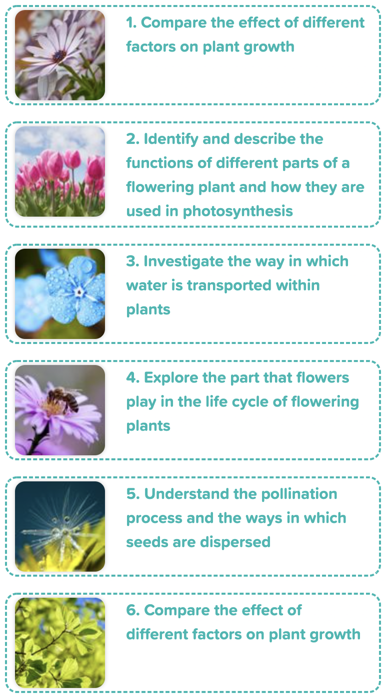
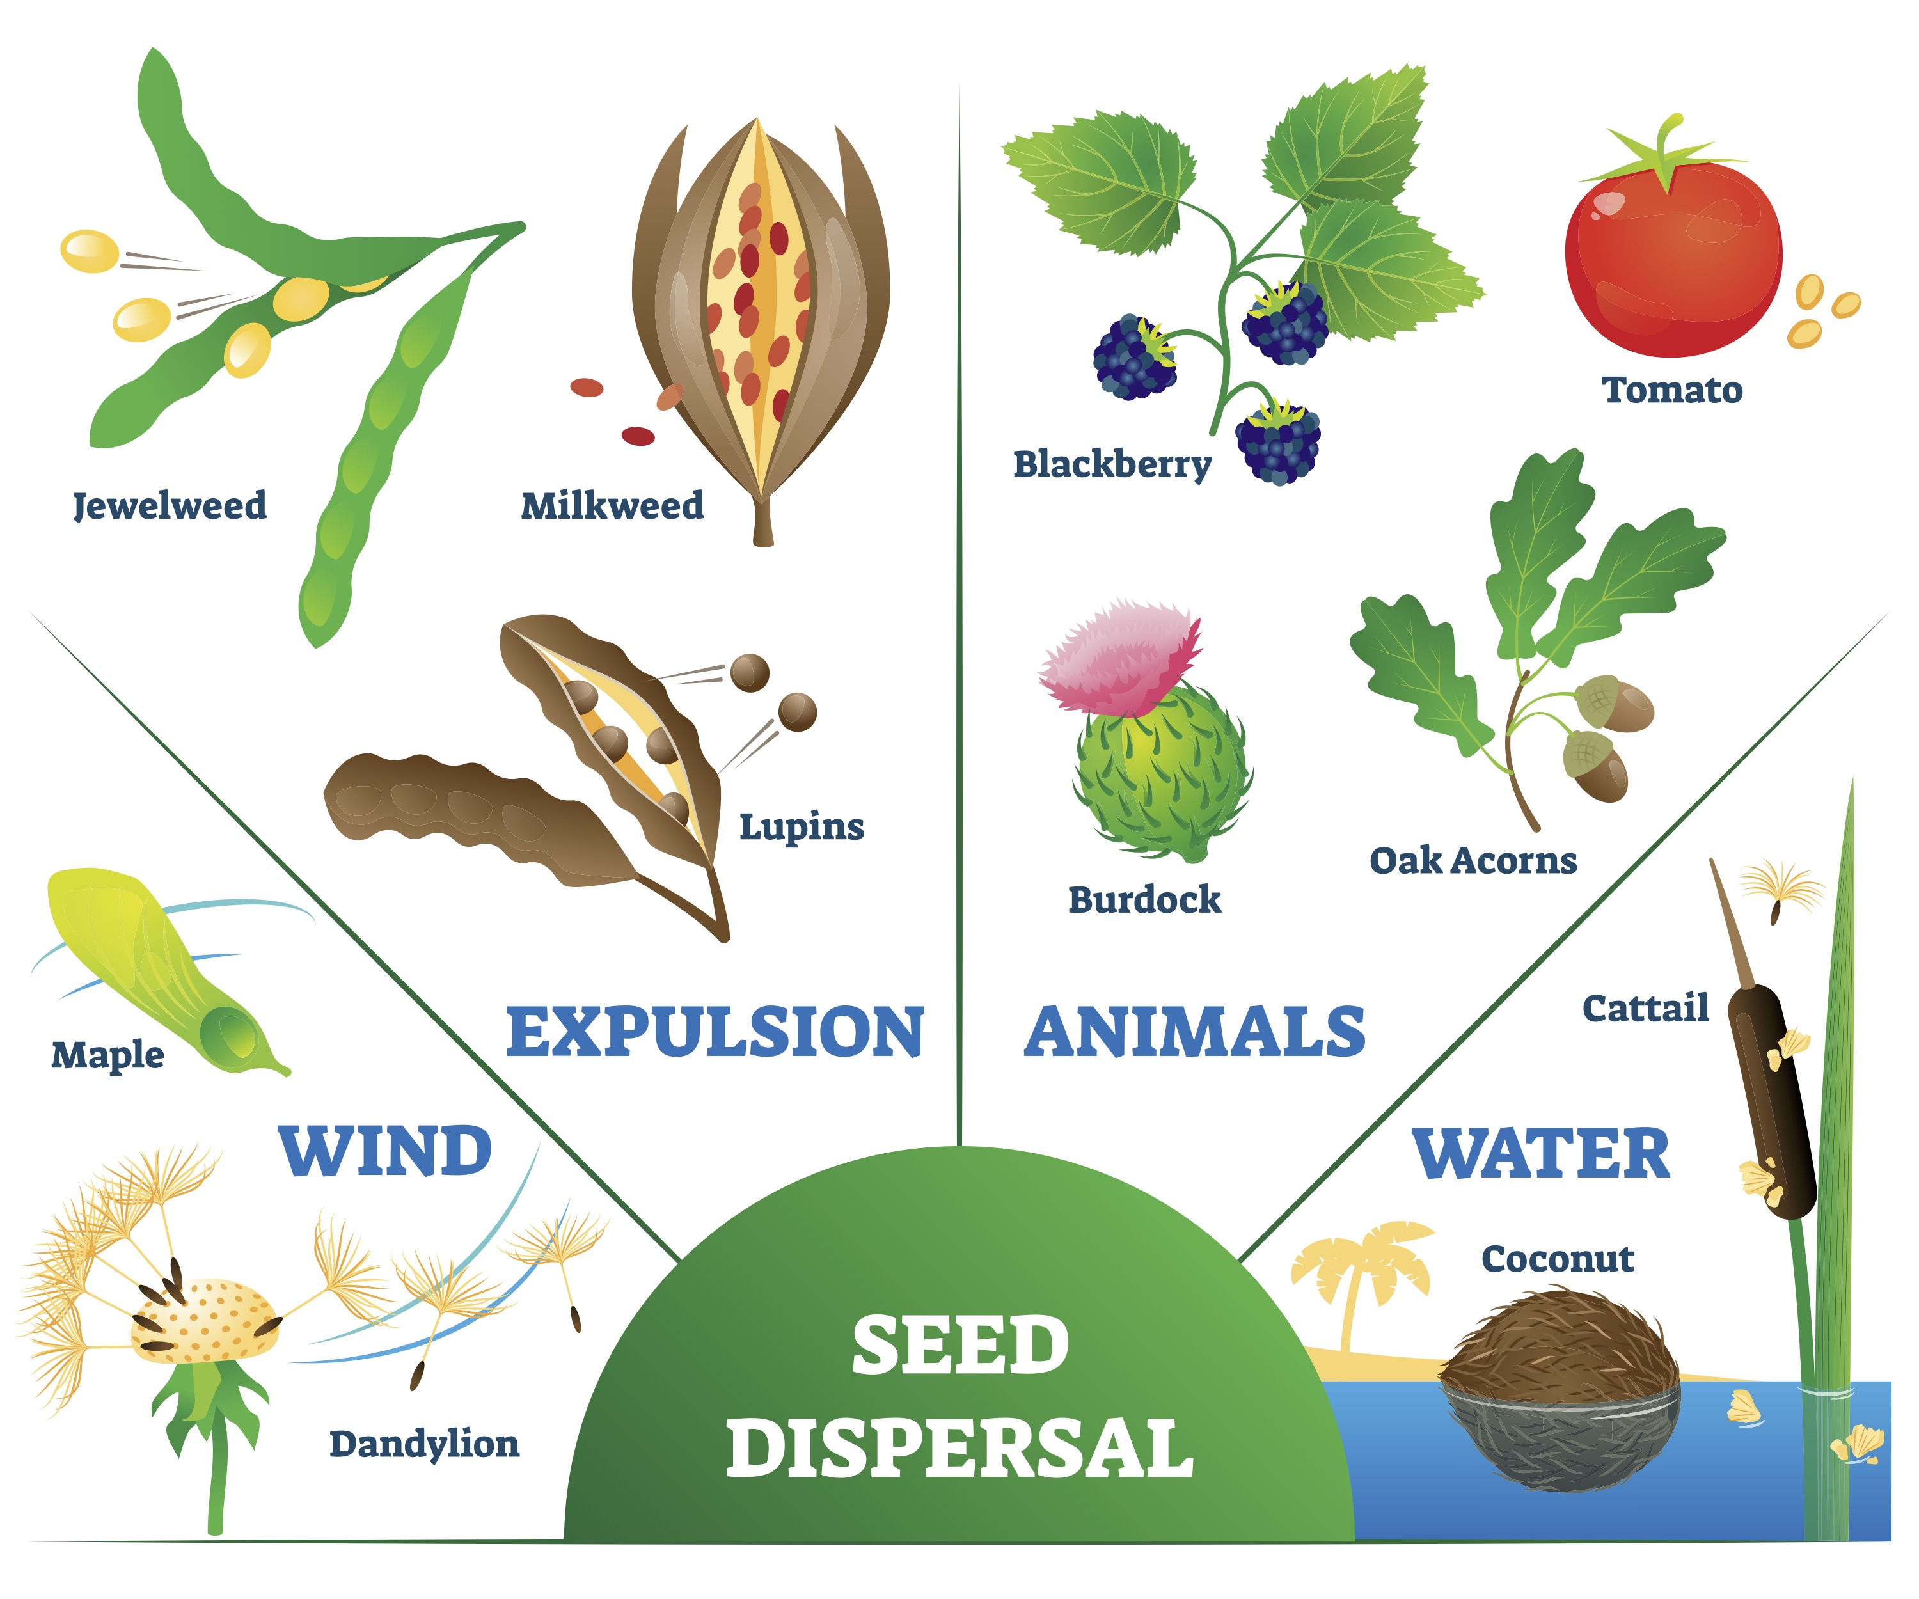
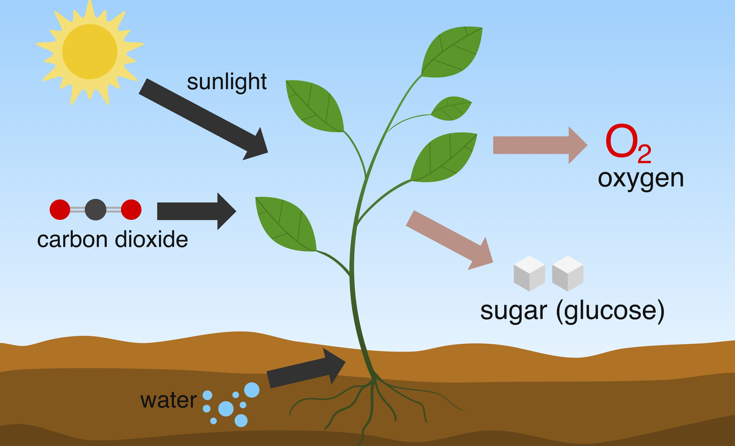
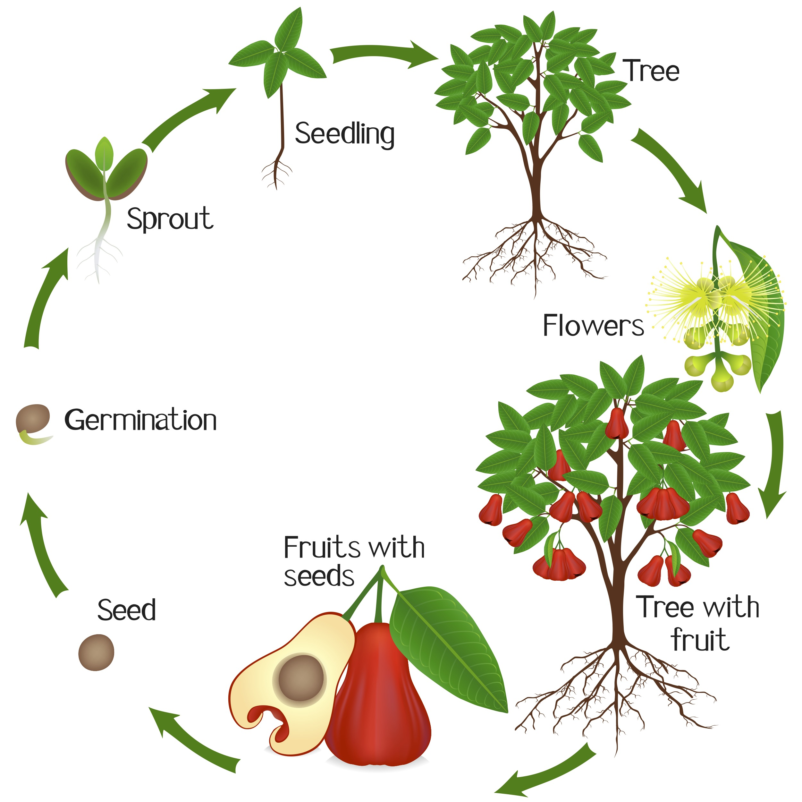
Careers connected to plants:
conservation scientist, floriculturist, organic farmer
Knowledge Organiser: Plants
Careers connected to the human body:
doctor, nurse, massage therapist, personal trainer, theatre technician
Parts of a Flower
Parts of a Plant
Lesson Sequence
The roots of a plant absorb water from the soil.
The stem transports water to the leaves.
Water evaporates from the leaves.
This evaporation causes more water to be sucked up the stem.
The fruit is the part of a flowering plant that contains the seeds.
1. Compare the effects of different factors on plant growth
2. Describe the functions of different parts of a flowering plant and how they are used in photosynthesis
Seed Dispersal
3. Investigate the way in which water is transported within plants
Photosynthesis
4. Explore the part that flowers play in the life cycle of flowering plants
Life Cycle of a Plant
5. Understand the pollination and the ways in which seeds are dispersed
6. Compare the effect of different factors on plant growth
Developing Experts Copyright 2022 All Rights Reserved

Slide 2

Rocket Words
What I already know:
Year 2
❑ I can observe and describe how seeds and bulbs turn into mature plants
❑ I can find out and describe how plants need water, light and a suitable temperature to grow and stay healthy
fertiliser | substances added to the soil or sprayed on the leaves of plants to keep them well
potassium | a metal that is used in fertilising crops
chlorophyll | captures the sun's rays and creates sugary carbohydrates or energy, which allows the plant to grow
photosynthesis | the process in which green plants use sunlight to make their own food
xylem | carries water from the roots to all parts of the tree or plant
phloem | a tissue where substances can flow up and down to carry the food throughout the plant
anther | the part of a stamen that produces and contains pollen and is usually borne on a stalk
filament | the stalk of a plant stamen that bears the anther
stomata | tiny openings or pores, found mostly on the undersurface of a plant leaf and used for gas exchange
transpiration | the process of water movement in a plant
pollen | a fine powder produced by certain plants
nectar | a liquid produced by the flower of plants
What I am learning now:
Year 5
I can identify and describe the functions of different parts of flowering plants: roots, stem/trunk, leaves and flowers
❑ I can explore the requirements of plants for life and growth (air, light, water, nutrients from soil, and room to grow) and how they vary from plant to plant
❑ I can investigate the way in which water is transported within plants
❑ I can explore the part that flowers play in the life cycle of flowering plants, including pollination, seed formation and seed dispersal
What I will learn next:
Describe the life process of reproduction in some plants and animals
Give reasons for classifying plants and animals based on specific characteristics
Identify how animals and plants are adapted to suit their environment in different ways and that adaptation may lead to evolution
Developing Experts Copyright 2022 All Rights Reserved

Slide 3
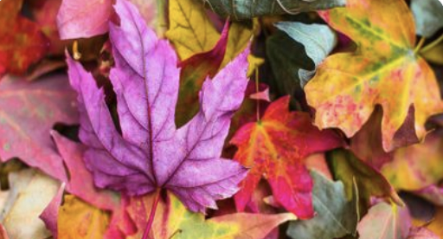
Knowledge Organiser: Plants
Careers connected to the human body:
doctor, nurse, massage therapist, personal trainer, theatre technician
Before and After Test
a
Label the parts of the flower.
Petal
Anther
Filament
Stem
Sepal
Stamen
Stigma
Style
Ovule
Ovary
What does each part of the plant do?
g
Number
a = ______
b = ______
c = ______
d = ______
e = ______
Number
f = _______
g = _______
h = _______
l = _______
j = _______
k = _______
Root = ________________________________________________
Stem = ________________________________________________
Leaves = ________________________________________________
Fruit = ________________________________________________
h
b
d
i
c
j
k
e
f
Draw the four types of seed dispersal.
What is photosynthesis?
________________ is the process in which ________ plants use _____________ to make their own ________.
Draw the stages for the life cycle of a plant.
food
sunlight
green
photosynthesis
Developing Experts Copyright 2022 All Rights Reserved

