Slide 1


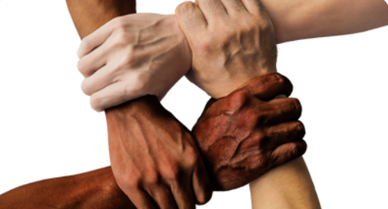









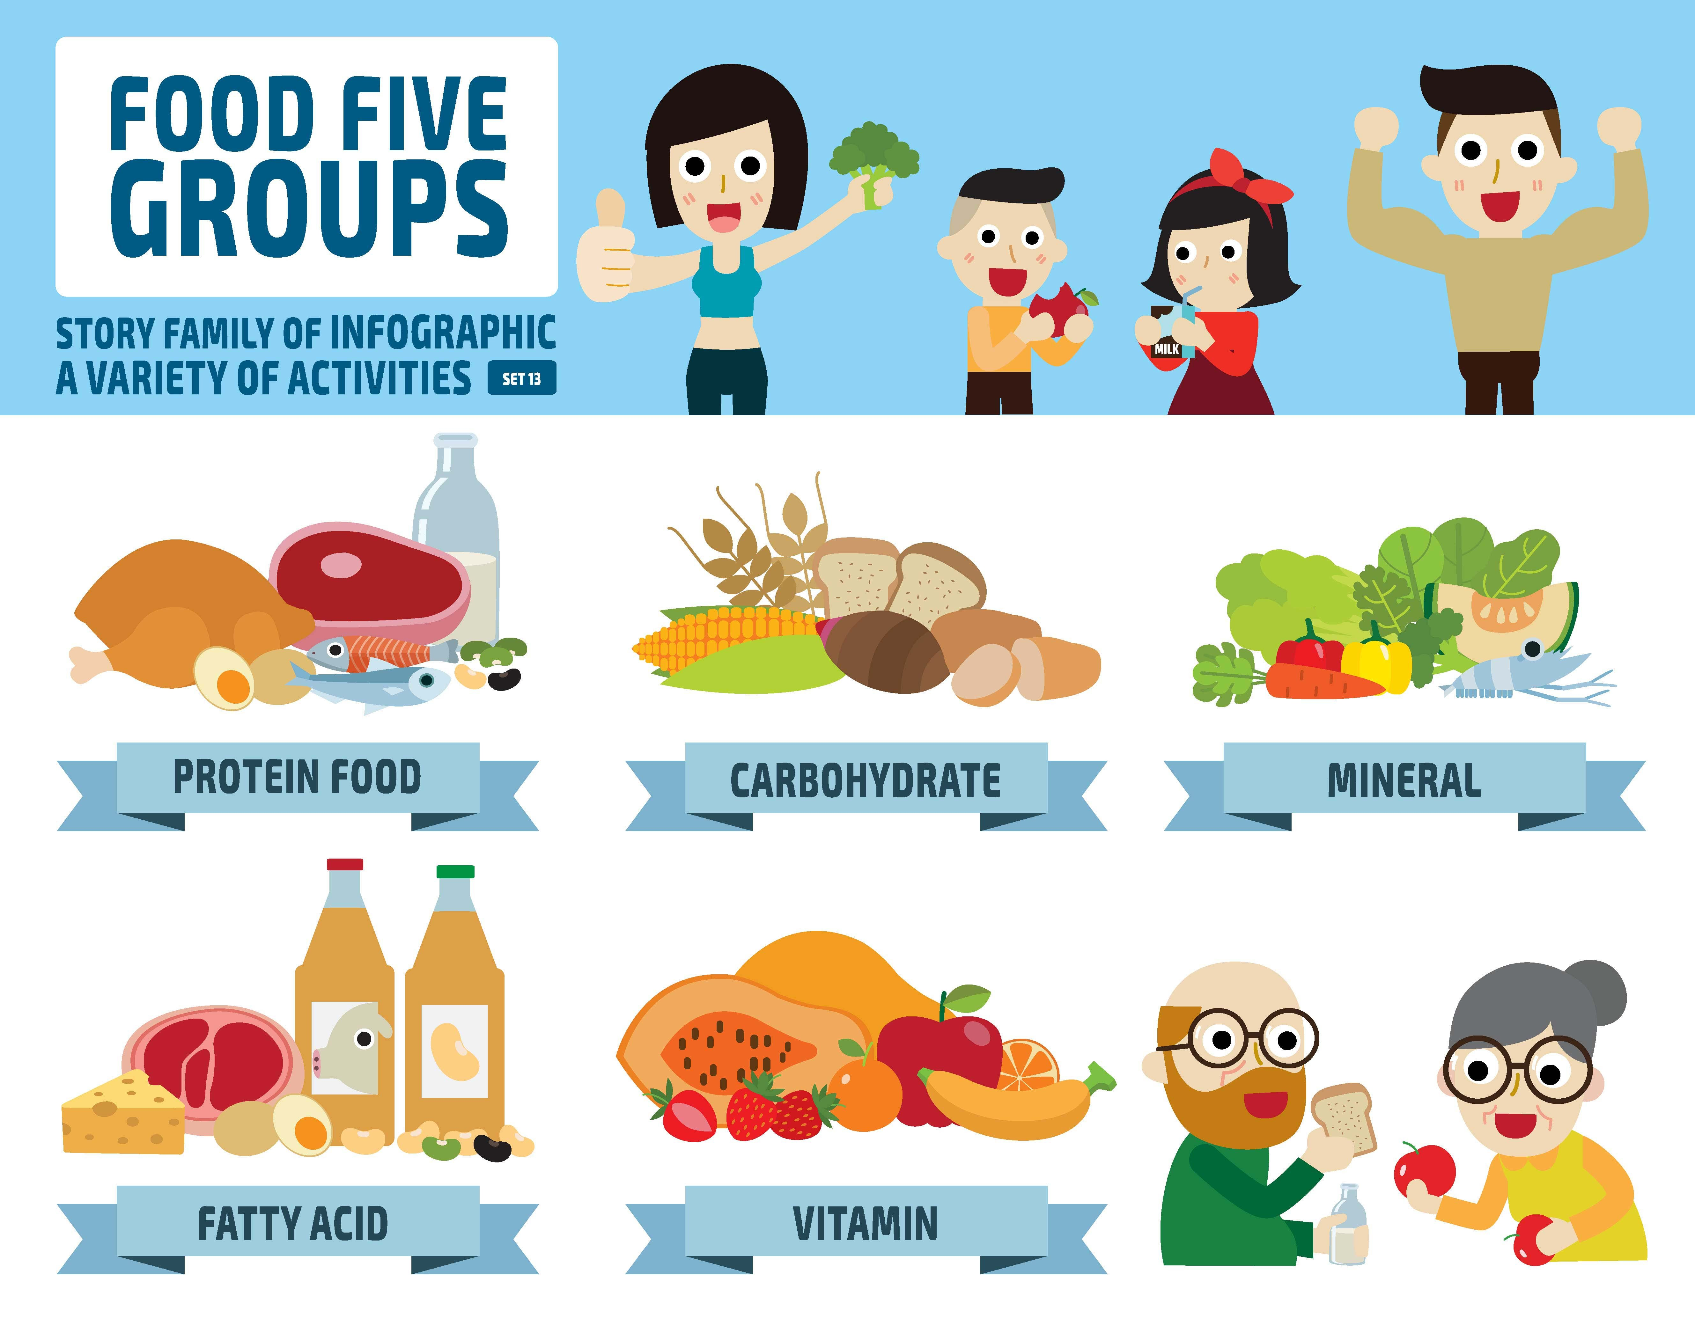
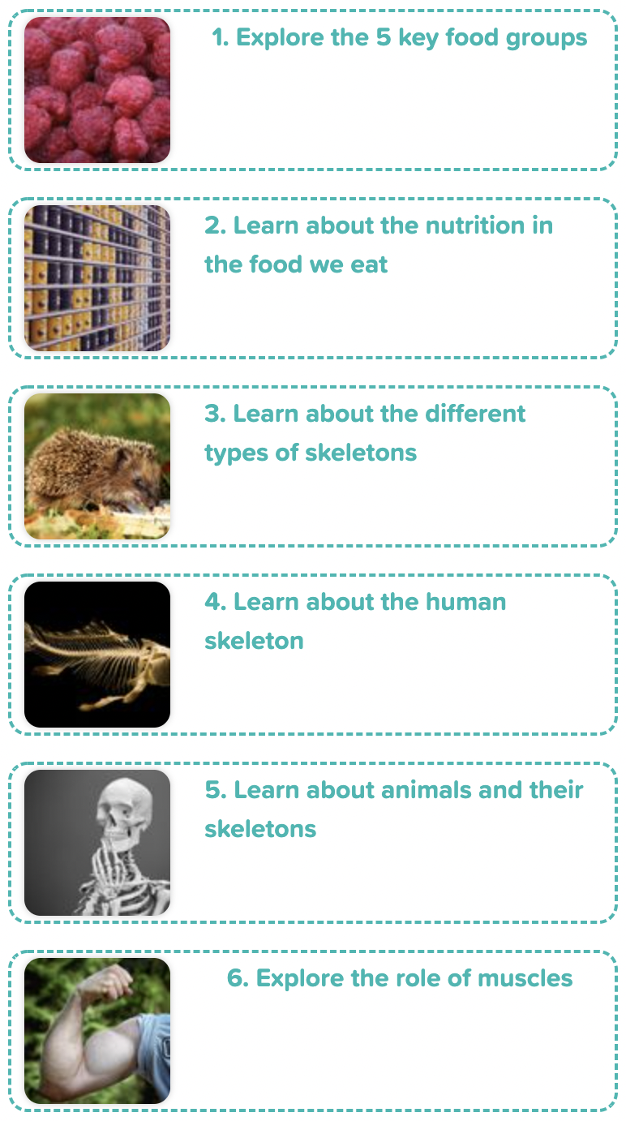
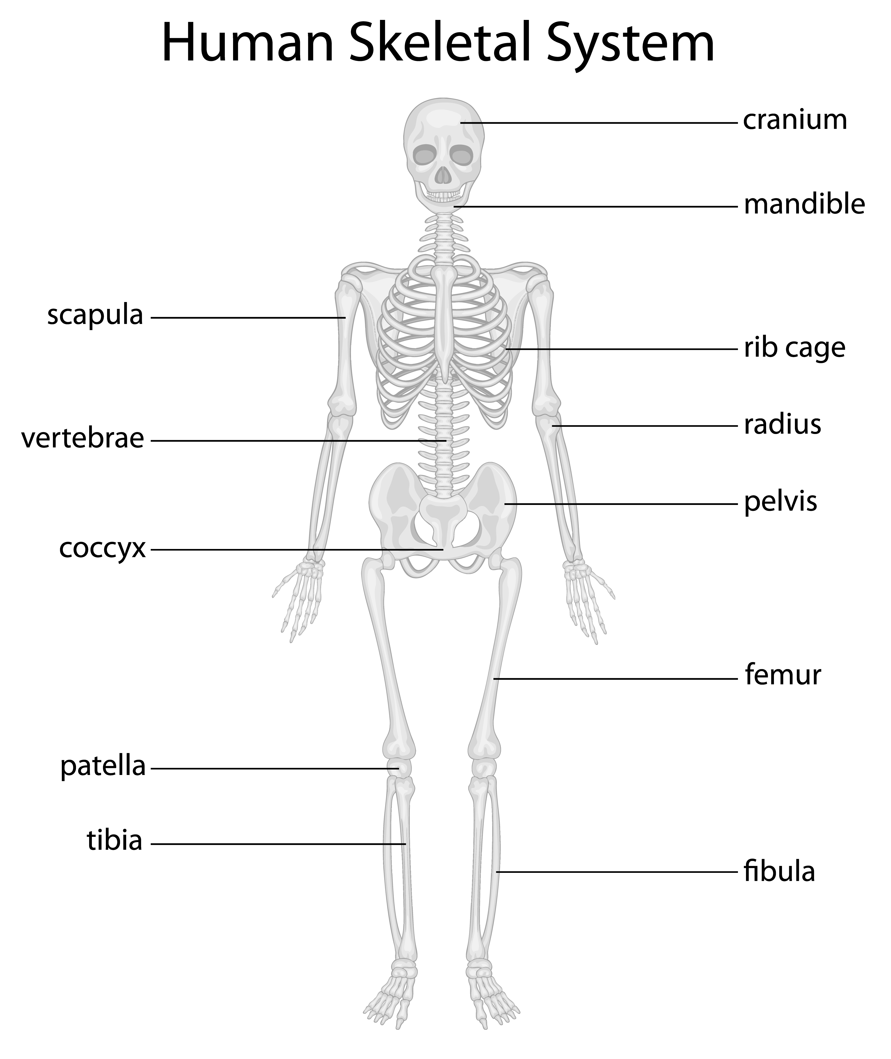
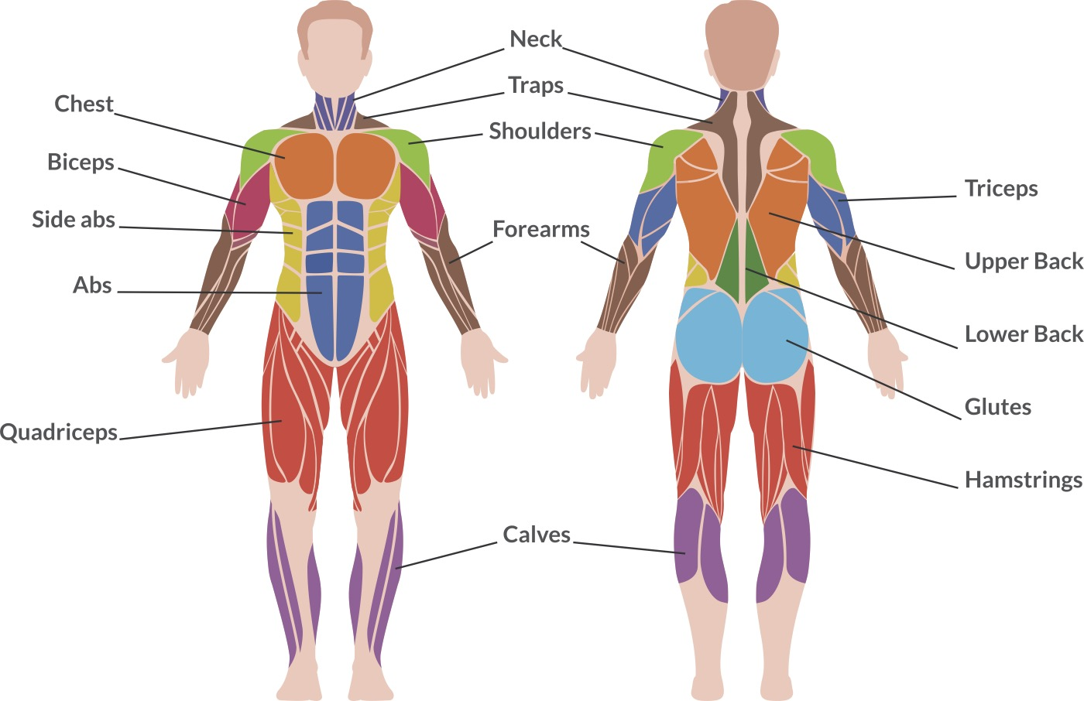
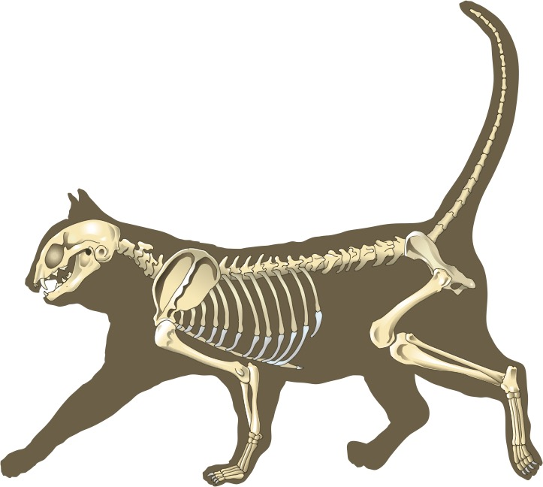
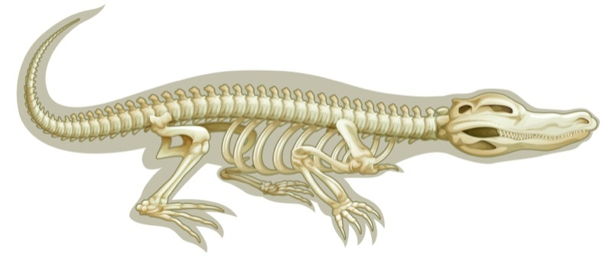
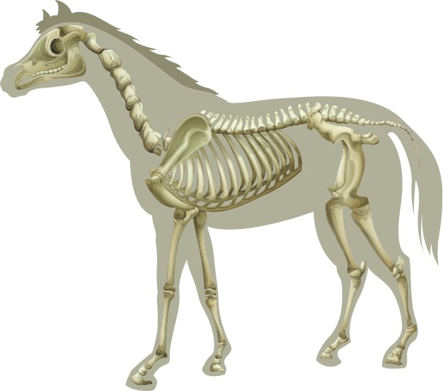
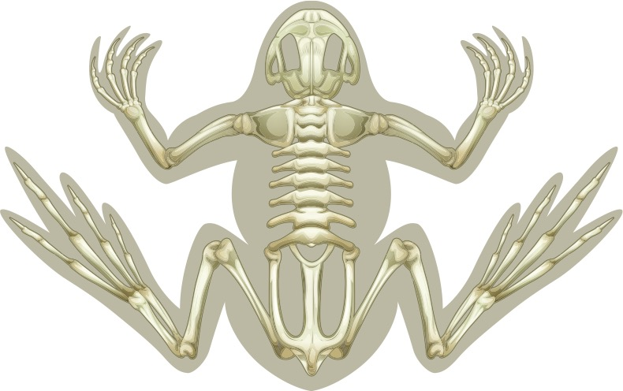
Careers connected to animals & humans:
anthropologist, orthopaedic doctor
Knowledge Organiser: Animals, including humans
Careers connected to the human body:
doctor, nurse, massage therapist, personal trainer, theatre technician
5 Food Groups
Human Skeleton
Lesson Sequence
1. Explore the 5 key food groups
2. Learn about the nutrition in the food we eat
3. Learn about the different types of skeletons
Human Muscles
4. Learn about the human skeleton
Animal Skeletons
5. Learn about animals and their skeletons
6. Explore the role of muscles
Developing Experts Copyright 2022 All Rights Reserved

Slide 2
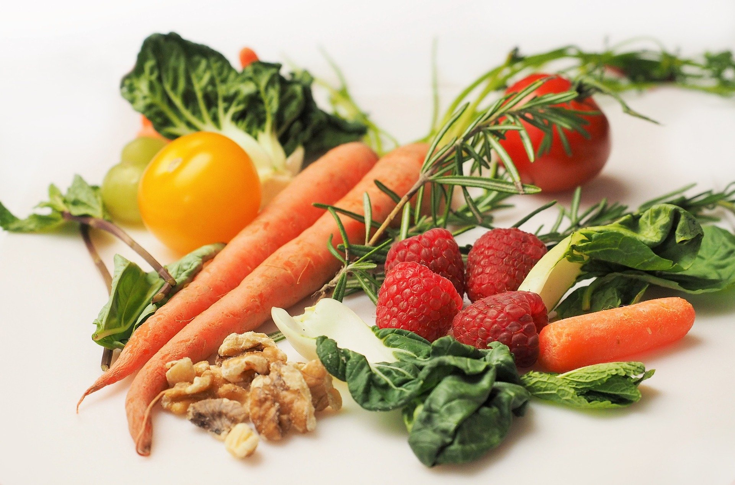


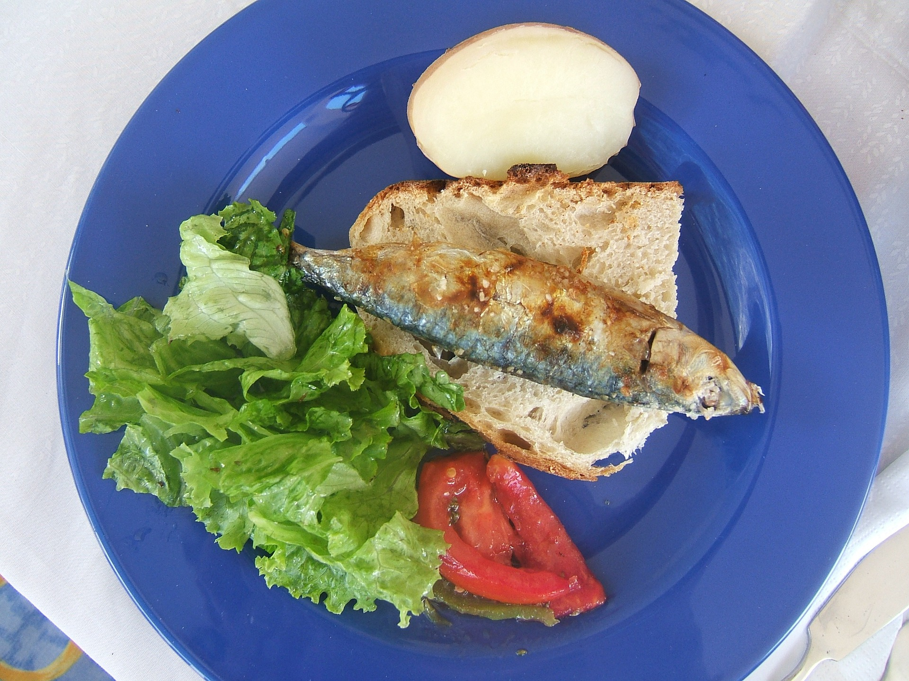
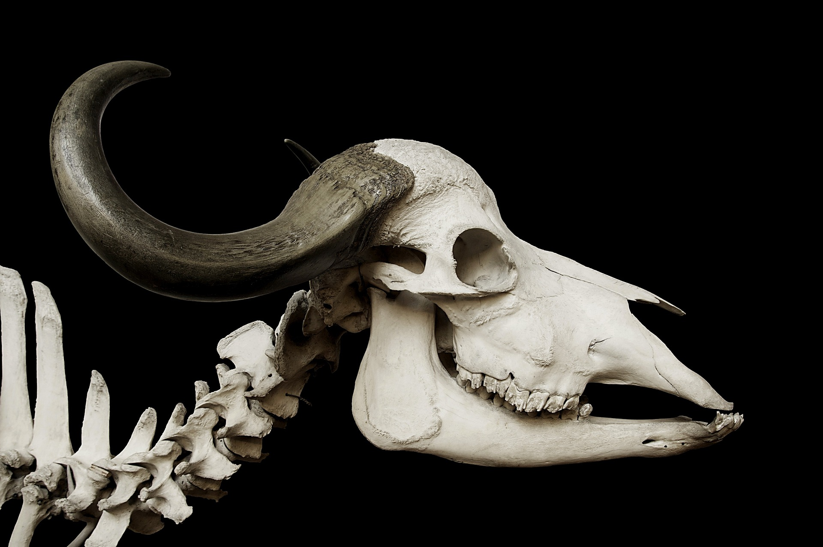
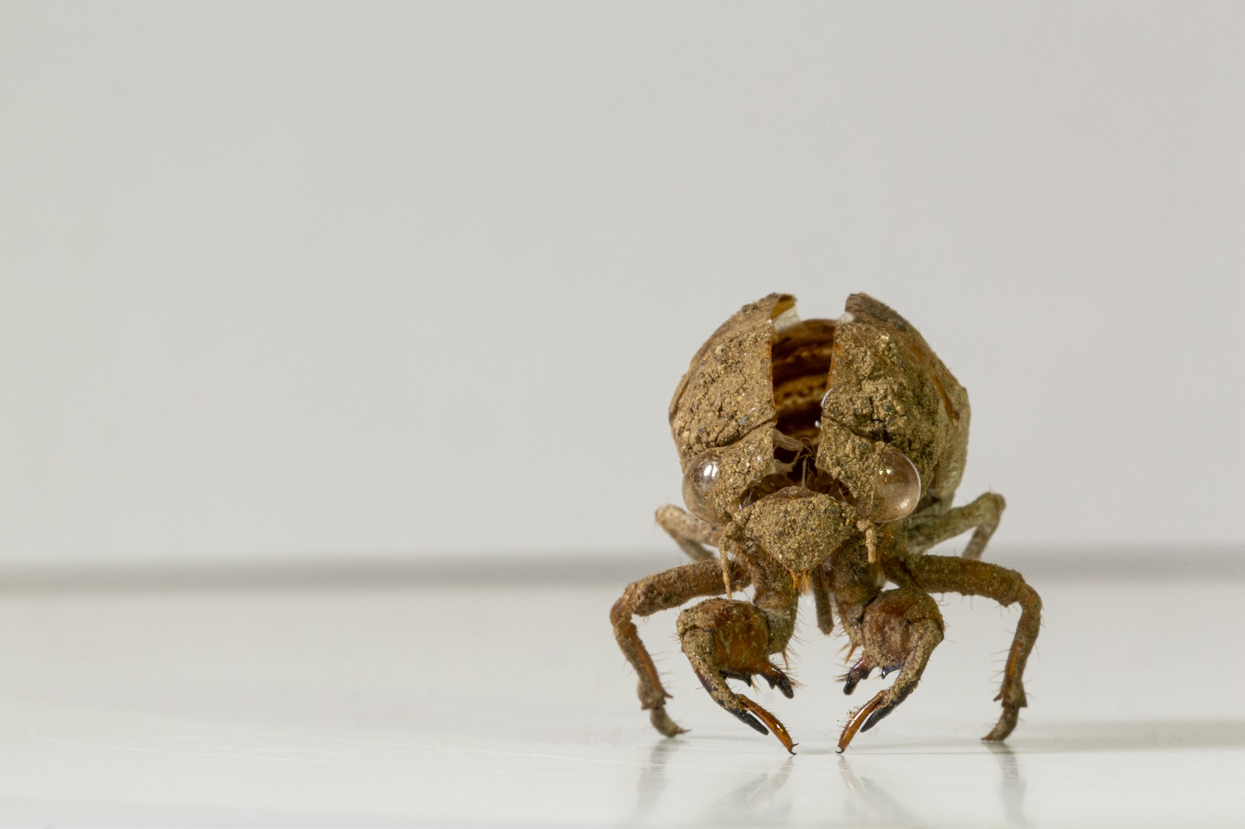
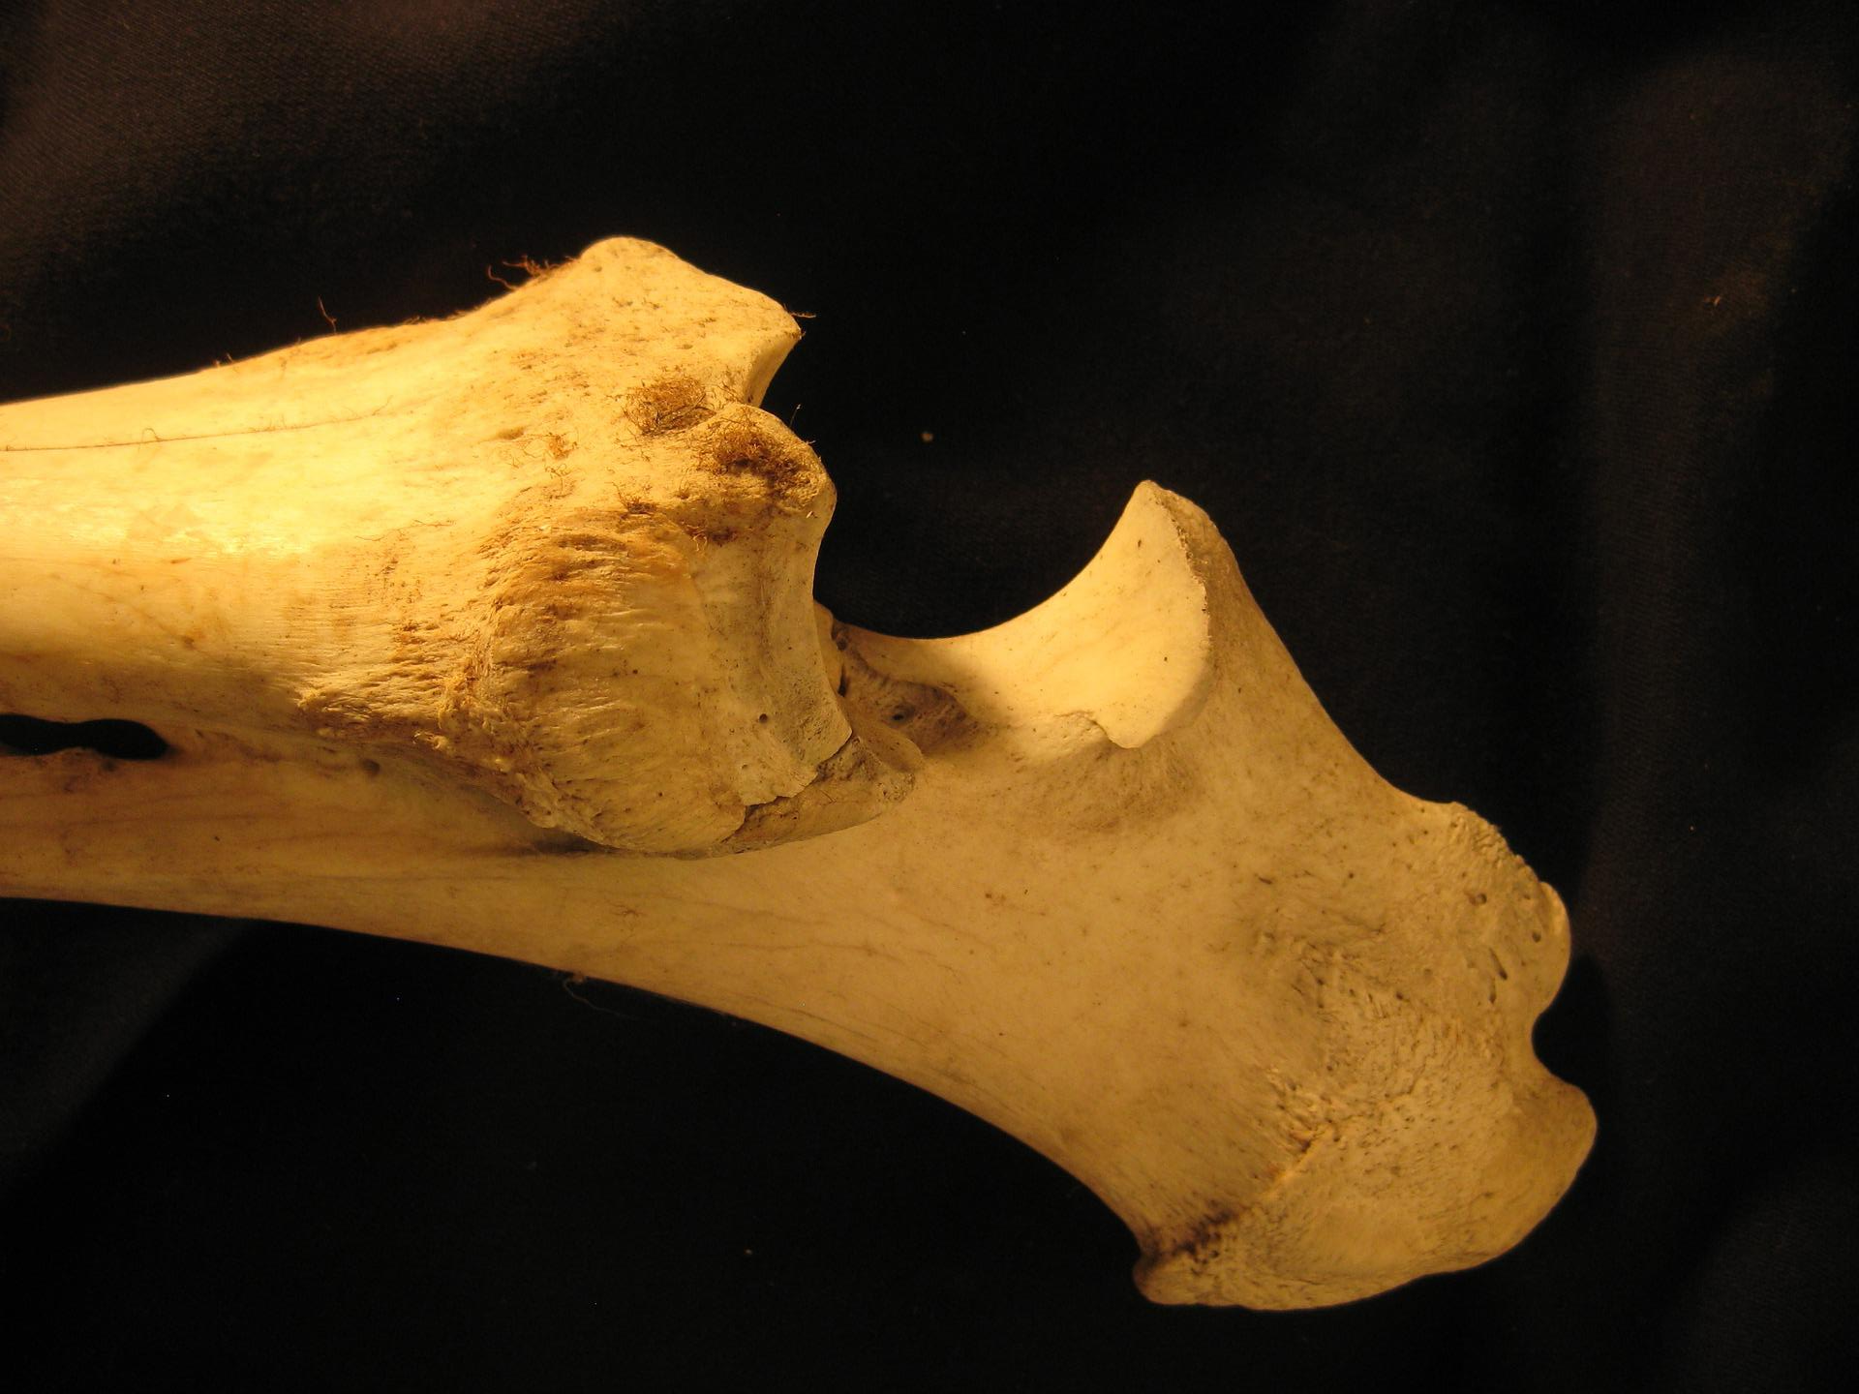

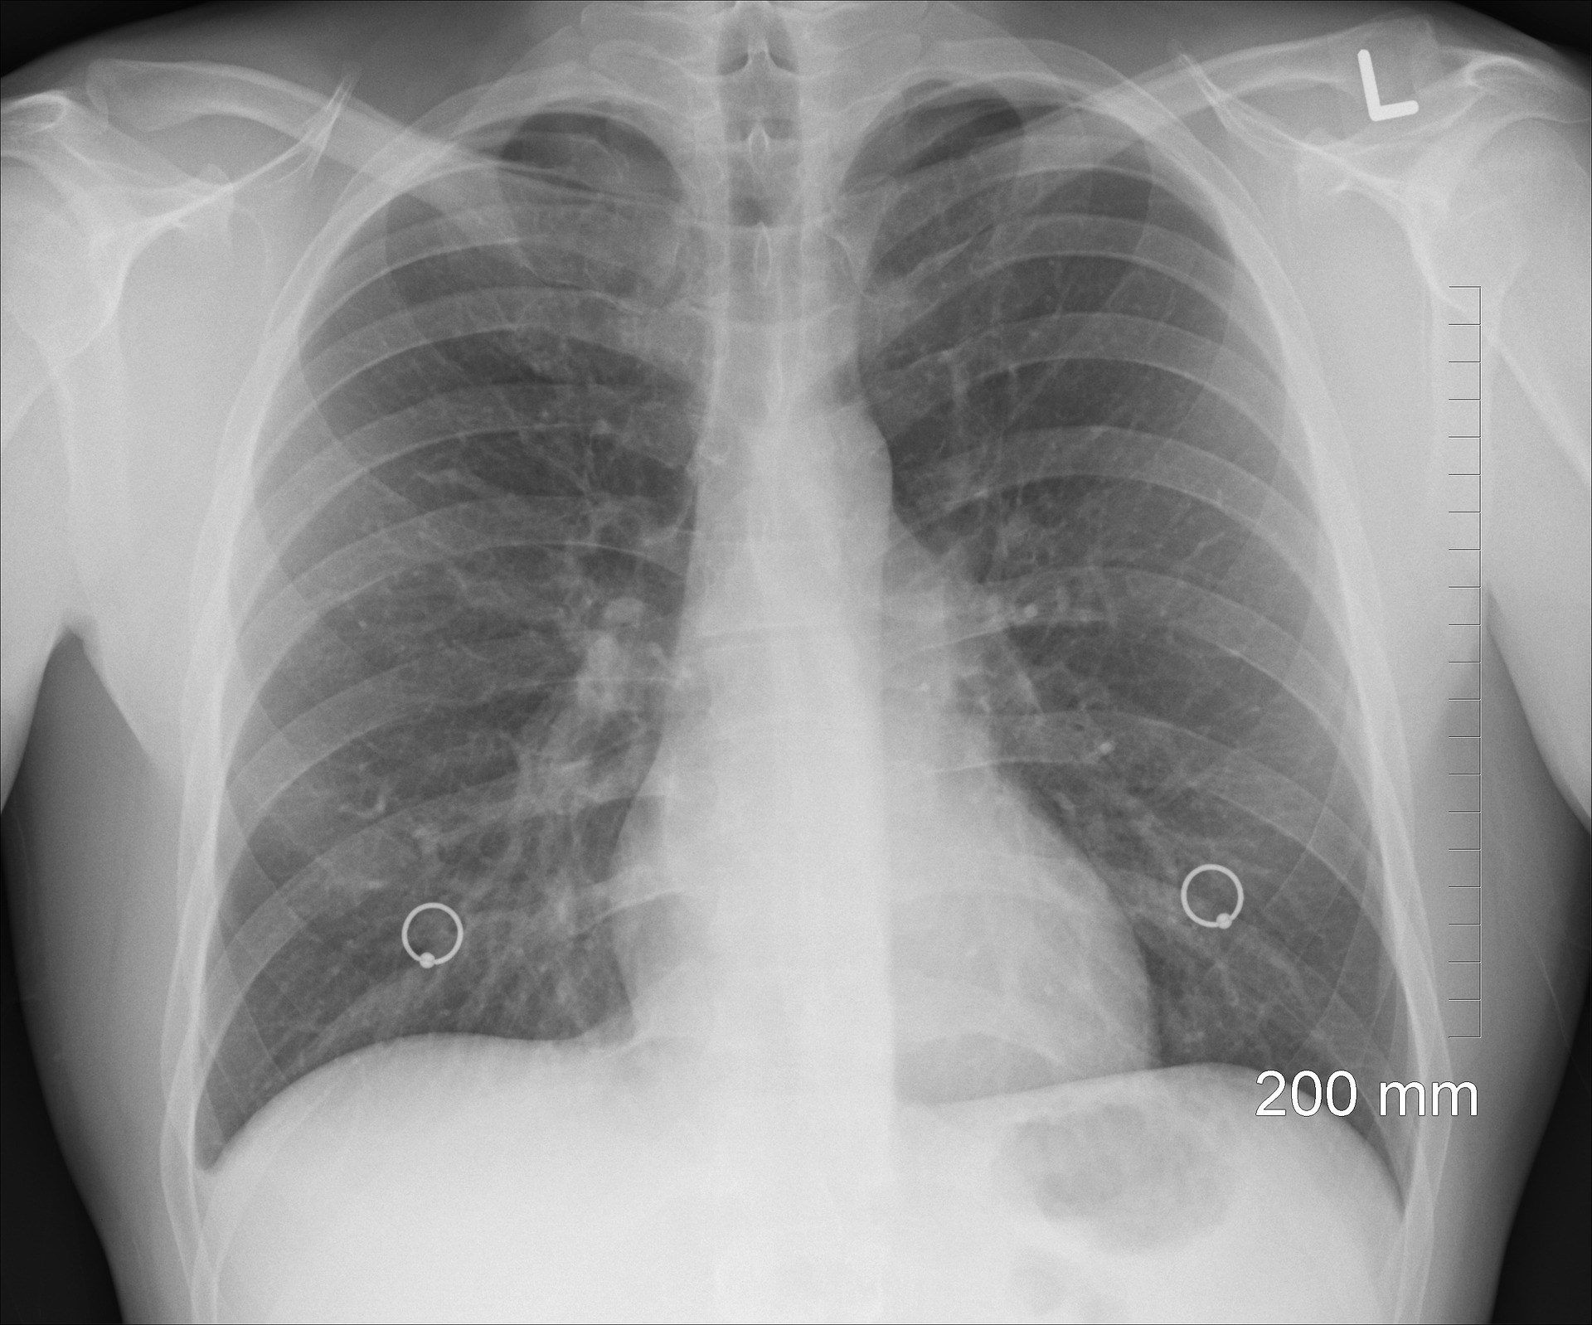
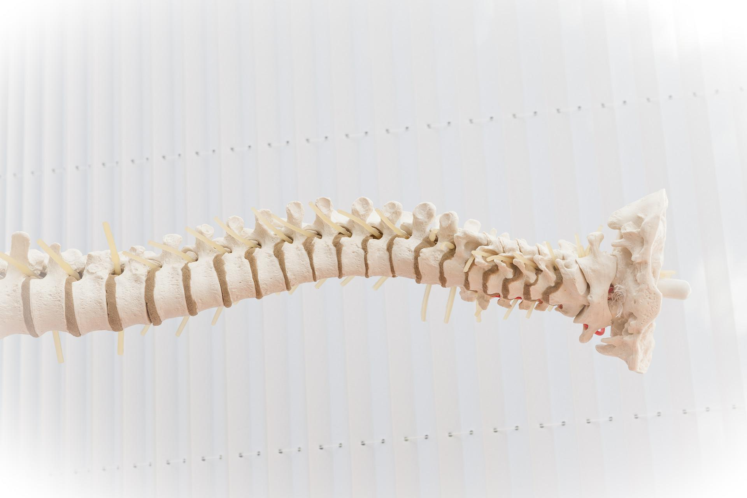


Rocket Words
What I already know:
Year 2
I notice that animals, including humans, have offspring, which grow into adults.
I can find out about and describe the basic needs of animals, including humans, for survival (water, food and air).
I can describe the importance for humans of exercise, eating the right amounts of different types of food, and hygiene.
 | vitamin | found in foods and are essential for the body’s growth, repair and building immunity
 | mineral | found in foods and help build strong bones and teeth
 | nutrition label | gives information about what the food contains
 | balanced | in good proportion
 | endoskeleton | animals with skeletons inside their body
 | exoskeleton | animals with skeletons outside their body
 | radius | one of the bones found in the lower arm
 | tibia | one of the bones in the lower leg
 | rib cage | the structure of bones protecting the lungs and heart
 | spine | the structure of bones that runs up the centre of the back
 | hamstrings | muscles that run down the back of the leg
 | biceps | muscles found in the upper arm
What I will learn now:
Year 5
❑ I can identify that animals, including humans, need the right types and amount of nutrition, and that they cannot make their own food; they get nutrition from what they eat
❑ I can identify that humans and some other animals have skeletons and muscles for support, protection and movement
What I will learn next:
❑ I can describe the simple functions of the basic parts of the digestive system in humans
❑ I can identify the different types of teeth in humans and their simple functions
❑ I can construct and interpret a variety of food chains, identifying producers, predators and prey

Slide 3
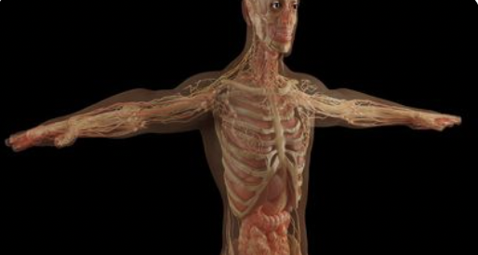
Knowledge Organiser: Animals, including humans
Careers connected to the human body:
doctor, nurse, massage therapist, personal trainer, theatre technician
Before and After Test
Label the parts of the human skeleton
What are the 5 food groups?
____________
_________
________
_________
________
________
____________
Label the human muscles
____________
____________
_____
______
____________
biceps
triceps
____________
____________
Identify the animal skeletons
fibula
vertebrate
cranium
scapula
rib cage
femur
tibia
________
________
________
________
Developing Experts Copyright 2022 All Rights Reserved

