Slide 1

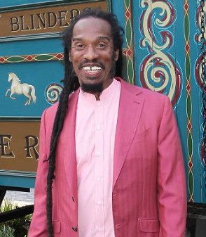
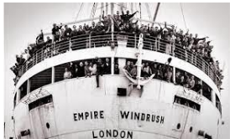
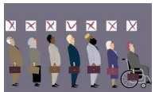
Rotherhithe Primary Year 6 – Windrush
What I should already know
Local history
What will I learn in this unit?
-Introduce the British Empire and the Transatlantic slave trade -Research and explore the participation of people of Caribbean descent during and after WW2 -Understand bias against certain artefacts from the past. -Recognise and discuss the roles of individuals from the Windrush period, understanding why they migrated and being able to evaluate their achievements to British history and culture.
What I will learn next
WW2
Benjamin Zephaniah
Key Words
Caribbean | The region consisting of the Caribbean Sea, its islands (including the West Indies), and the surrounding coasts.
Citizen | A legally recognized subject or national of a state or commonwealth.
Commonwealth | An international association consisting of the UK together with states that were previously part of the British Empire, and dependencies.
Discrimination | The unjust or prejudicial treatment of different categories of people, especially on the grounds of race, age, sex, or disability.
Immigration | The action of coming to live permanently in a foreign country.
Race | A group of people sharing the same culture, history, language
Voyage | A long journey involving travel by sea or in space
immigration
discrimination
TIMELINE
1948 | 1958 | 1959 | 1963 | 1965 | 2012 | 2018
British nationality act HMT Windrush ship arrives in London | Racist attacks on the Notting Hill community | First Caribbean carnival organised | British bus boycott | Race Relations Act | Windrush celebrated at London Olympics | First Windrush day celebrated

