Slide 1

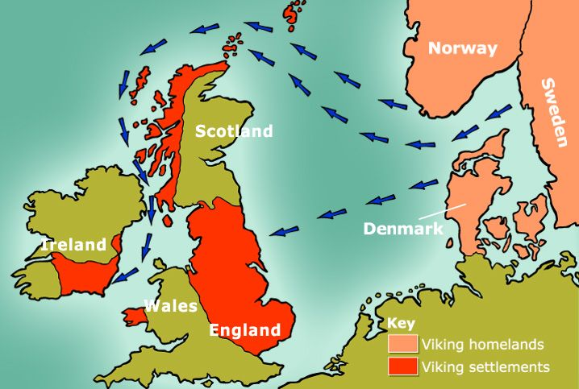
Rotherhithe Primary- Year 5 – Vikings
What I should already know
Matthew Henson
What will I learn in this unit?
Understand what Invading and Settling is. Investigate reasons why Anglo-Saxons invaded Britain. Understand where the Vikings came from and how they travelled Understand the order of Viking raids and explain why the Vikings raided monasteries. Understand who King Alfred the Great was. Make inferences from artefacts. Explain how Christianity came to Britain. Use evidence to explore how Vikings truly lived.
What I will learn next
Local history
Viking invasion
Key Words
conquer | To overcome and take control of a place or people, by military force
Dane law | The area of England ruled by the Vikings
Dragon-ship | A Viking long ship ornamented with a beaked prow
invaders | A person or group that invades a country, region or other places
raid | A surprise attack on an enemy by troops, aircraft or other armed force
settlement | A place, typically previously inhabited, where people established a community
Timeline
700AD | 793AD | 876AD | 1,014AD | 1,066AD | 1,100AD
The Viking Age begins | First invasion to Britain raiding monasteries on the coast | Vikings settle permanently in Britain | King Canute of Denmark becomes King of England | Battle of Hastings take place and William the conqueror is crowned King | End of the Viking age

