Slide 1

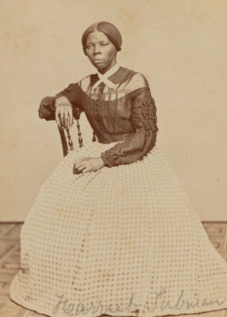
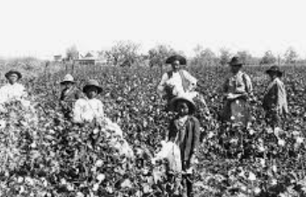
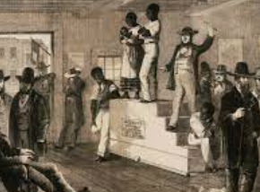
Rotherhithe Primary- Year 5 – Harriet Tubman
What I should already know
Roman Empire
What will I learn in this unit?
To know who Harriet Tubman was To recall some of the key events in Harriet Tubman’s life To understand slavery and why it is abolished today To why Harriet Tubman was brave To understand why Harriet Tubman is still important today
What I will learn next
Matthew Henson
Harriet Tubman
Key Words
abolitionist | Someone who campaigned to end slavery
auction | Slaves were sold to the highest bidder
Jim Crow laws | Black and white people couldn’t mix. Black people couldn’t vote. Slaves were banned from reading and writing.
plantation | A large farm where crops were grown, such as sugar cane
shackles | Iron chains used to fasten the legs or hands of a slave or prisoner
slaves | A person who is the property of another and is forced to obey them
underground railroad | The network of routes that helped slaves escape
plantation
auction
TIMELINE
1820 | 1844 | 1849 | 1850 | 1859 | 1862-1865 | March 1913
Harriet Tubman is born in Maryland | Harriet marries John Tubman | Fearing she will be sold, Harriet flees | Harriet frees her sister and 2 children and goes onto do 19 more journeys freeing more than 300 slaves | She buys herself a small farm | She serves as a cook and nurse in the American civil war | Harriet dies

