Slide 1

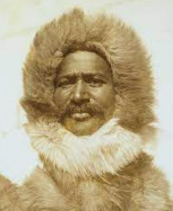
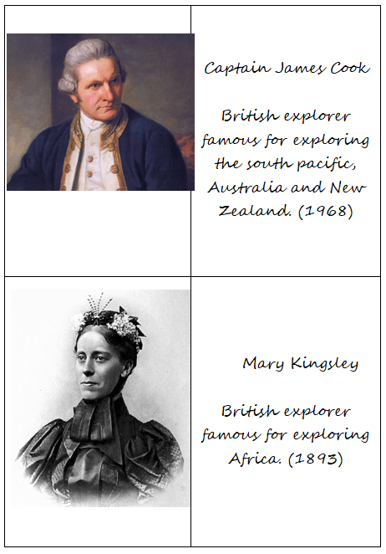
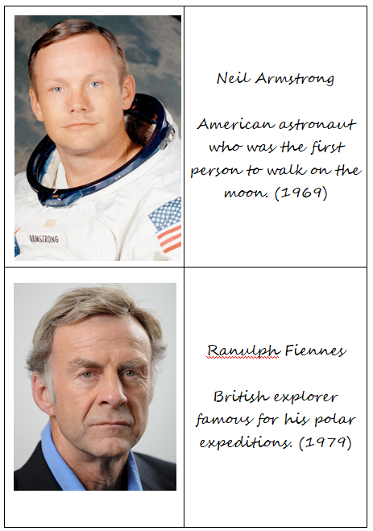
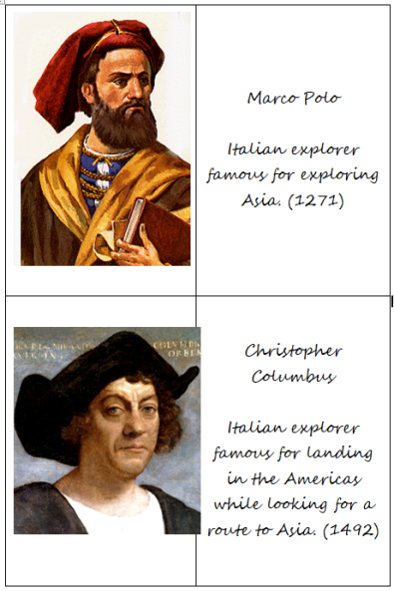
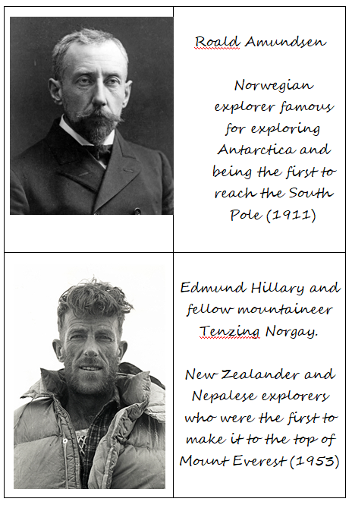
Rotherhithe Primary- Year 5 – Explorers
What I should already know
Harriet Tubman
What will I learn in this unit?
Learn about why people risked their lives to explore Know what an explorer would take with them on an expedition Study the life of Mathew Henson Create a timeline of explorers expeditions over time Discuss some significant events from exploration history
What I will learn next
Vikings
Significant black explorer- Matthew Henson
Key Words
expedition | A journey undertaken by a group of people with a particular purpose, especially that of exploration or research
explorer | A person who explores a new or unfamiliar area
famous | Someone who is known by any people
native | Being born in a specific place
pioneer | A person who is first to explore or settle a new country or are
voyage | A long journey involving travel by sea.
Key explorers in history

