Slide 1

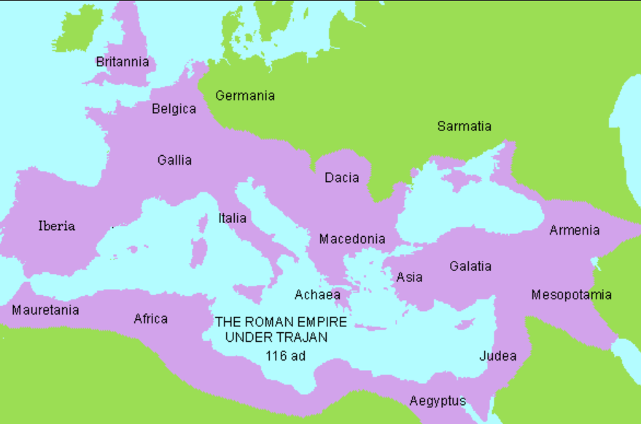
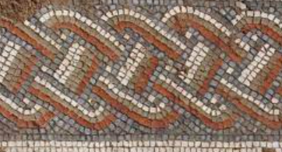
Rotherhithe Primary- Year 4 – Romans
What I should already know
Local history
What will I learn in this unit?
Learn about the founding of Rome, the Roman ruling Identify features of a Roman life, system and the expansion of the Roman empire. The rise of the Roman Empire and what life was like in the Roman army. Understand why Julius Caesar invaded Britain in 55BC. Explore the Roman heating system and how they built the aqueducts.
What I will learn next
Harriet Tubman
Roman Empire
Key Words
aqueduct | A channel or a pipe built to carry water over a long distance
Empire | A very big country or a group of countries or peoples ruled over by a powerful leader or government
Emperor | The ruler of an Empire
forum | A central place in Roman towns and cities where people gathered for business and public meetings
mosaic | A pattern or picture made from small pieces of stone
legion | a large group of soldiers who form a part of an army
mosaic
Timeline
509BC | 73BC | 44BC | 43AD | 121AD | 476AD
The city of Rome is founded | Rome became a Republic | Julius Caesar becomes the first dictator of Rome | The Roman empire invades the British Empire | The colosseum is built and is one of the greatest examples of Roman engineering | The fall of the Roman empire

