Slide 1

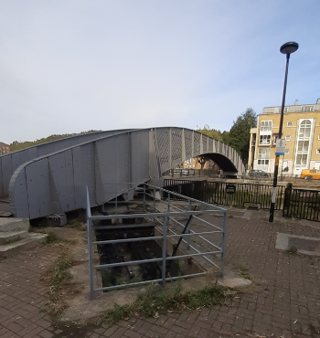
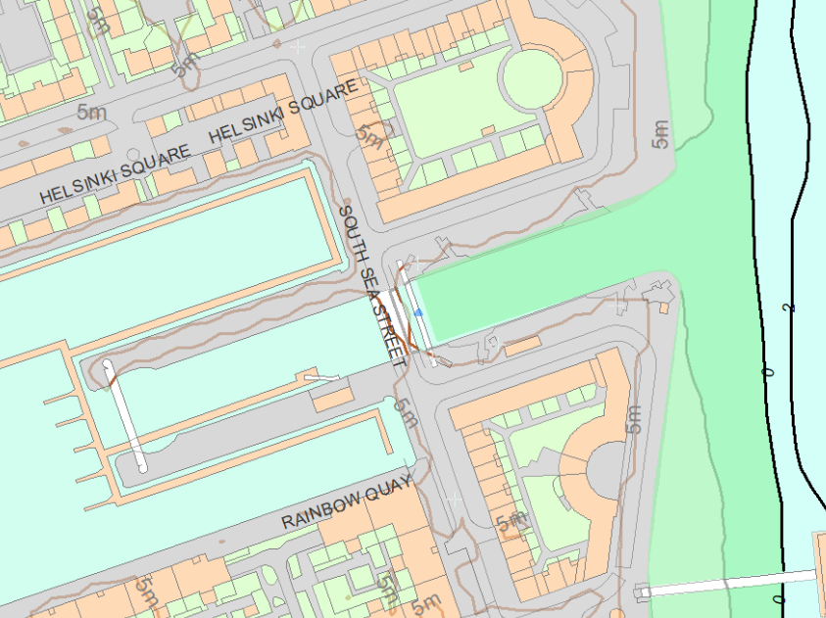
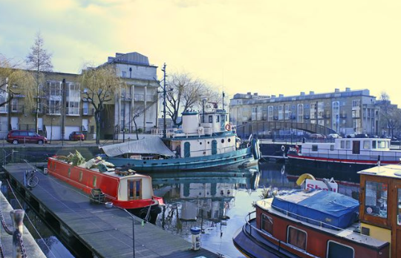
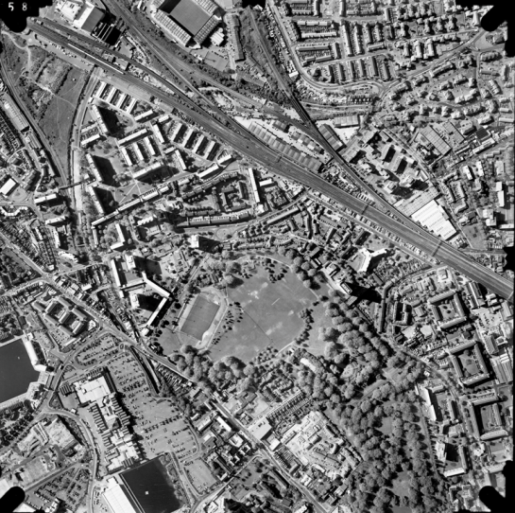
Rotherhithe Primary- Year 4 – Local history- Footbridge over Greenland Dock
What I should already know
Local history: Turntable and machinery of former swing road bridge
What will I learn in this unit?
Develop an awareness of Rotherhithe’s past To identify similarities and differences between ways of life in Rotherhithe through different periods. Compare an aerial photograph from the past to a modern day map To create a piece of art based on the heritage site, Footbridge over Greenland Dock
What I will learn next
Local history- Former Dock Managers Office and 1 -14 Dock Offices
Footbridge over Greenland Dock
Key Words
Aerial photograph | A photograph taken from an aircraft or satellite in flight
heritage site | A building or an area important to a countries heritage
Ordinance survey map | A detailed map
Rotherhithe | A place part of the borough of Southwark
ordinance survey map
aerial photograph of Rotherhithe 1997

