Slide 1



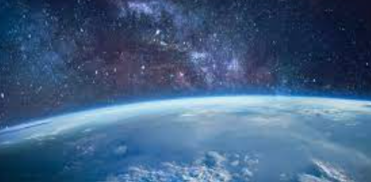

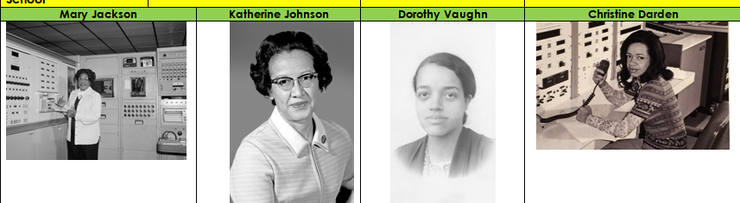
Rotherhithe Primary- Year 4 – Women of NASA
What I should already know
Stone Age to Iron Age
What will I learn in this unit?
Recount the story of Hidden figures. To learn about the jobs the women did. Create a biography on one of the women of NASA. That equality is important, and we should not discriminate against anyone.
What I will learn next
Local history
equality | To have equal rights
discriminate | To be prejudice towards someone due to their ethnicity, sex, age, or disability
diversity | To show a range of variety.
NASA | National Aeronautics and Space Administration
racism | Discrimination of an individual or a community
Science | The study of the natural world
space | The space around our Earth where there is no air to breath.
NASA
science
equality
space

