Slide 1

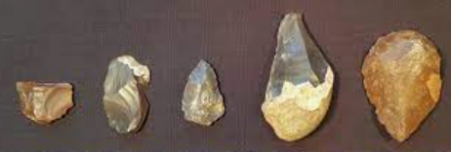
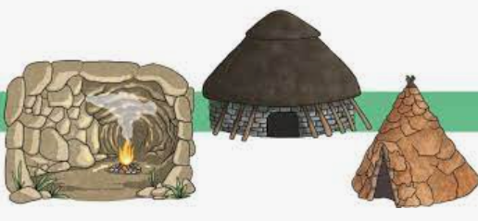
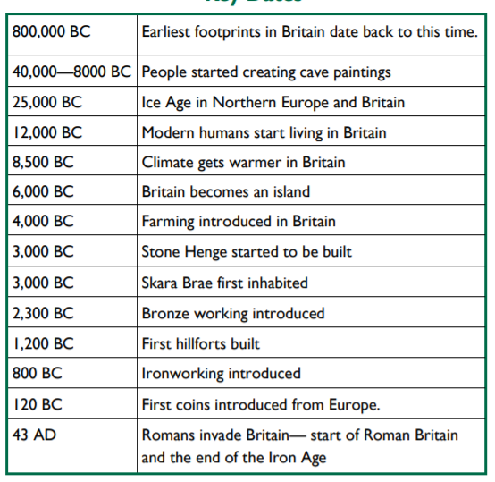
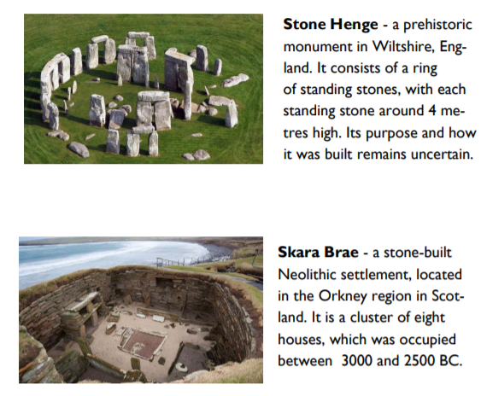
Rotherhithe Primary- Year 3 – Stone Age to Iron Age
What I should already know
Ancient Egyptians
What will I learn in this unit?
Use evidence to investigate what life was like for the Stone Age man to the Iron Age Man. Explore the changes that took place during the Stone Age and describe their significance. Use evidence from Skara Brae to find out what life was like towards the end of the Stone Age. Explain how Stone Henge was built. Discuss reasons why Stone Henge was built. Describe the major changes that took place from the Stone Age to the Iron Age
What I will learn next
Women of NASA
flint tools
Key Words
agriculture | The practice of farming and growing crops.
archaeologist | Person who learns about the past by digging up artefacts and studying them.
artefact | An object made by a human being.
flint | A type of stone that can be shaped into blades, knives and spears for hunting.
hunter gatherer | Food is obtained by hunting, fishing, and foraging
Neolithic | The new Stone Age
preserve | To keep something in good condition.
settlement | A place where a group of people live together in many buildings.
Stone Age homes
timeline

