Slide 1

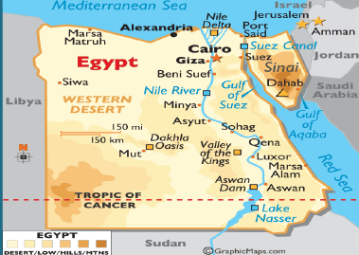
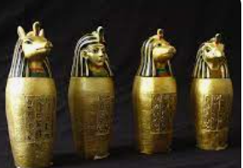
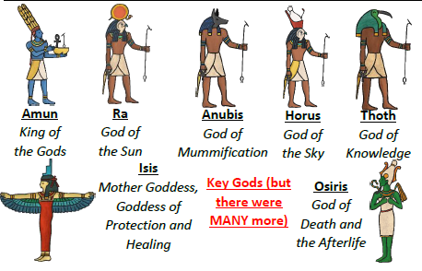
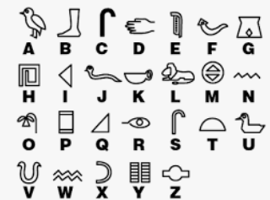
Rotherhithe Primary- Year 3 – Egyptians
What I should already know
Local history
What will I learn in this unit?
Develop an understanding of the Ancient Egyptian time period. Understand the mummification process. Recognise the significance of papyrus. Consider the significance of the role of a Pharaoh. Consider how Ancient Egyptian inventions are relevant today. Understand what everyday life was like for men, women and children.
What I will learn next
Stone Age to Iron Age
map of the Egyptian rule
Key Words
afterlife | The place where Egyptians believed they would go after they died.
canopic jars | Special jars that held the organs of a mummy.
Egyptologist | An archaeologist who focuses Ancient Egypt.
hieroglyphics | A type of writing that used a combination of pictures and symbols
mummification | The process of preserving a body after death in preparation for the afterlife.
papyrus | A plant that grew on the banks of the Nile. It was used as an early version of paper.
Pharaoh | The supreme ruler of all of Ancient Egypt.
sarcophagus | A large stone box that held a mummy’s coffin.
canopic jars
Egyptian Gods
hieroglyphics

