Slide 1

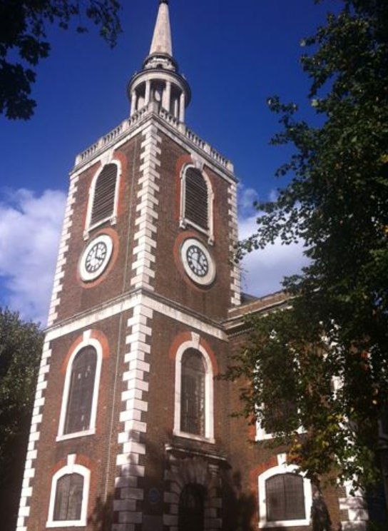
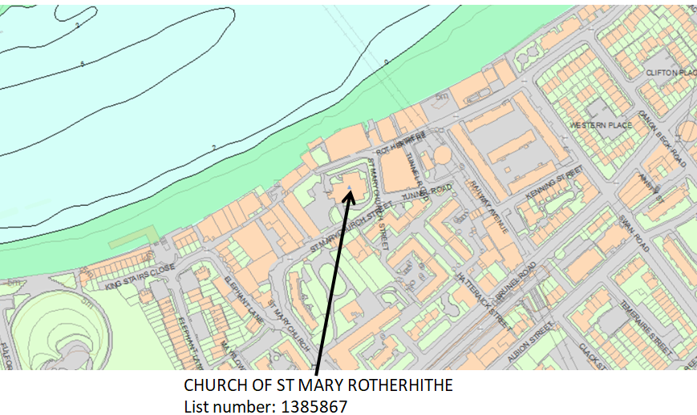
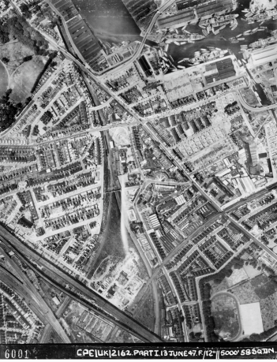
Rotherhithe Primary- Year 2 – Local history- Church of St Mary’s Rotherhithe
What I should already know
Local history- Southwark Park
What will I learn in this unit?
Develop an awareness of Rotherhithe’s past, To identify similarities and differences between ways of life in Rotherhithe through different periods. Compare an aerial photograph from the past to a modern day map To create a piece of art based on the heritage site, St Mary’s church
What I will learn next
Local history- Turntable and machinery of former swing road bridge
Church of St Mary’s Rotherhithe
Key Words
Aerial photograph | A photograph taken from an aircraft or satellite in flight
heritage site | A building or an area important to a countries heritage
Ordinance survey map | A detailed map
Rotherhithe | A place part of the borough of Southwark
ordinance survey map
aerial photograph of Rotherhithe 1947

