Slide 1

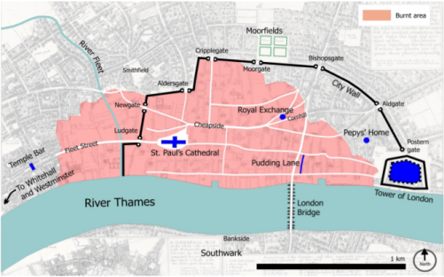
Rotherhithe Primary- Year 2 – Great fire of London
What I should already know
Life for Britain's at the seaside in the past How people lived over 100 years ago.
What will I learn in this unit?
To know what London was like in the 17th Century. To understand how The Great Fire of London started in 1666. To understand why the fire spread over London. To understand how the fire was extinguished. To know the impact of the Great Fire of London. To understand the significance of Samuel Pepys’ diary.
What I will learn next
Local history
map of the fire
Key Words
diary | A book in which a person writes an account of events and experiences.
fire hooks | Giant hooks used to pull houses down.
fire break | A gap that stops a fire spreading nearby buildings.
leather bucket | Leather is a material and was what buckets were made from before plastic was invented.
Pudding Lane | The road that the bakery where the fire started was on.
Samuel Pepys | Write about the event in his diary and reported to the King.
St Pauls Cathedral | A very large church in London.
The River Thames | The river that runs through London which many people escaped to
Timeline
Sunday 2nd September 1666 | Monday 3rd September 1666 | Tuesday 4th September 1666 | Wednesday 5th September 1666 | Thursday 6th September 1666
1am – The fire begins. 3am – The Lord Mayor goes to look at the fire, but decides it is not too bad, so goes back to bed. 7am – The fire has spread rapidly. 11am – The Mayor orders the pulling down of houses. 3pm – The King sails down the River Thames to observe the fire. | The government order fire posts to be set up Midday – The fire can be seen 60 miles away in Oxford. Half the city has been destroyed. | The fire reaches its peak. A number of prisons and St Paul’s Cathedral are destroyed. The fire narrowly misses the Tower of London. 11pm – The wind begins to die down. | The wind changes direction, blowing the fire towards the River Thames. Most of the remaining fires have been put out. | The final fires are extinguished.

