Slide 1

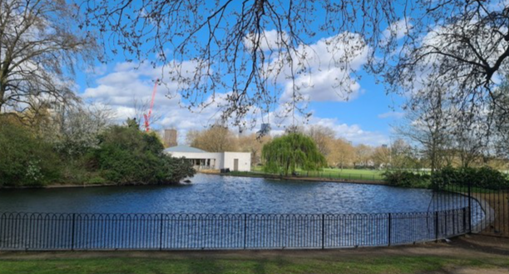
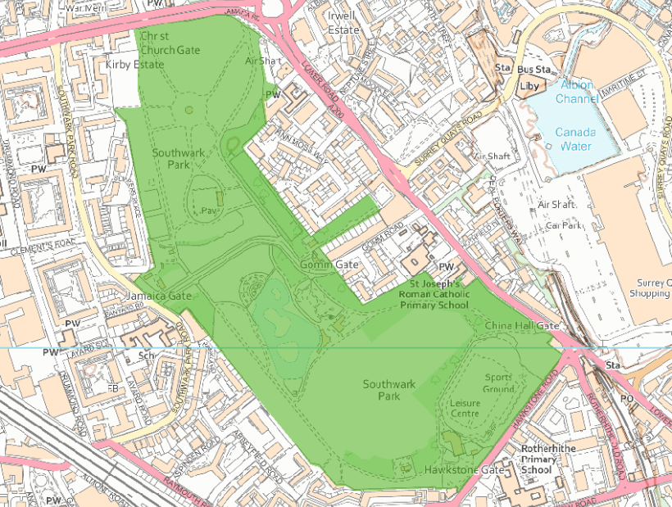
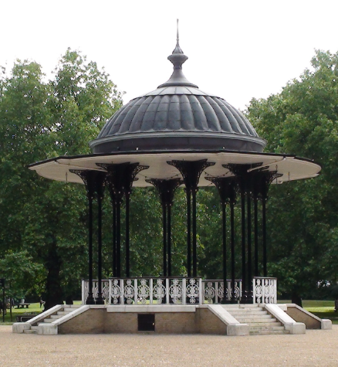
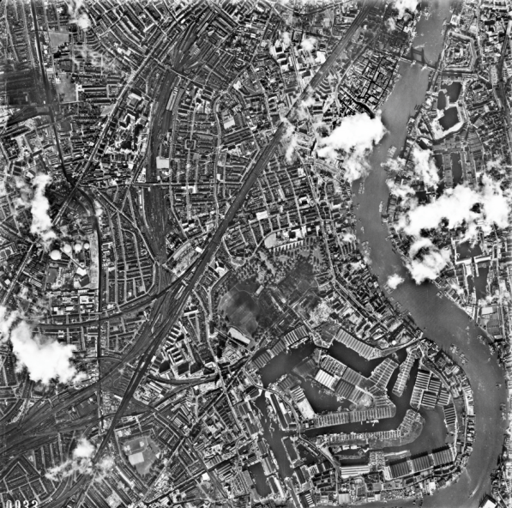
Rotherhithe Primary- Year 1 – Local history- Southwark Park
What I should already know
Local history- my local area of Rotherhithe
What will I learn in this unit?
To identify similarities and differences between ways of life in Rotherhithe Compare an aerial photograph from the past to a modern day map To create a piece of art based on the heritage site, Southwark Park
What I will learn next
Local history-St Mary’s church
Southwark Park
Key Words
Aerial photograph | A photograph taken from an aircraft or satellite in flight
heritage site | A building or an area important to a countries heritage
Ordinance survey map | A detailed map
Rotherhithe | A place part of the borough of Southwark
ordinance survey map
aerial photograph of Rotherhithe 1962
Southwark Park Grade: II (List Entry Number: 1000838)

