Slide 1
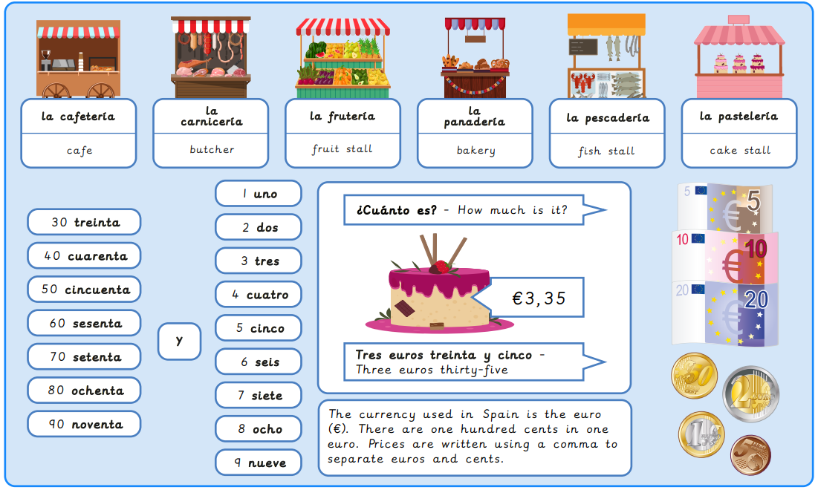
Year 6, – Shopping in Spain
What I will learn now:
To explore pronunciation rules using vocabulary for food and market stalls. To describe the location of a market stall using prepositions. To express different amounts of money using numbers up to 100. To express how much/how many using food vocabulary. To adapt and use language structures for a shopping game. To create and use dialogue for a shopping transaction.

Slide 2
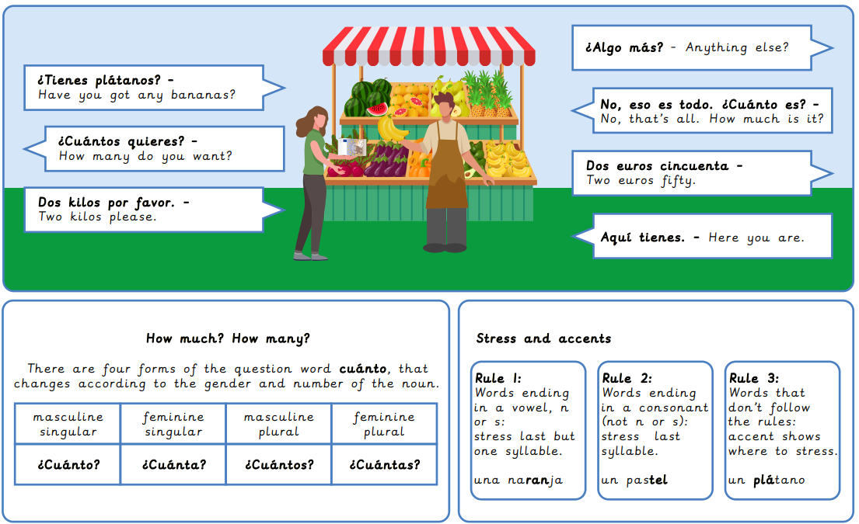
What I will learn next:
To identify the meaning of new words. To describe everyday objects. To give reasons for actions using extended sentences. To write a short descriptive text. To identify and use key information in a text. To present information orally.

Slide 3
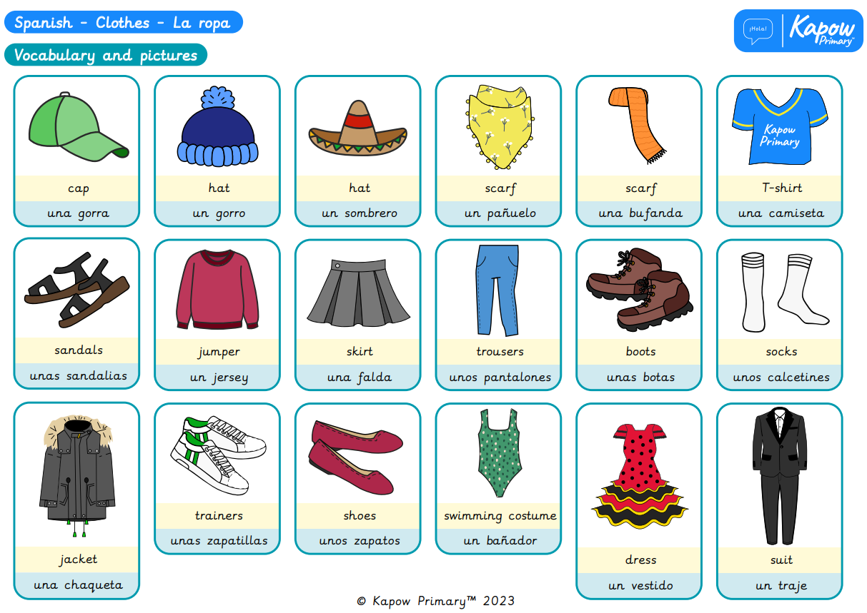
Year 6, Autumn 1 – Clothes in Spanish
What I will learn now:
To identify the meaning of new words. To describe everyday objects. To give reasons for actions using extended sentences. To write a short descriptive text. To identify and use key information in a text. To present information orally.

Slide 4
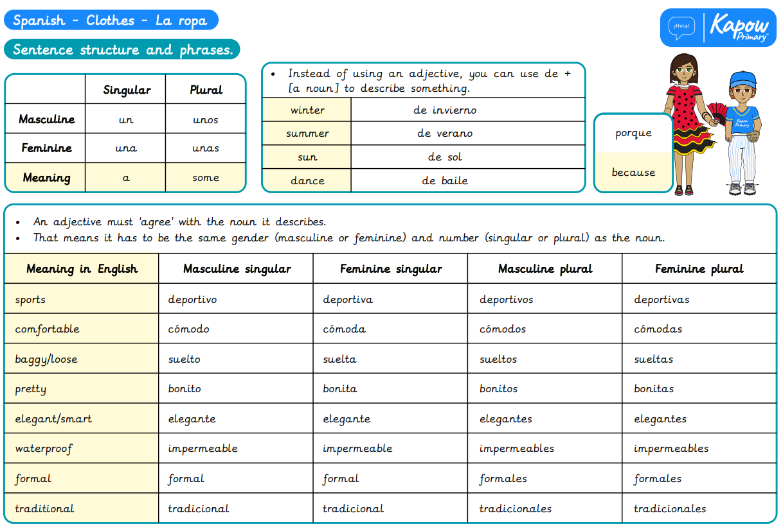
What I will learn next:
To express likes and dislikes in a conversation. To give opinions in a conversation. To make comparisons. To seek and give information in a conversation. To engage in conversations expressing preferences. To use familiar phrases and vocabulary in writing.

Slide 5
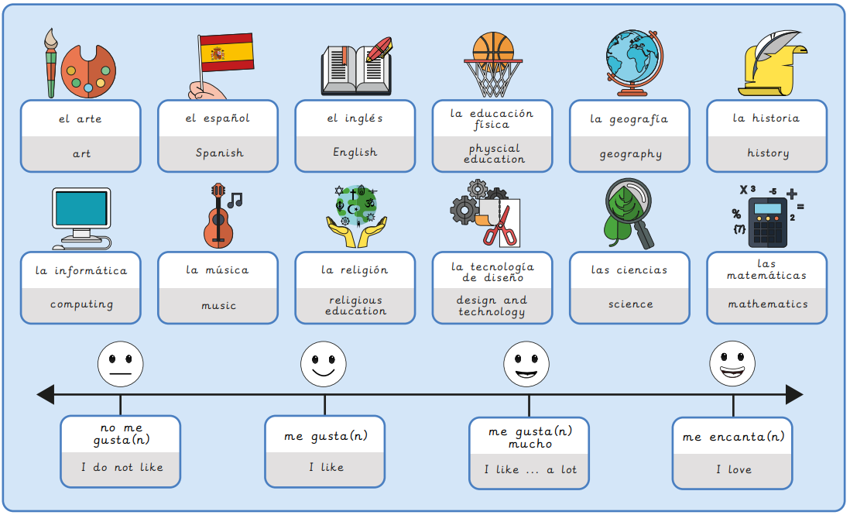
Year 6, Spring 1 – School life in Spanish
What I will learn now:
To express likes and dislikes in a conversation. To give opinions in a conversation. To make comparisons. To seek and give information in a conversation. To engage in conversations expressing preferences. To use familiar phrases and vocabulary in writing.

Slide 6
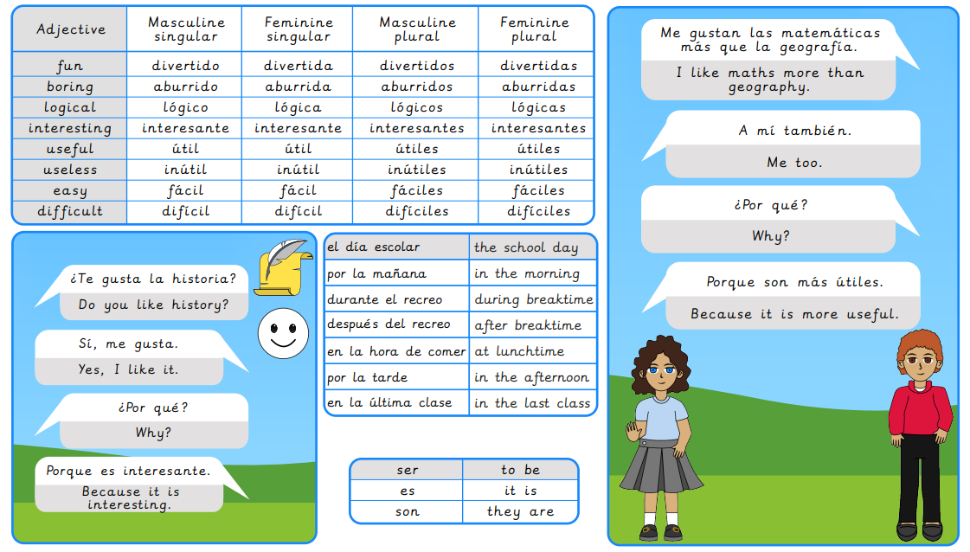
What I will learn next:
To interpret and translate opinions about household tasks. To find and categorise vocabulary from descriptions of different robots. To describe a robot’s purpose using verbs and adverbs. To write a descriptive text about an invented robot. To describe the functions of a robot using a persuasive advert. To evaluate and justify a choice of robot.

Slide 7
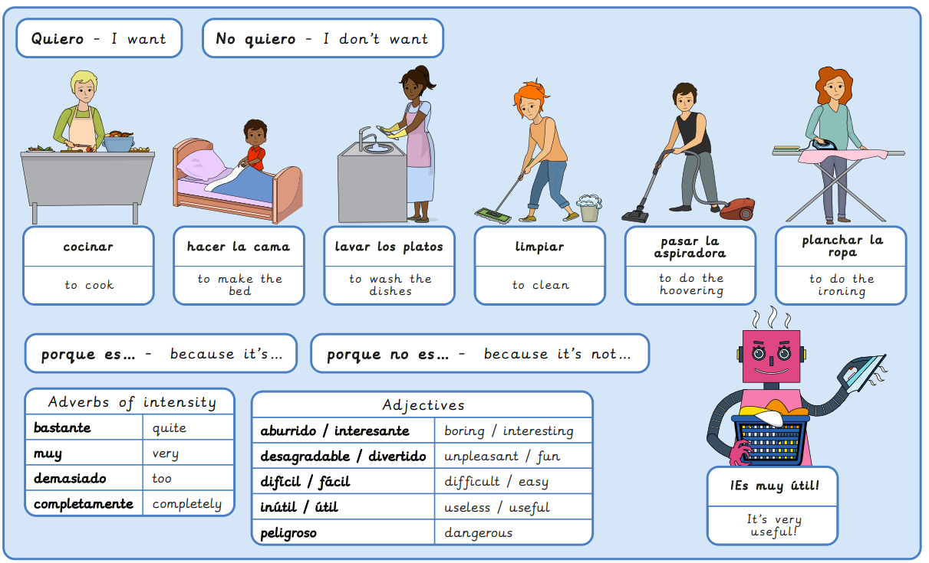
Year 6, Spring 2 – Household tasks in Spanish
What I will learn now:
To interpret and translate opinions about household tasks. To find and categorise vocabulary from descriptions of different robots. To describe a robot’s purpose using verbs and adverbs. To write a descriptive text about an invented robot. To describe the functions of a robot using a persuasive advert. To evaluate and justify a choice of robot.

Slide 8
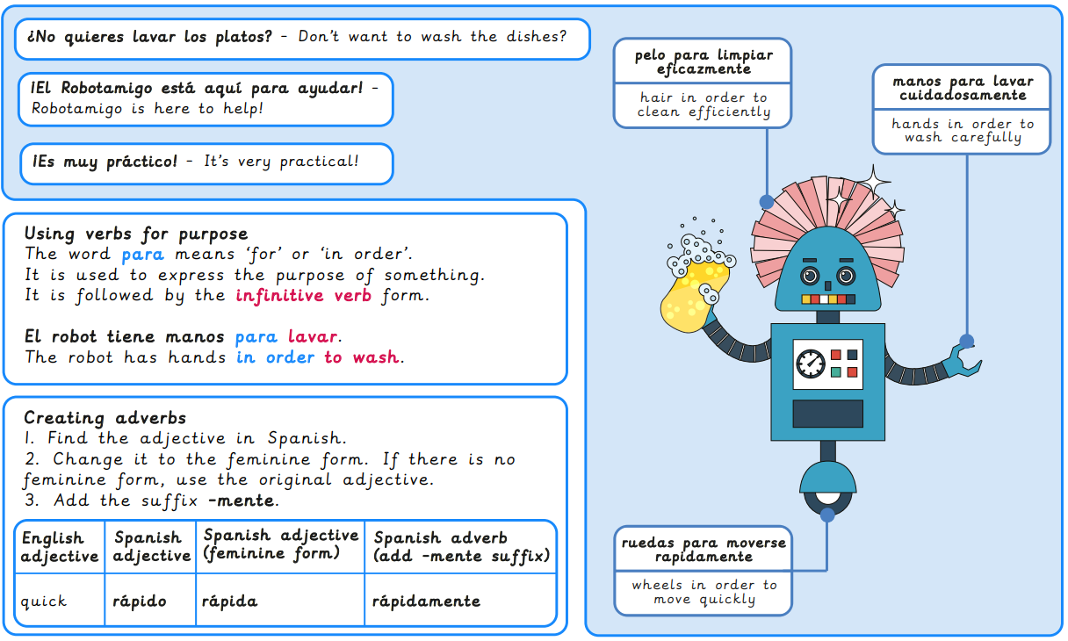
What I will learn next:
To read a cartoon to identify how verb endings change. To report about seasonal activities using regular verb endings. To answer questions about free time in Spain using appropriate verb endings. To translate travel reports from English to Spanish. To construct a descriptive travel blog using a range of verbs in the present tense. To compare and respond to different travel blogs to express preference.

Slide 9
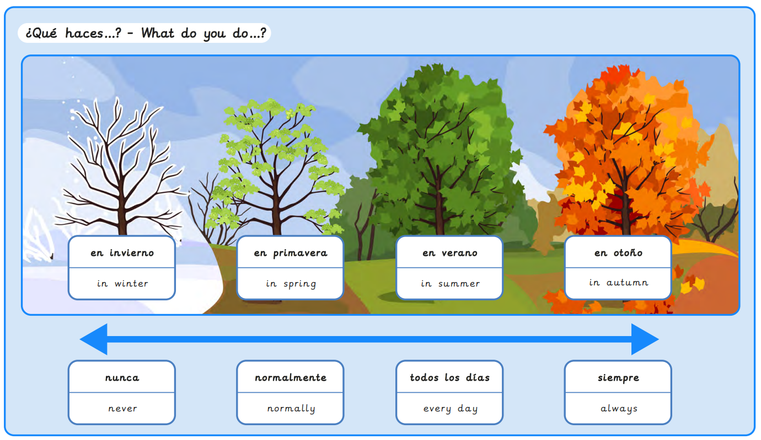
Year 6, Summer 1 – Free time in Spain
What I will learn now:
To read a cartoon to identify how verb endings change. To report about seasonal activities using regular verb endings. To answer questions about free time in Spain using appropriate verb endings. To translate travel reports from English to Spanish. To construct a descriptive travel blog using a range of verbs in the present tense. To compare and respond to different travel blogs to express preference.

Slide 10
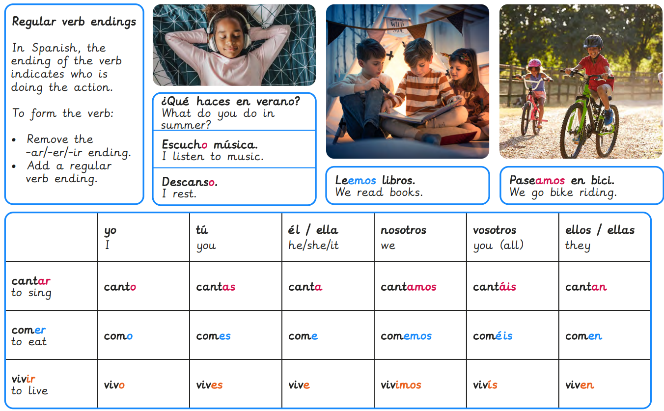
What I will learn next:
To translate sentences to find out about Ancient Maya cities. To describe the Ancient Maya people. To deduce and follow simple directions to different Maya city landmarks. To interpret directional language to navigate around a Maya city. To create written clues for a treasure hunt around an Ancient Maya city. To evaluate the use of language used in giving directions.

Slide 11
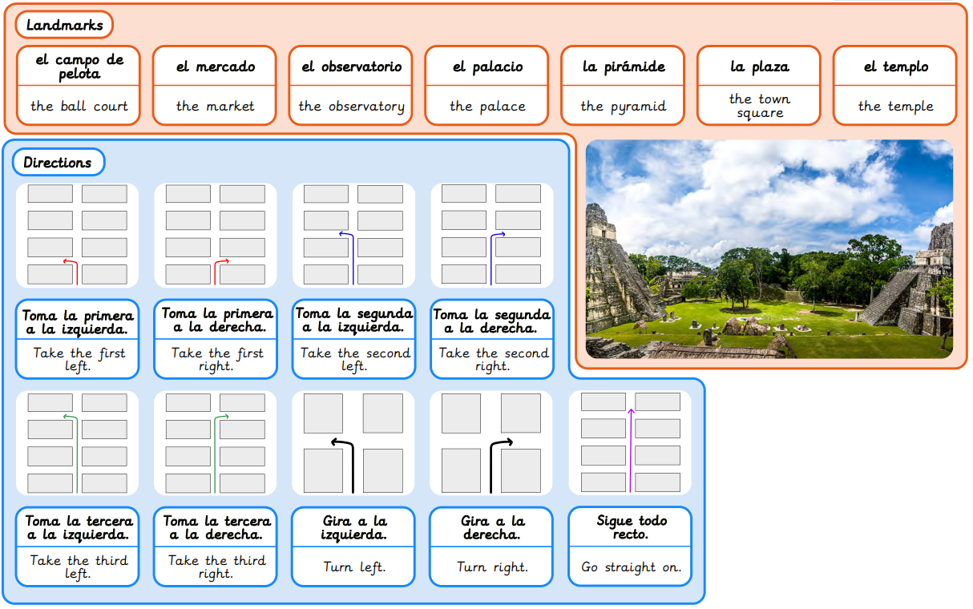
Year 6, Summer 2 – Maya city treasure hunt
What I will learn now:
To translate sentences to find out about Ancient Maya cities. To describe the Ancient Maya people. To deduce and follow simple directions to different Maya city landmarks. To interpret directional language to navigate around a Maya city. To create written clues for a treasure hunt around an Ancient Maya city. To evaluate the use of language used in giving directions.

Slide 12
