Slide 1
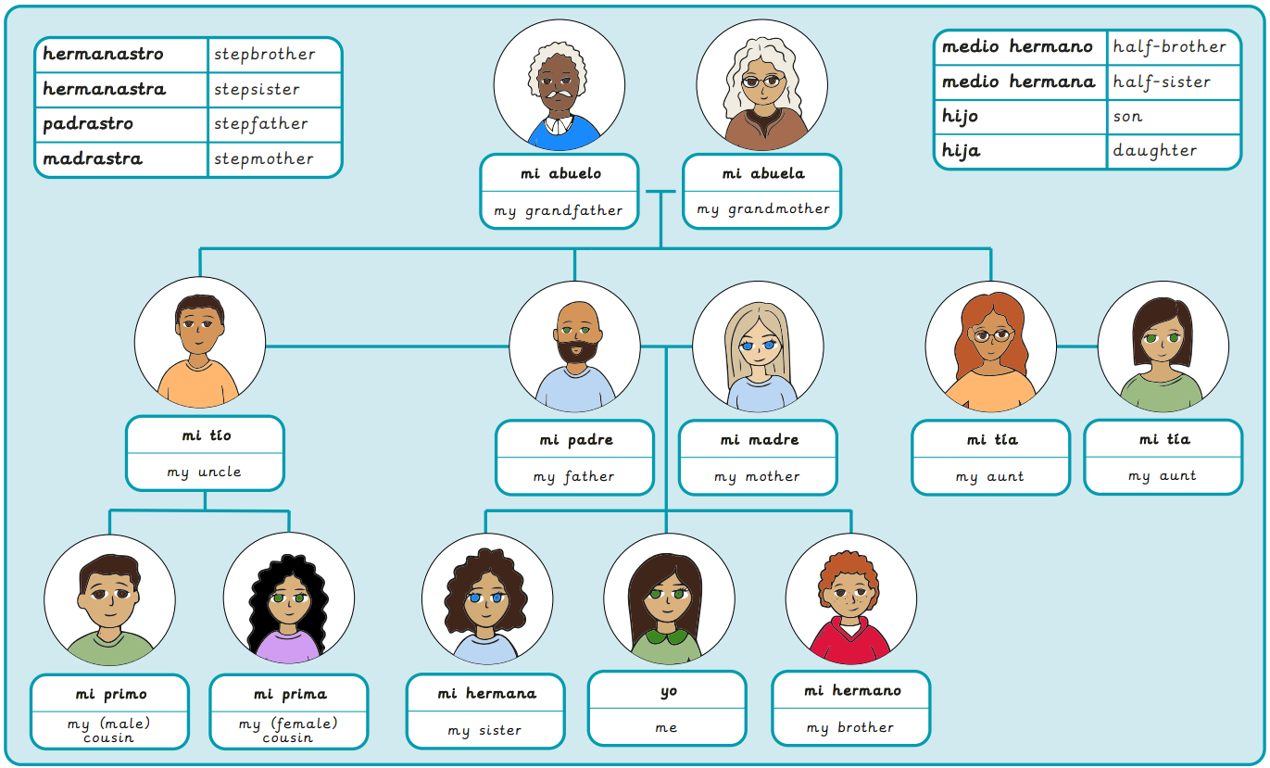
Year 5, Autumn 1 – Describing family and friends in Spanish
What I will learn now:
To give and receive information in a conversation. To describe the relationship between family members. To identify the third person singular of some common verbs. To describe what someone likes to do. To create a description giving basic information about a person. To identify key information in descriptive sentences.

Slide 2
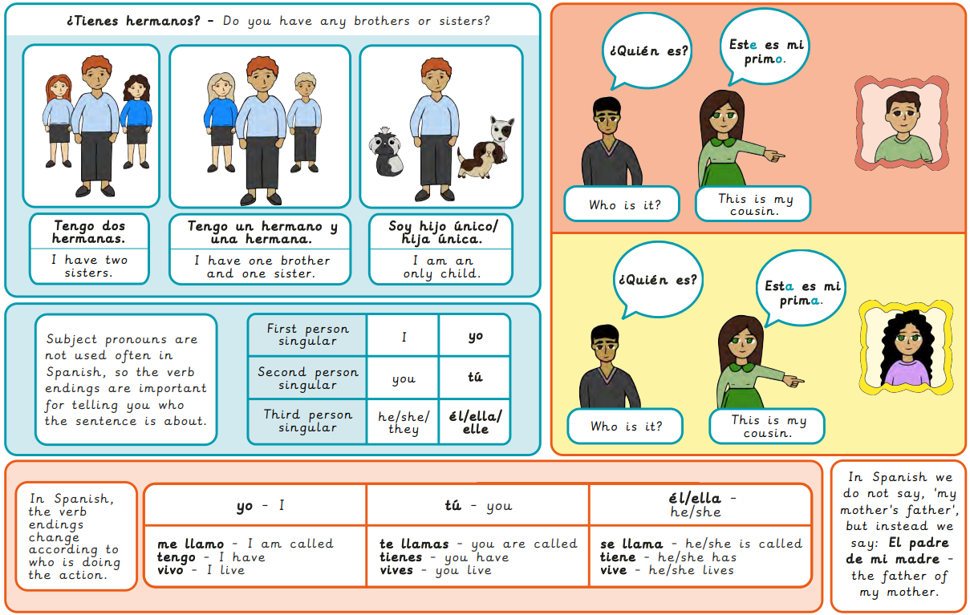
What I will learn next:
To determine the meaning of new vocabulary. To describe a person’s eyes and hair. To expand my vocabulary of facial features. To describe plural nouns. To describe portraits orally. To describe a portrait in detail.

Slide 3
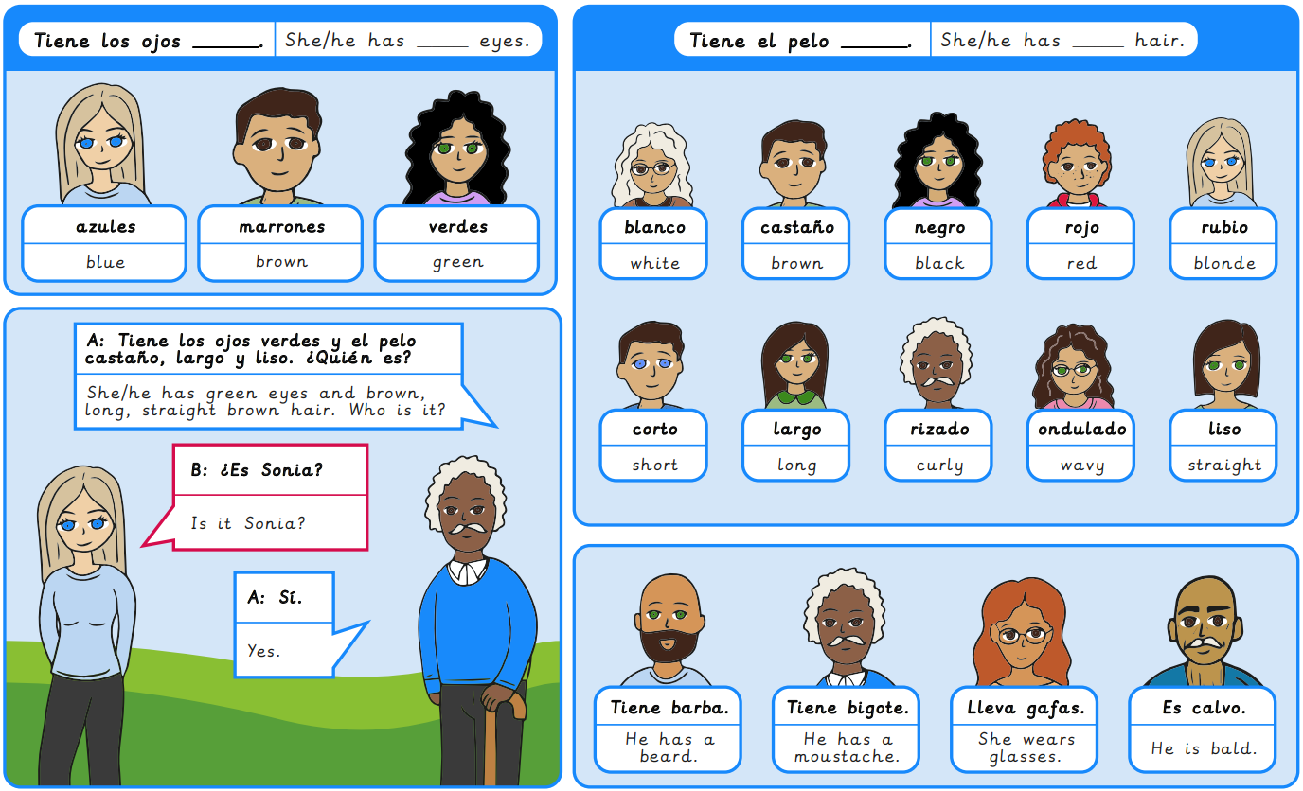
Year 5, Autumn 2 – Spanish portraits
What I will learn now:
To determine the meaning of new vocabulary. To describe a person’s eyes and hair. To expand my vocabulary of facial features. To describe plural nouns. To describe portraits orally. To describe a portrait in detail.

Slide 4
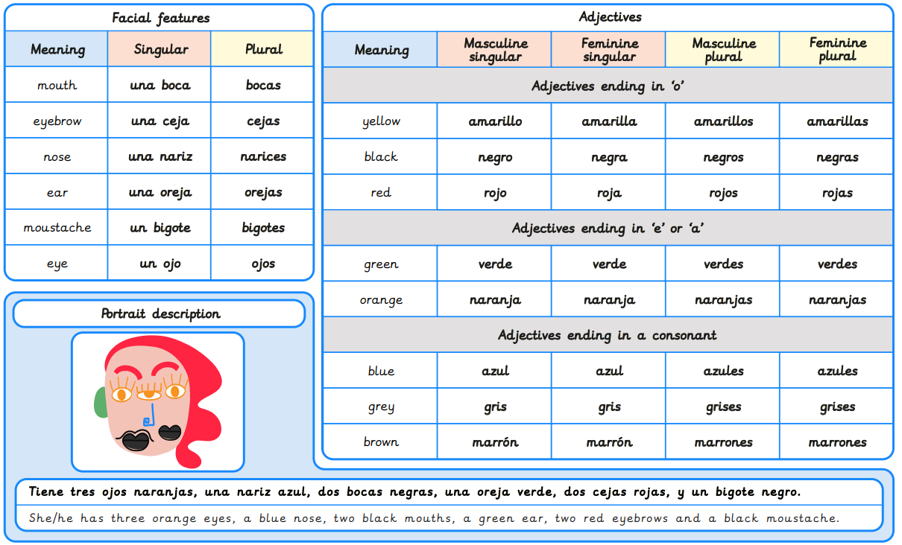
What I will learn next:
To apply knowledge of verbs when asking and answering questions about sport. To recognise and use imperative verbs to give game instructions. To translate written instructions for the Maya ball game. To use instructional and motivational language when playing the Maya ball game. To identify and classify keywords from instructions for games. To create written instructions for an original ball game.

Slide 5
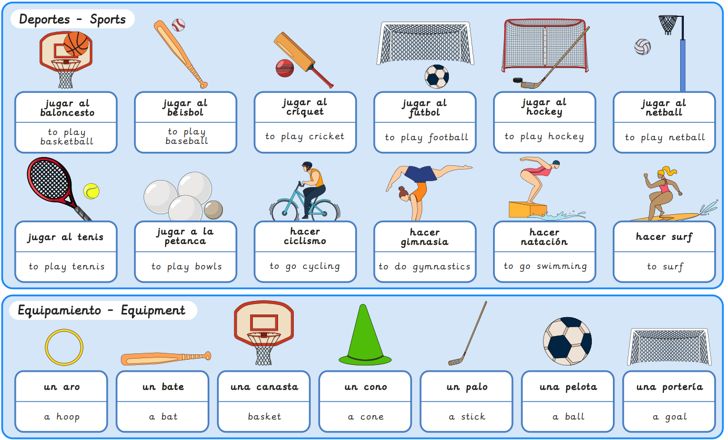
Year 5, Spring 1 – Sports in Spanish
What I will learn now:
To apply knowledge of verbs when asking and answering questions about sport. To recognise and use imperative verbs to give game instructions. To translate written instructions for the Maya ball game. To use instructional and motivational language when playing the Maya ball game. To identify and classify keywords from instructions for games. To create written instructions for an original ball game.

Slide 6
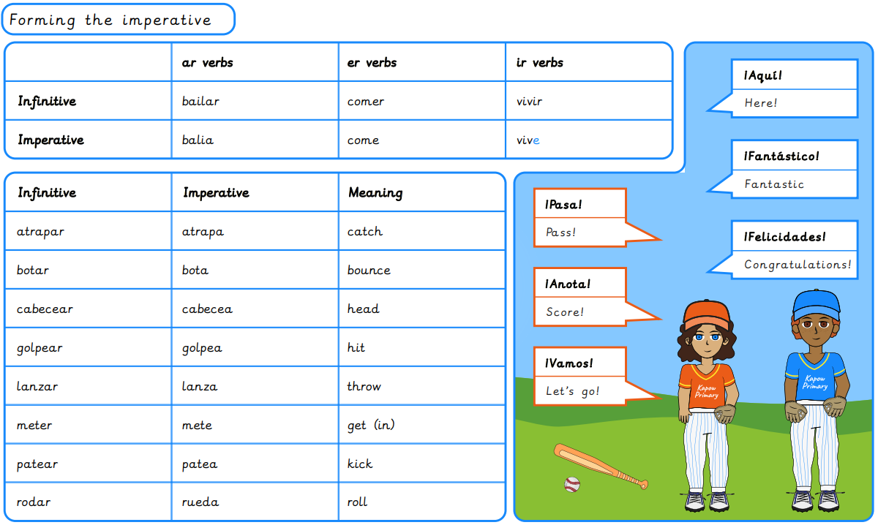
What I will learn next:
To express likes and dislikes about food. To ask and answer questions about food preferences. To listen to spoken language and identify food preferences. To deduce a person’s pizza choice by finding out their food preferences. To conduct an interview about food preferences. To develop questioning skills to find out about food preferences.

Slide 7
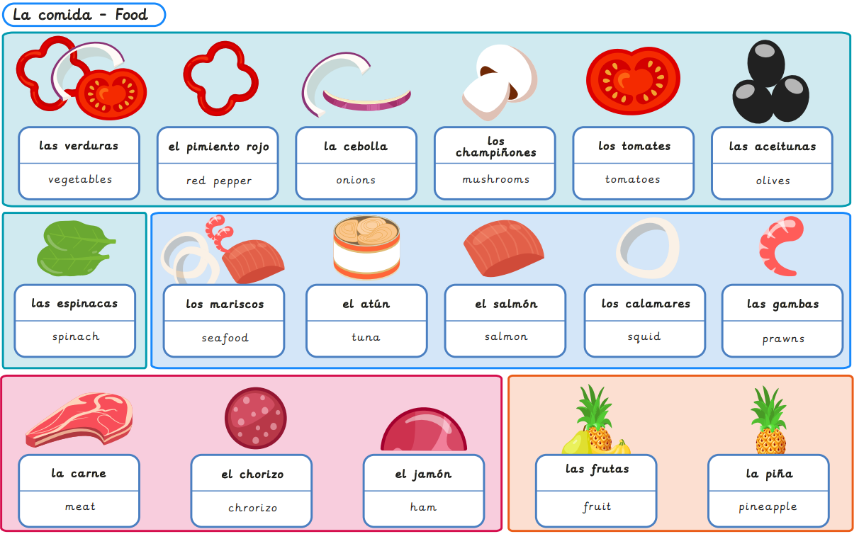
Year 5, Spring 2 – Spanish food and drink
What I will learn now:
To express likes and dislikes about food. To ask and answer questions about food preferences. To listen to spoken language and identify food preferences. To deduce a person’s pizza choice by finding out their food preferences. To conduct an interview about food preferences. To develop questioning skills to find out about food preferences.

Slide 8
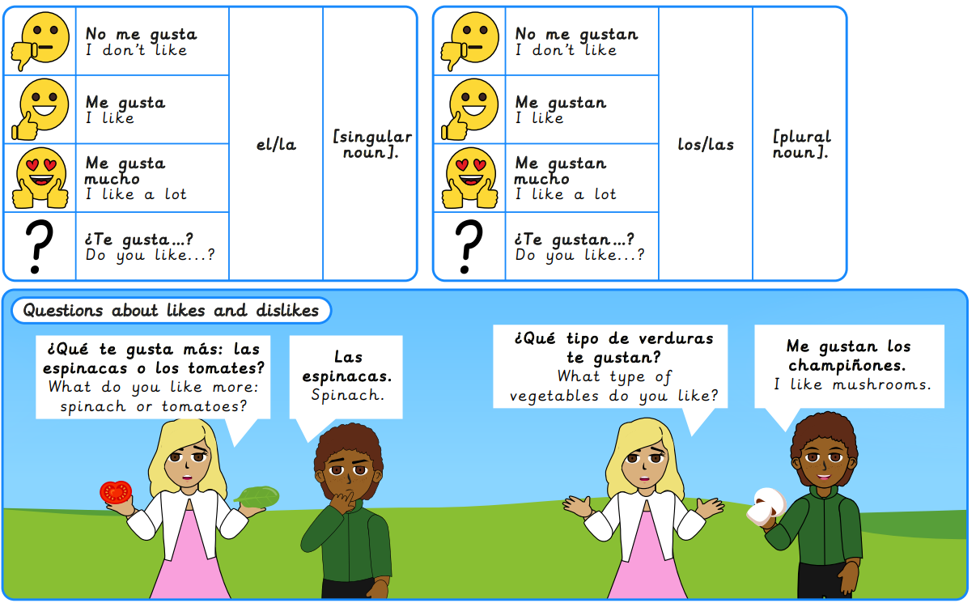
What I will learn next:
To describe the location of some Spanish cities. To use a range of strategies to widen my vocabulary for describing places. To construct sentences describing future plans. To discuss future travel plans. To create a role-play conversation about future travel plans. To perform a role play conversation about future travel plans.

Slide 9
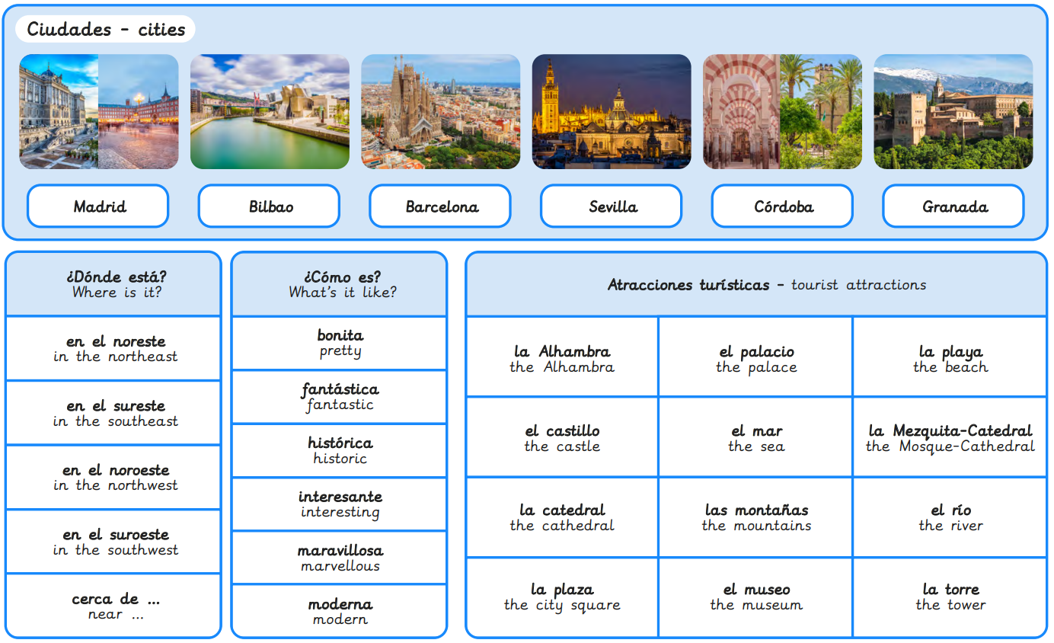
Year 5, Summer 1 – A trip across Spain
What I will learn now:
To describe the location of some Spanish cities. To use a range of strategies to widen my vocabulary for describing places. To construct sentences describing future plans. To discuss future travel plans. To create a role-play conversation about future travel plans. To perform a roleplay conversation about future travel plans.

Slide 10
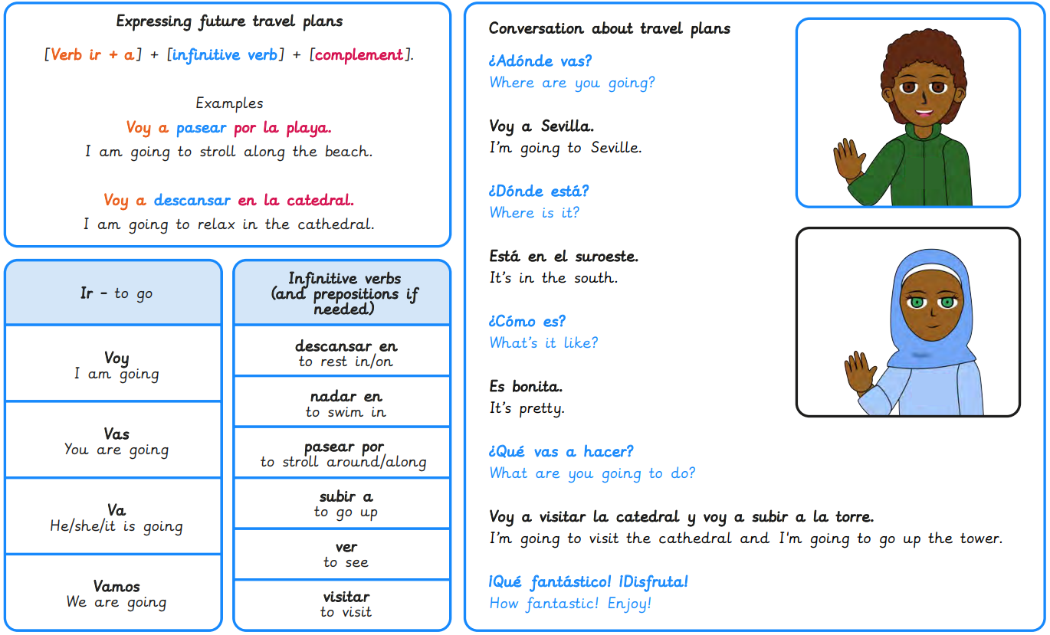
What I will learn next:
To interpret locational language in a description of South America. To construct comparative sentences about South America’s environment. To discuss ways to help protect South America’s environment. To write a set of instructions for creating a healthy world. To script an advert campaigning for action on South America’s environmental problems. To present adverts campaigning for action on South America’s environmental problems.

Slide 11
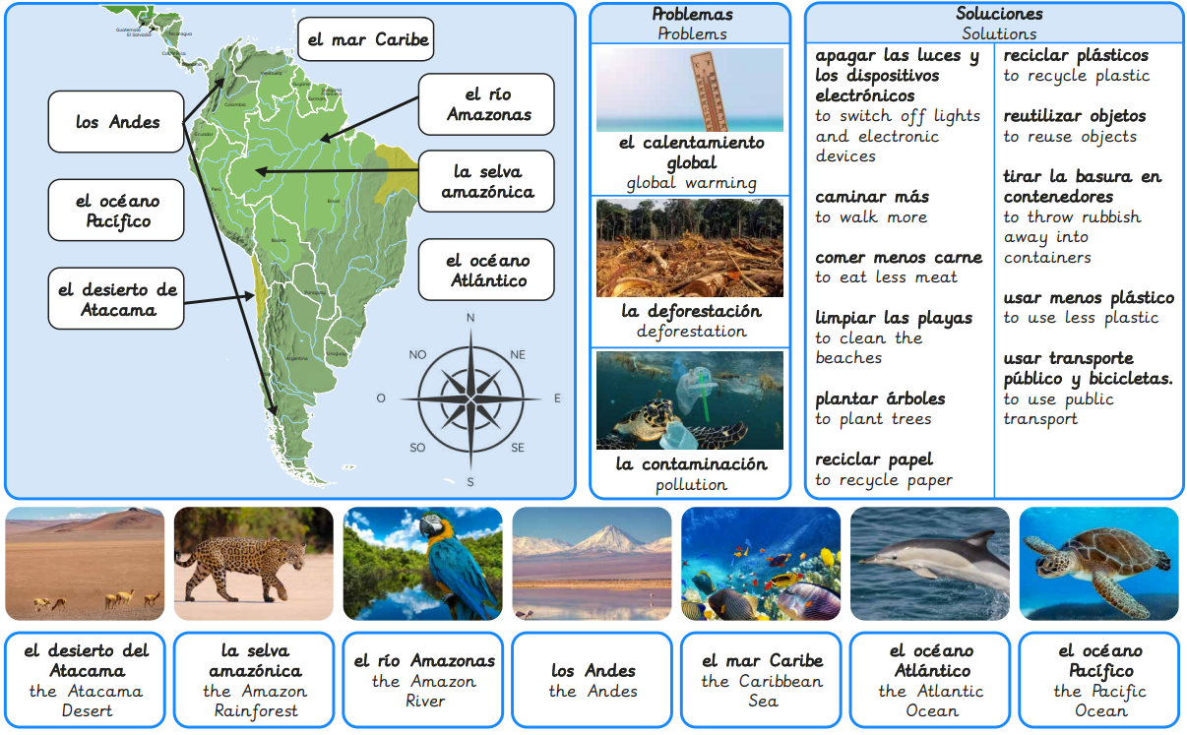
Year 5, Summer 2 – Saving South America
What I will learn now:
To interpret locational language in a description of South America. To construct comparative sentences about South America’s environment. To discuss ways to help protect South America’s environment. To write a set of instructions for creating a healthy world. To script an advert campaigning for action on South America’s environmental problems. To present adverts campaigning for action on South America’s environmental problems.

Slide 12
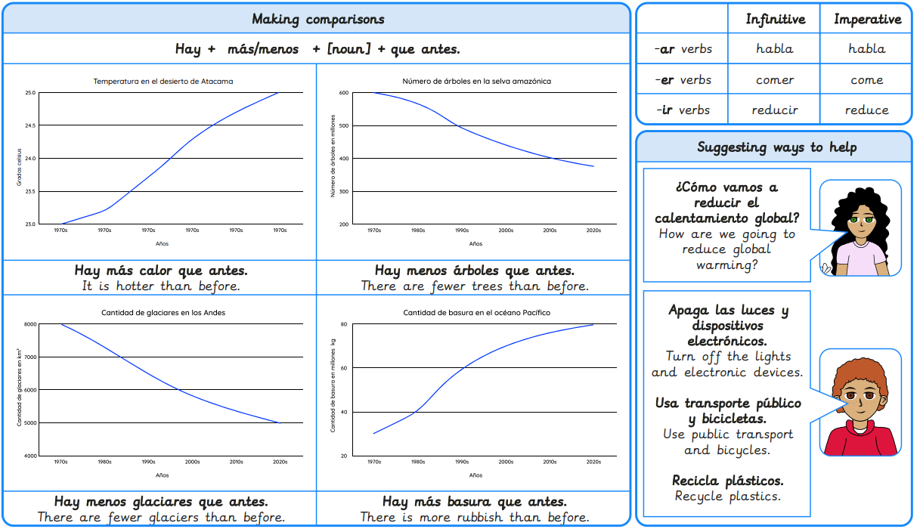
What I will learn next:
To explore pronunciation rules using vocabulary for food and market stalls. To describe the location of a market stall using prepositions. To express different amounts of money using numbers up to 100. To express how much/how many using food vocabulary. To adapt and use language structures for a shopping game. To create and use dialogue for a shopping transaction.

