Slide 1
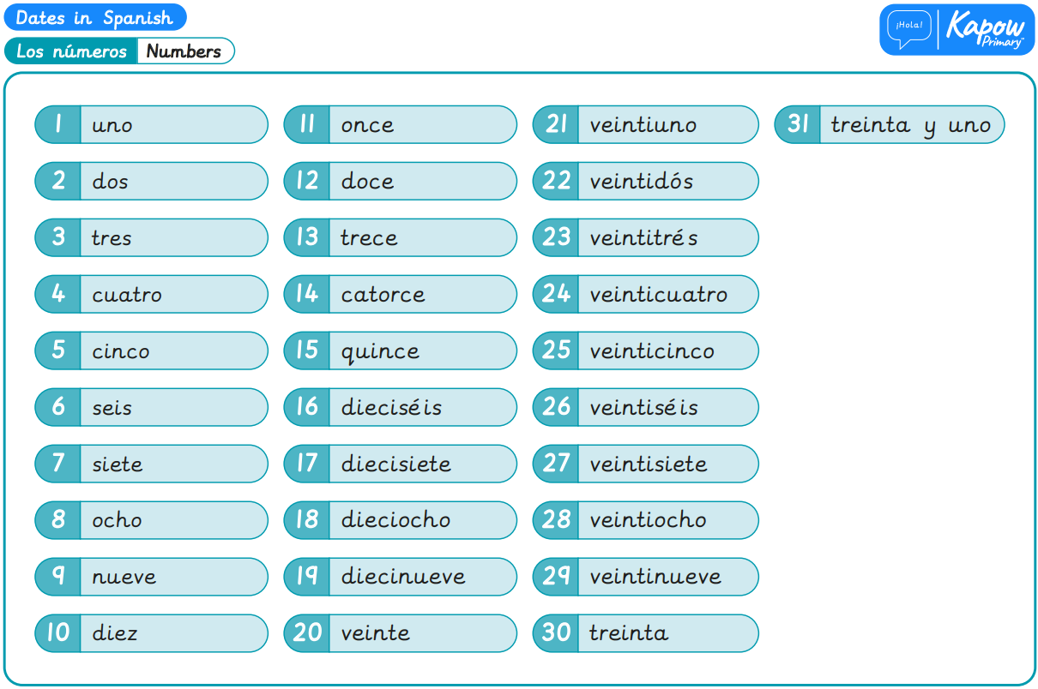
Year 4, Autumn 1 – Dates in Spanish
What I will learn now:
To identify and say the numbers 13 to 31. To ask and answer questions about the months of the year. To identify and say dates. To ask and answer questions about significant dates. To identify and give the dates of specific events. To listen to and understand spoken language.

Slide 2
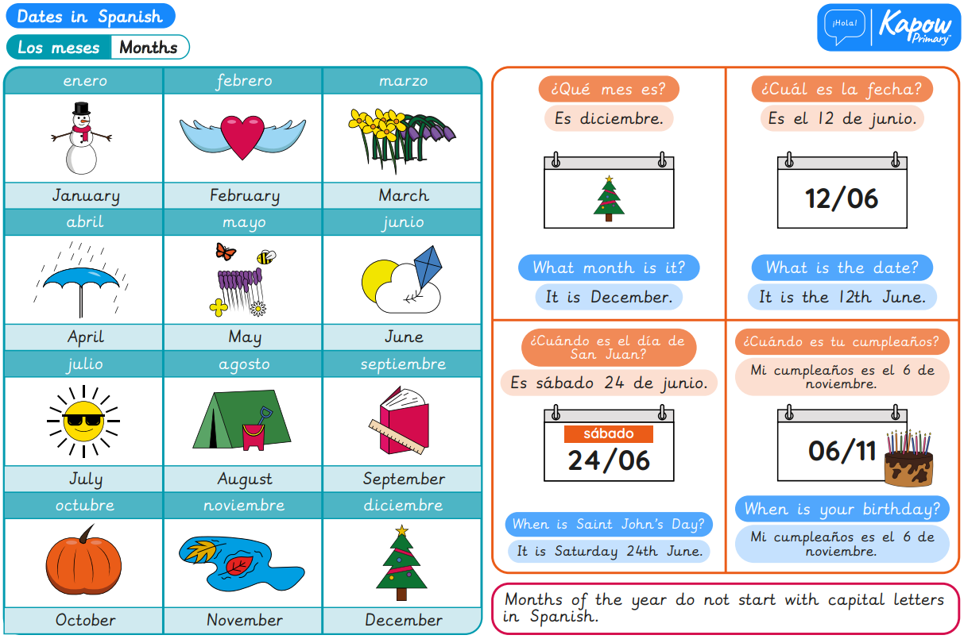
What I will learn next:
To apply new vocabulary to talk about pets. To recognise that an adjective must agree with the noun it describes. To describe an animal’s characteristics. To read and understand a short story. To write a story about pets. To rehearse and perform a short role play.

Slide 3
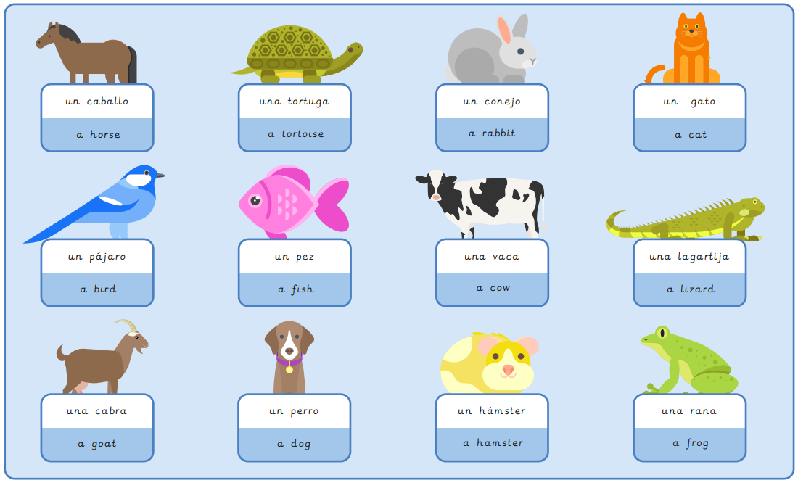
Year 4, Autumn 2 – Pets in Spanish
What I will learn now:
To apply new vocabulary to talk about pets. To recognise that an adjective must agree with the noun it describes. To describe an animal’s characteristics. To read and understand a short story. To write a story about pets. To rehearse and perform a short role play.

Slide 4
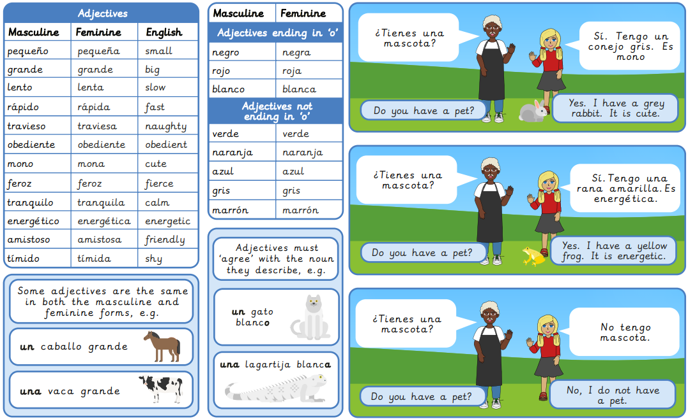
What I will learn next:
To apply comprehension strategies and discover the meaning of new words. To make polite requests about what I want to eat and drink. To identify conversational language. To engage in conversations that involve making requests. To write a role play script for a conversation. To perform, evaluate and improve a role play.

Slide 5
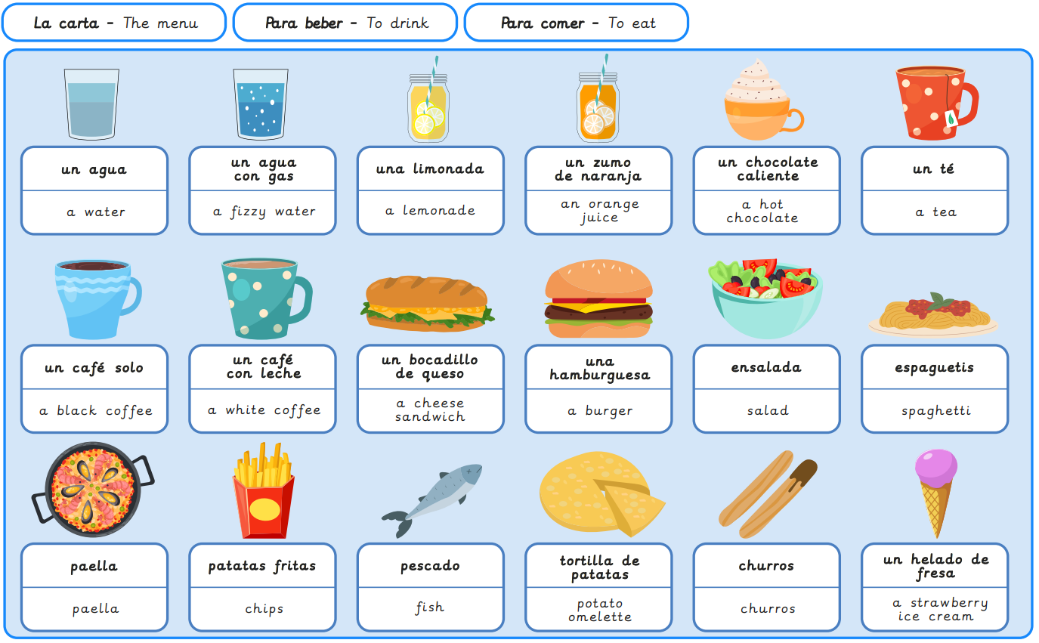
Year 4, Spring 1 – In a Spanish café
What I will learn now:
To apply comprehension strategies and discover the meaning of new words. To make polite requests about what I want to eat and drink. To identify conversational language. To engage in conversations that involve making requests. To write a role play script for a conversation. To perform, evaluate and improve a role play.

Slide 6
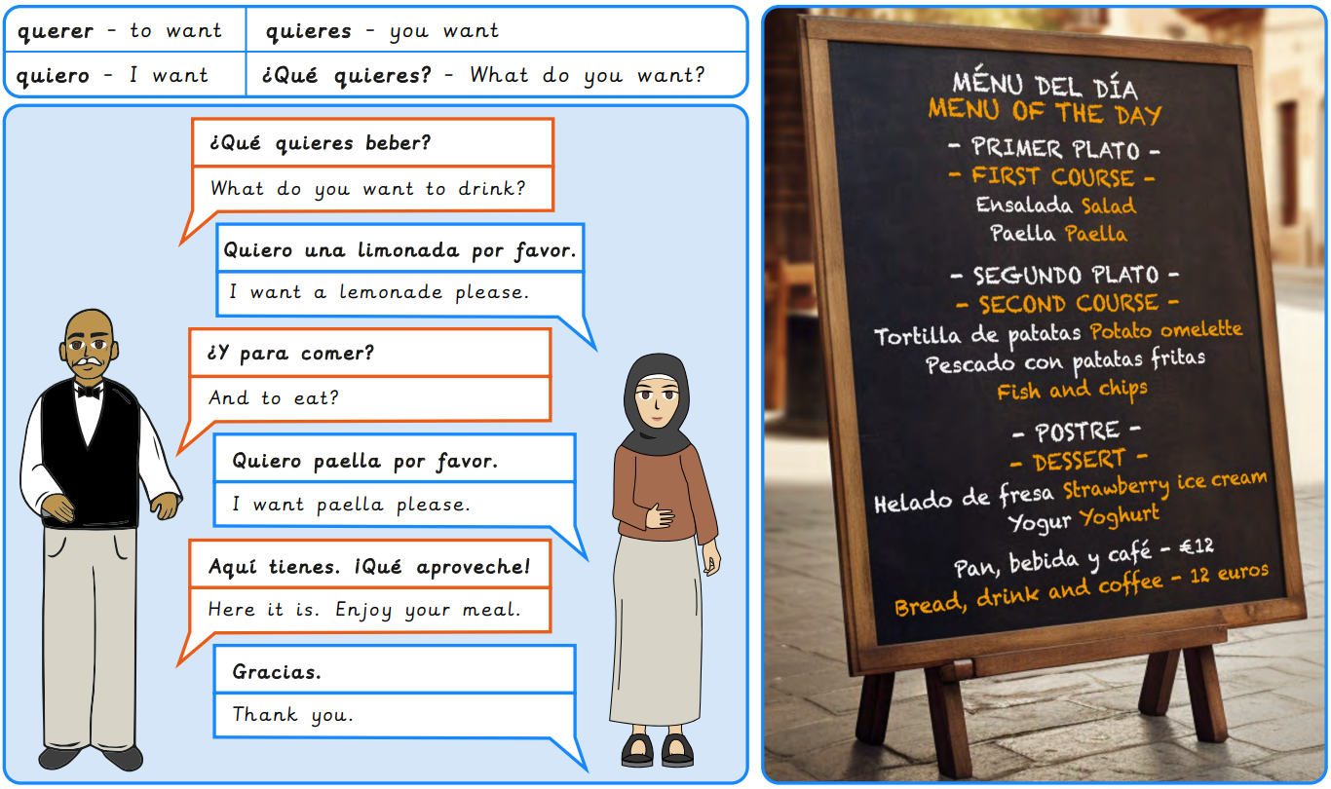
What I will learn next:
To identify the meaning of vocabulary related to important Spanish festivals. To use a bilingual dictionary to look up the meaning of new verbs. To apply new and familiar vocabulary to express what I like and dislike to do. To identify people’s likes and dislikes during a festival. To create phrases describing actions in detail. To describe likes and dislikes at specific celebrations.

Slide 7
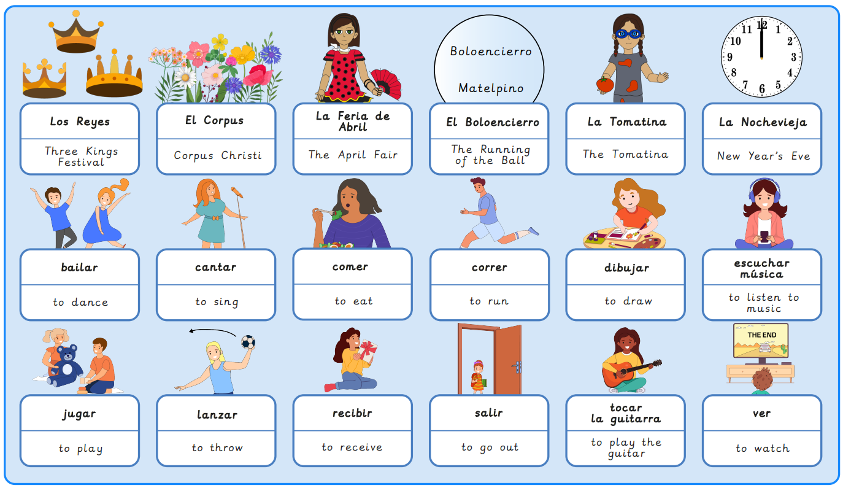
Year 4, Spring 2 – Spanish Celebrations
What I will learn now:
To identify the meaning of vocabulary related to important Spanish festivals. To use a bilingual dictionary to look up the meaning of new verbs. To apply new and familiar vocabulary to express what I like and dislike to do. To identify people’s likes and dislikes during a festival. To create phrases describing actions in detail. To describe likes and dislikes at specific celebrations.

Slide 8
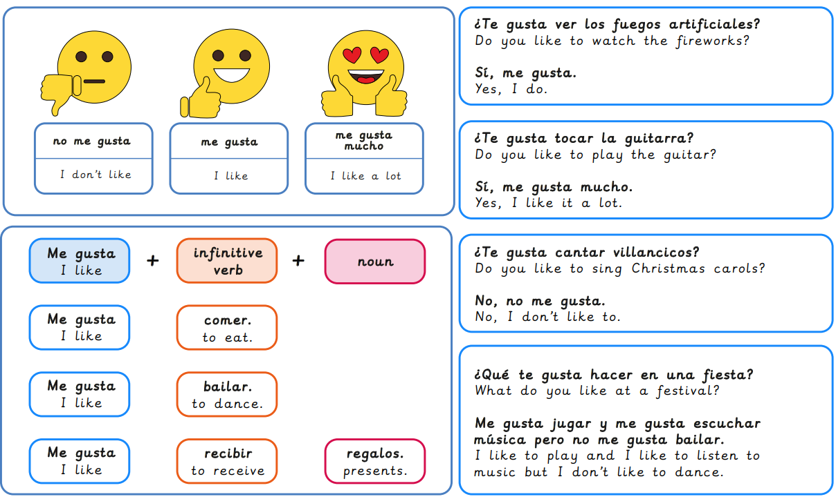
What I will learn next:
To name and identify types of weather in Spanish. To ask and answer questions about the weather. To read and interpret a text about the weather. To follow a spoken and written passage about the weather. To compose a weather forecast script. To perform a weather forecast in Spanish.

Slide 9
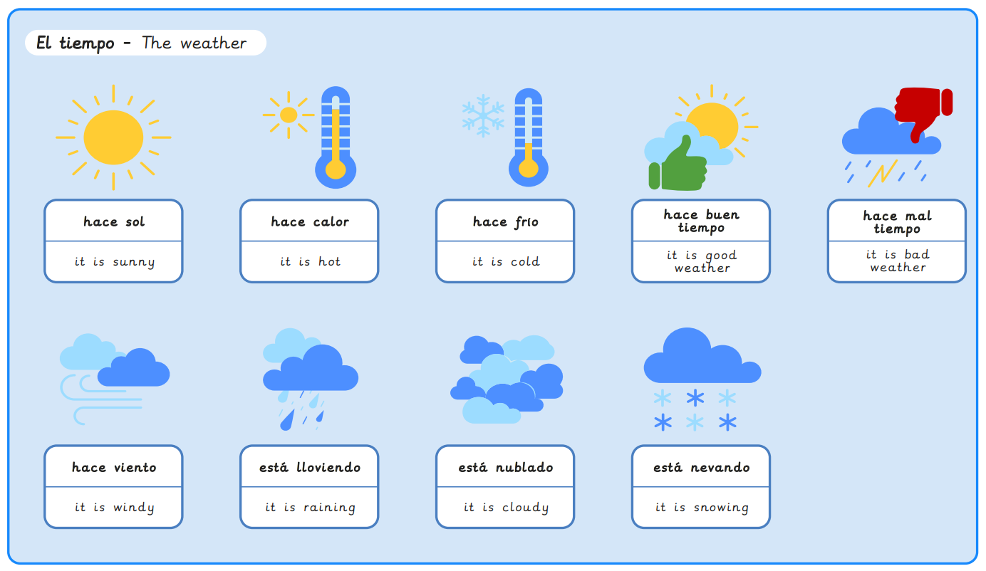
Year 4, Summer 1 – Weather in Spain
What I will learn now:
To name and identify types of weather in Spanish. To ask and answer questions about the weather. To read and interpret a text about the weather. To follow a spoken and written passage about the weather. To compose a weather forecast script. To perform a weather forecast in Spanish.

Slide 10
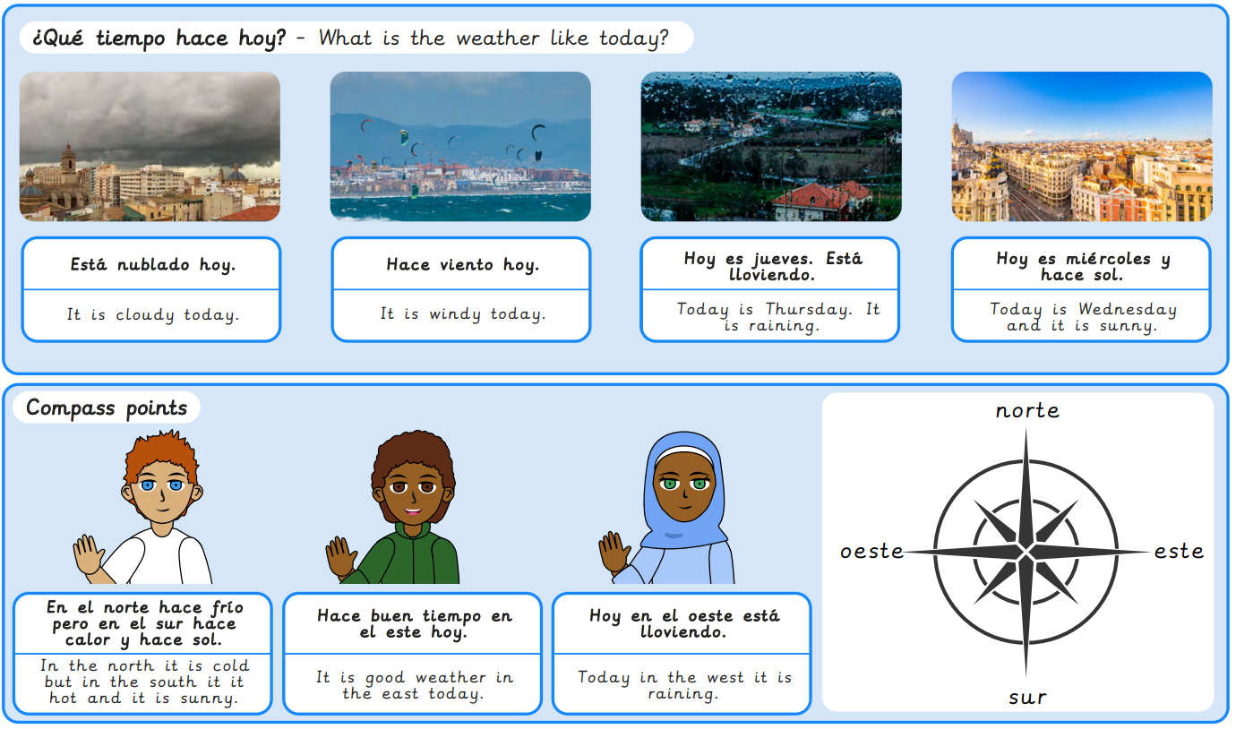
What I will learn next:
To identify and describe the geography of Peru. To use spelling patterns and rhythms to learn and perform rainforest animal names. To write descriptive sentences about rainforest animals. To describe the physical features of some rainforest animals using singular and plural nouns. To describe the features of rainforest creatures and their habitat. To present a podcast to introduce different Amazon animals.

Slide 11
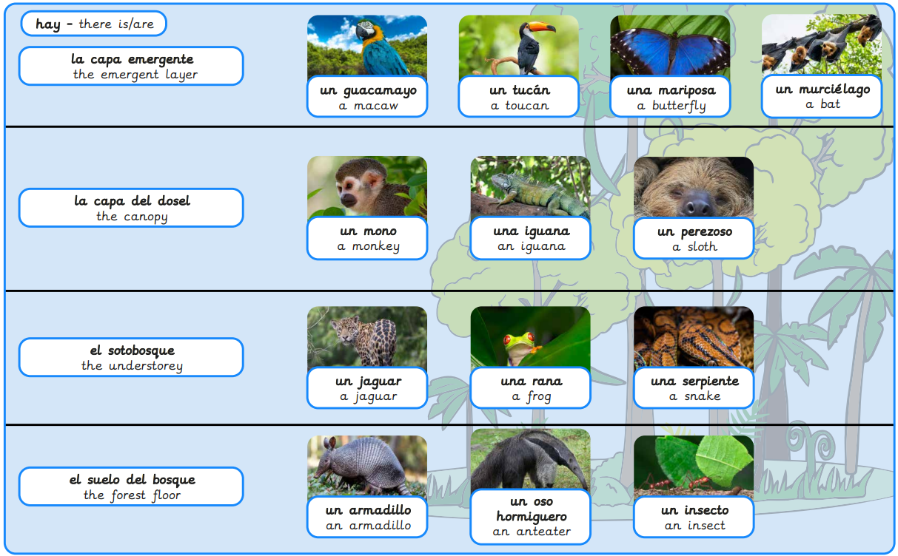
Year 4, Summer 2 – The Amazon rainforest
What I will learn now:
To identify and describe the geography of Peru. To use spelling patterns and rhythms to learn and perform rainforest animal names. To write descriptive sentences about rainforest animals. To describe the physical features of some rainforest animals using singular and plural nouns. To describe the features of rainforest creatures and their habitat. To present a podcast to introduce different Amazon animals.

Slide 12
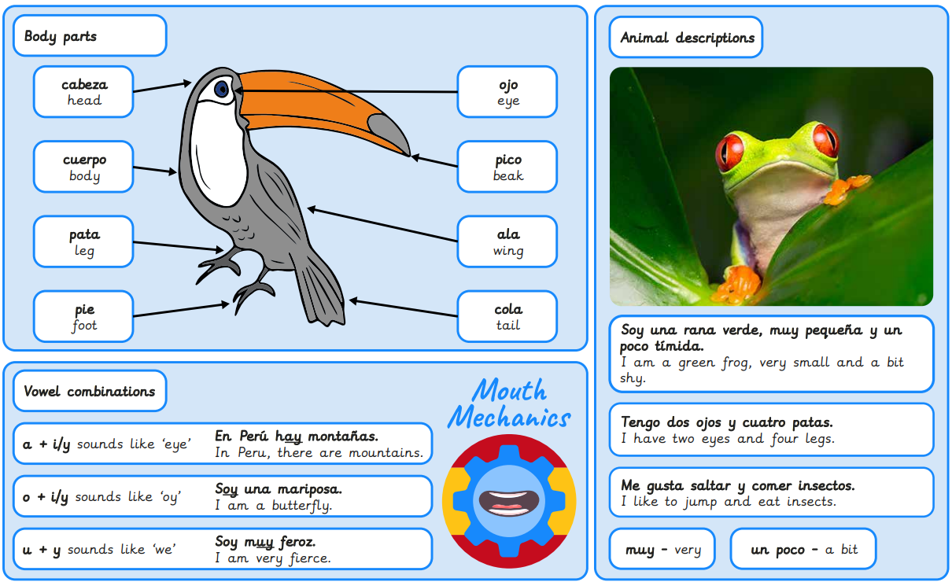
What I will learn next:
To give and receive information in a conversation. To describe the relationship between family members. To identify the third person singular of some common verbs. To describe what someone likes to do. To create a description giving basic information about a person. To identify key information in descriptive sentences.

