Slide 1
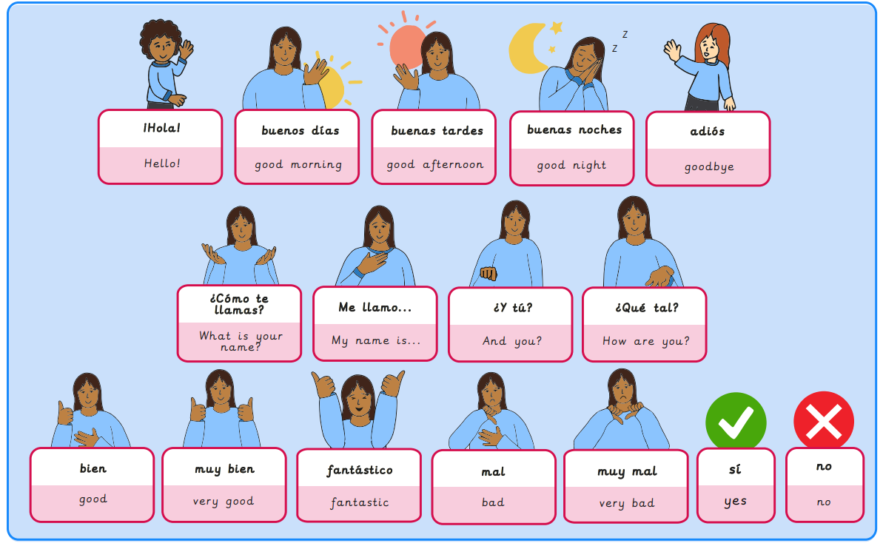
Year 3, Autumn 1 – Spanish greetings with puppets
What I will learn now:
To greet someone and make an introduction in Spanish. To listen and recognise key phonemes ‘o’ and ‘a’. To recognise different greetings in Spanish. To be able to find out how someone is feeling in Spanish. To listen and join in with a Spanish finger puppet rhyme. To apply understanding of greetings conventions in Spanish to perform a rhyme from memory.

Slide 2
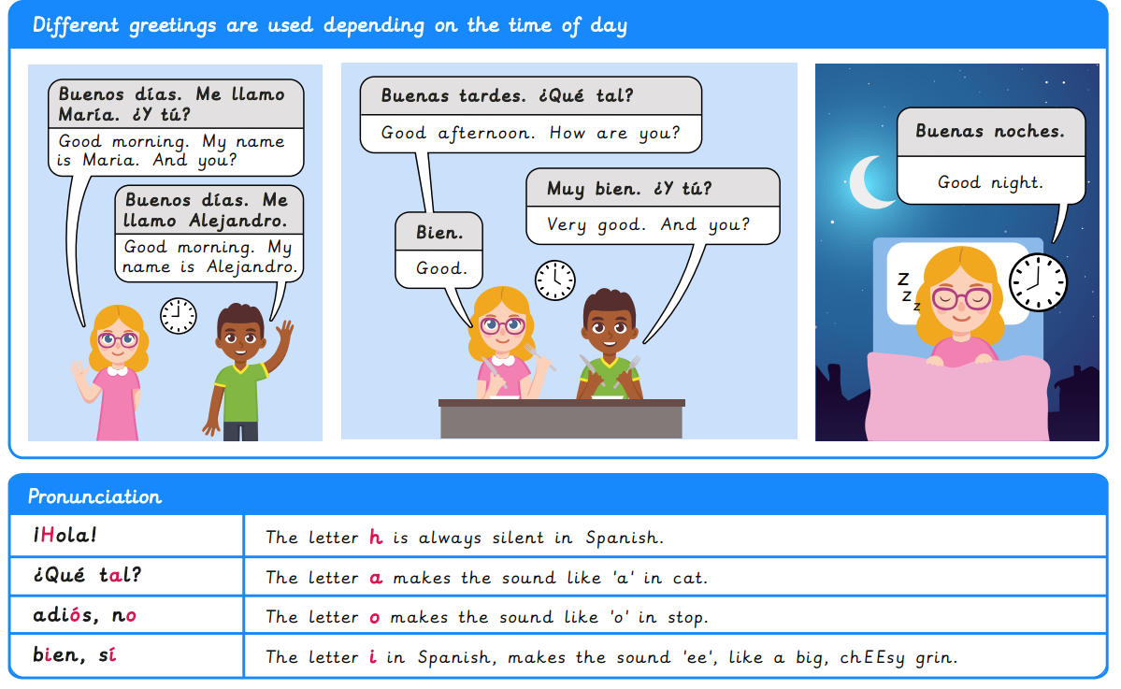
What I will learn next:
To recognise and name some colours in Spanish. To begin to describe shapes using colour adjectives. To create and practise descriptive phrases orally. To read and recognise descriptive phrases in Spanish. To write a design brief using shape and colour vocabulary. To create a short presentation using descriptive phrases.

Slide 3
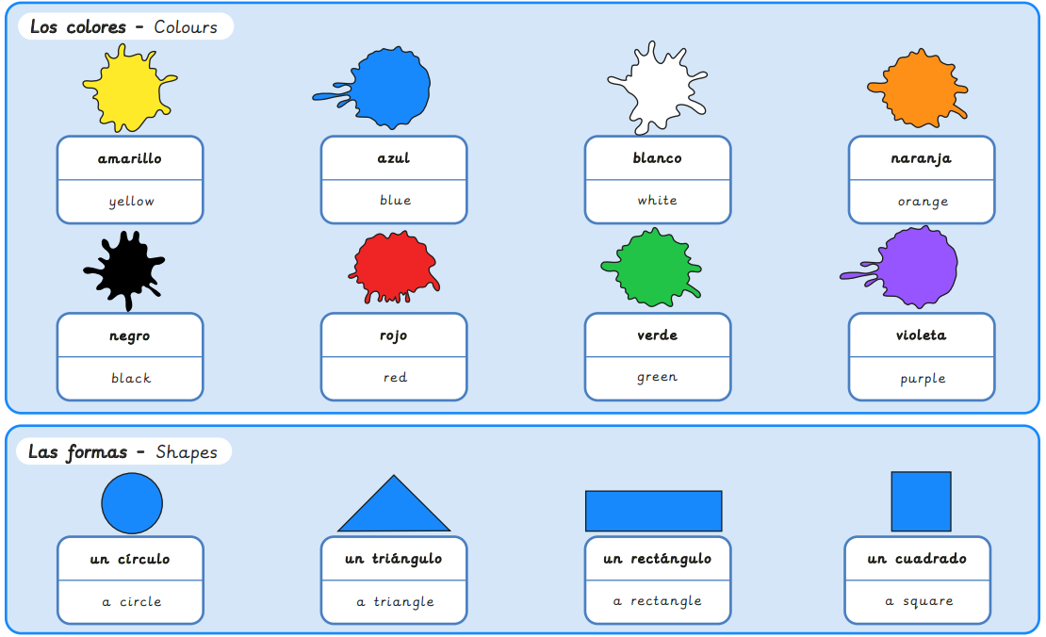
Year 3, Autumn 2 – Shapes and Colours in Spanish
What I will learn now:
To recognise and name some colours in Spanish. To begin to describe shapes using colour adjectives. To create and practise descriptive phrases orally. To read and recognise descriptive phrases in Spanish. To write a design brief using shape and colour vocabulary. To create a short presentation using descriptive phrases.

Slide 4
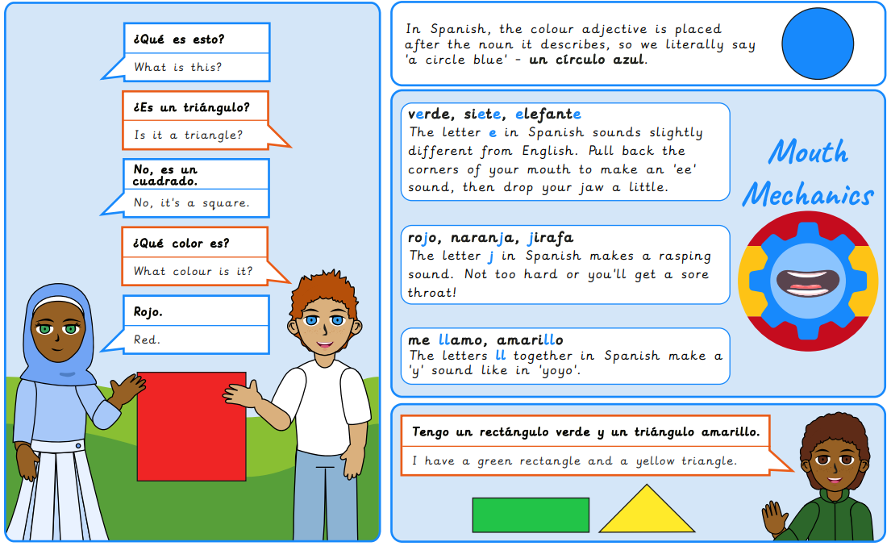
What I will learn next:
To recognise and recall numbers one to six in Spanish. To recognise and practise numbers one to ten in Spanish. To read and recognise numbers up to 12 in Spanish. To recognise and build a phrase to give your age in Spanish. To ask and answer questions giving personal information. To identify key phonemes in number words.

Slide 5
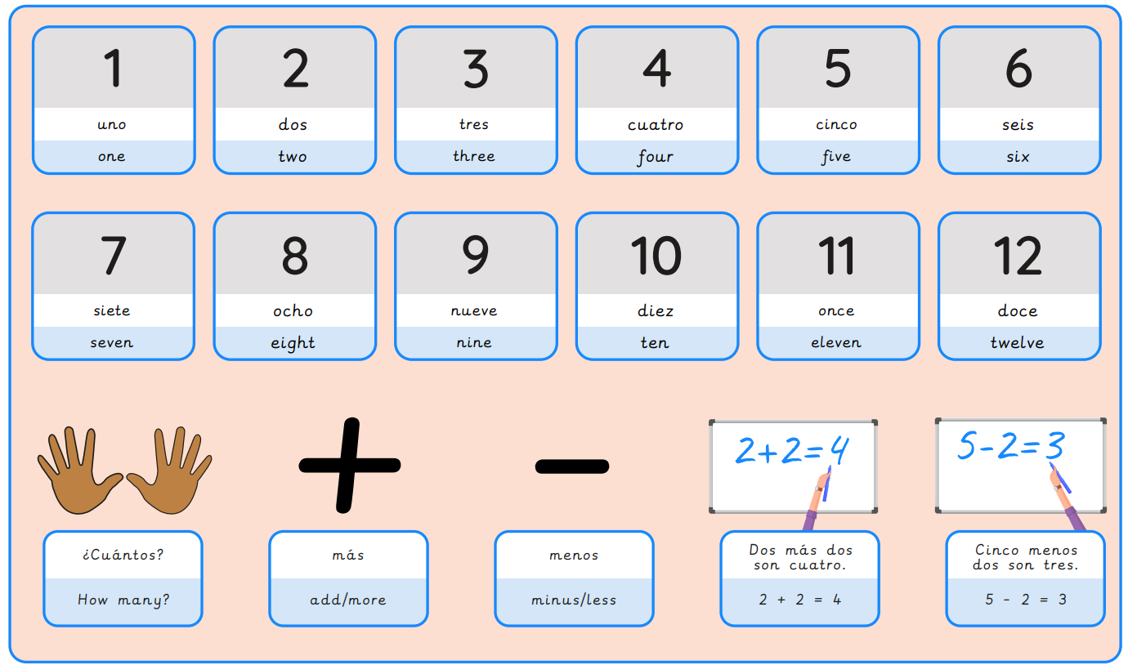
Year 3, Spring 1 – Spanish Numbers and Ages
What I will learn now:
To recognise and recall numbers one to six in Spanish. To recognise and practise numbers one to ten in Spanish. To read and recognise numbers up to 12 in Spanish. To recognise and build a phrase to give your age in Spanish. To ask and answer questions giving personal information. To identify key phonemes in number words.

Slide 6
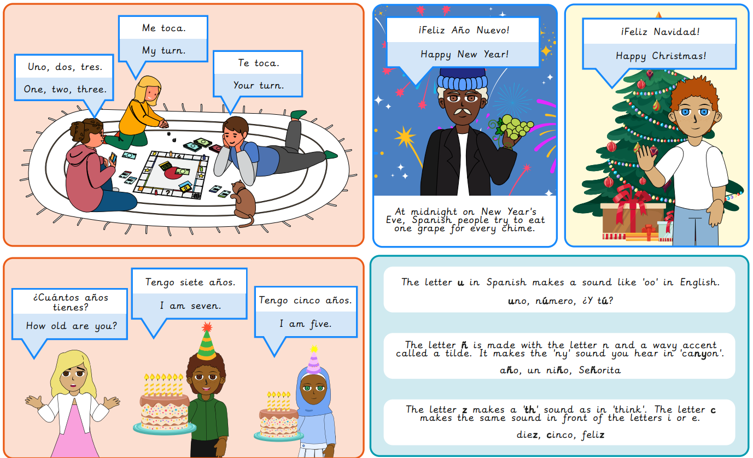
What I will learn next:
To recognise and respond to spoken classroom instructions. To name school bag objects and identify if they are masculine or feminine nouns. To identify how a noun phrase changes in the plural form when describing classroom items. To construct a phrase using the negative form, no tengo – I do not have. To read and interpret sentences featuring the conjunctions y and pero. To compose a piece of writing describing what is in a school bag.

Slide 7
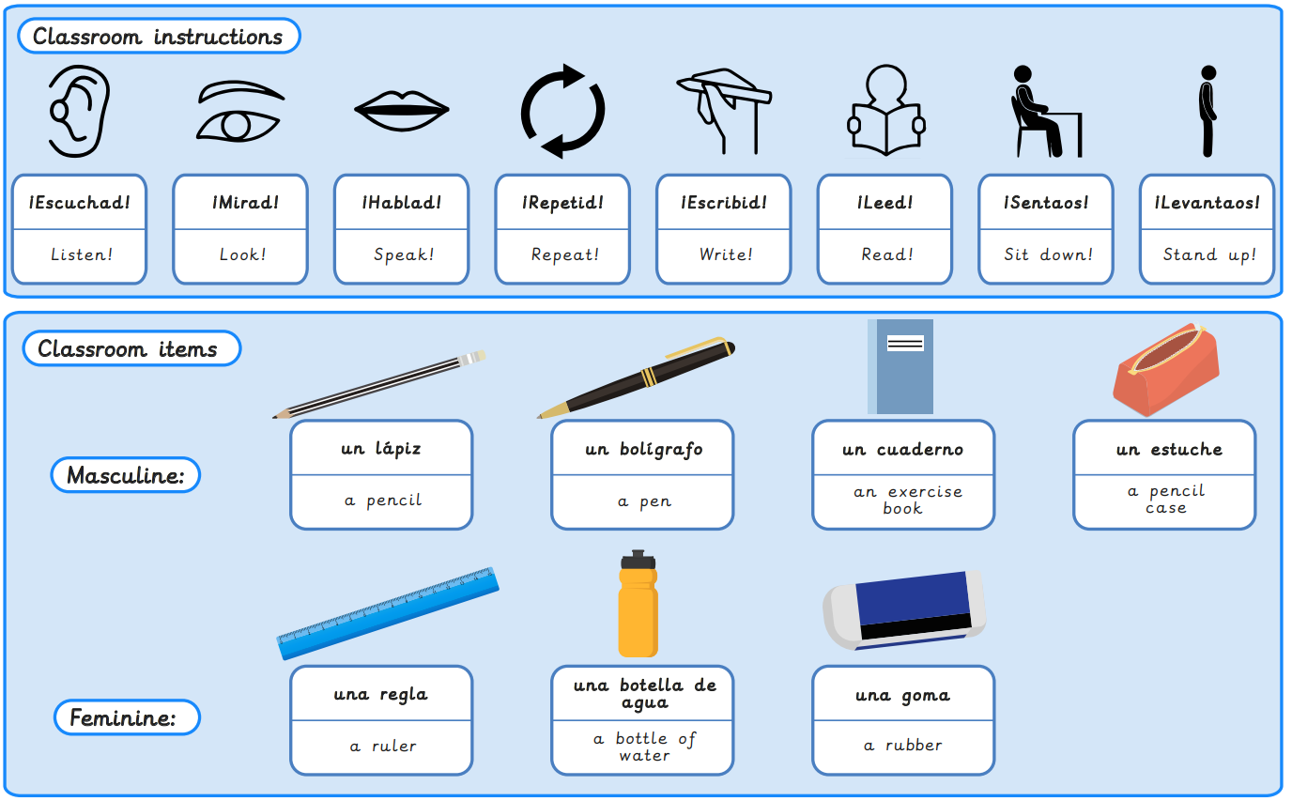
Year 3, Spring 2 – Classroom objects in Spanish
What I will learn now:
To recognise and respond to spoken classroom instructions. To name school bag objects and identify if they are masculine or feminine nouns. To identify how a noun phrase changes in the plural form when describing classroom items. To construct a phrase using the negative form, no tengo – I do not have. To read and interpret sentences featuring the conjunctions y and pero. To compose a piece of writing describing what is in a school bag.

Slide 8
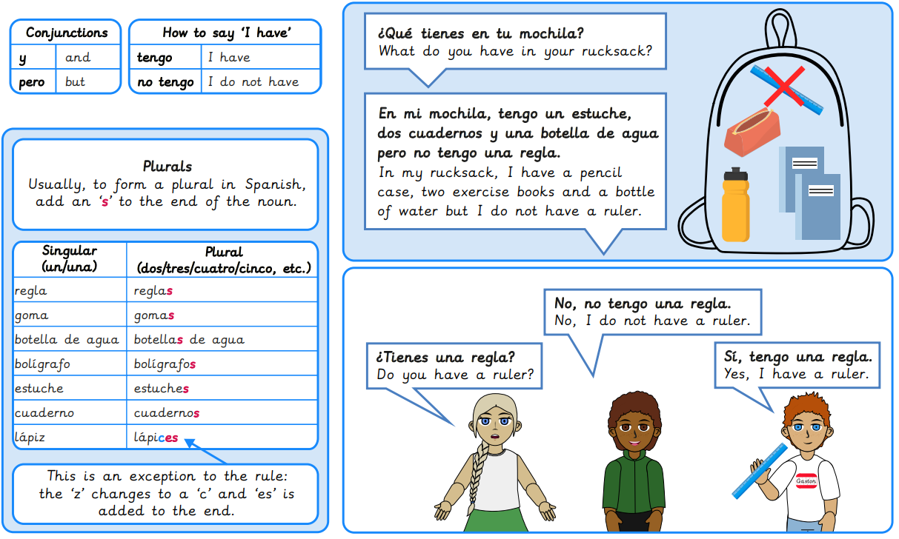
What I will learn next:
To name places in Spain using key phonemes. To practise answering questions about who I am and where I live. To use a bilingual dictionary to identify nouns and their gender. To listen for key information about where people live. To read and interpret information from a short descriptive text. To compose a short written paragraph to introduce yourself.

Slide 9
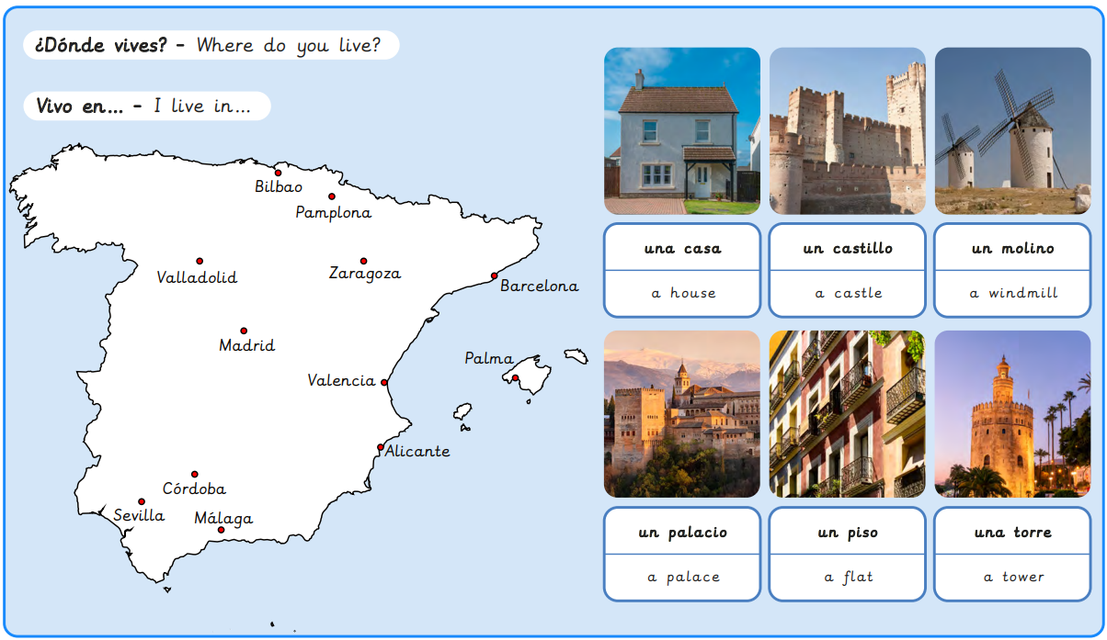
Year 3, Summer 1 – Where do you live in Spain?
What I will learn now:
To name places in Spain using key phonemes. To practise answering questions about who I am and where I live. To use a bilingual dictionary to identify nouns and their gender. To listen for key information about where people live. To read and interpret information from a short descriptive text. To compose a short written paragraph to introduce yourself.

Slide 10
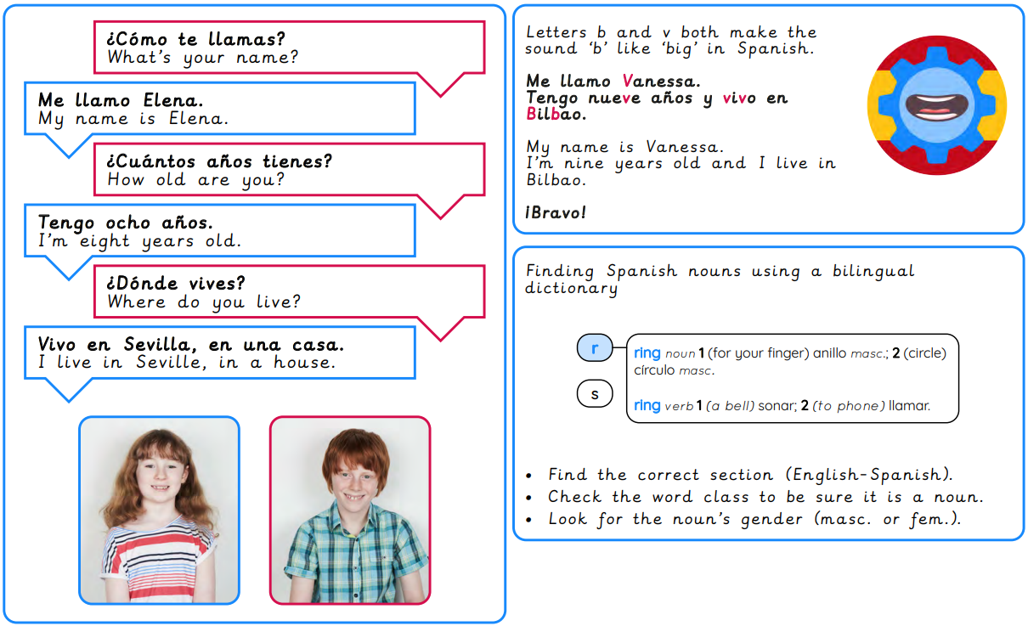
What I will learn next:
To identify and pronounce Spanish speaking countries in Latin America. To speak in short phrases to describe travel plans. To recognise and use the prepositions en and a when describing travel. To say the days of the week as part of a sentence in Spanish. To compose a travel diary in Spanish. To perform a travel diary in Spanish.

Slide 11
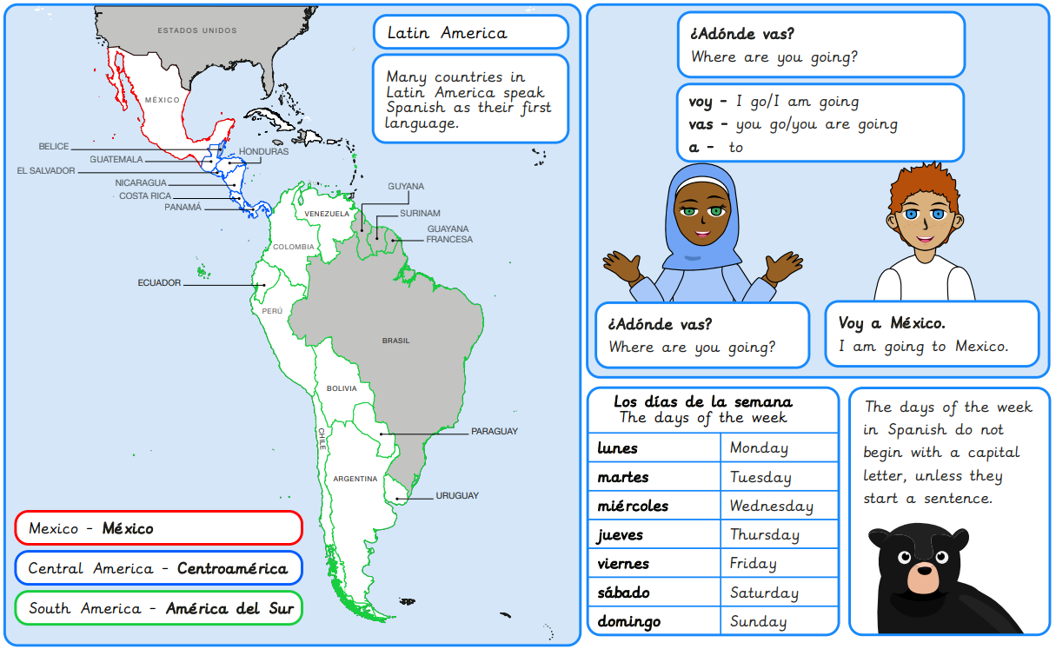
Year 3, Summer 2 – Journey around Latin America
What I will learn now:
To identify and pronounce Spanish speaking countries in Latin America. To speak in short phrases to describe travel plans. To recognise and use the prepositions en and a when describing travel. To say the days of the week as part of a sentence in Spanish. To compose a travel diary in Spanish. To perform a travel diary in Spanish.

Slide 12
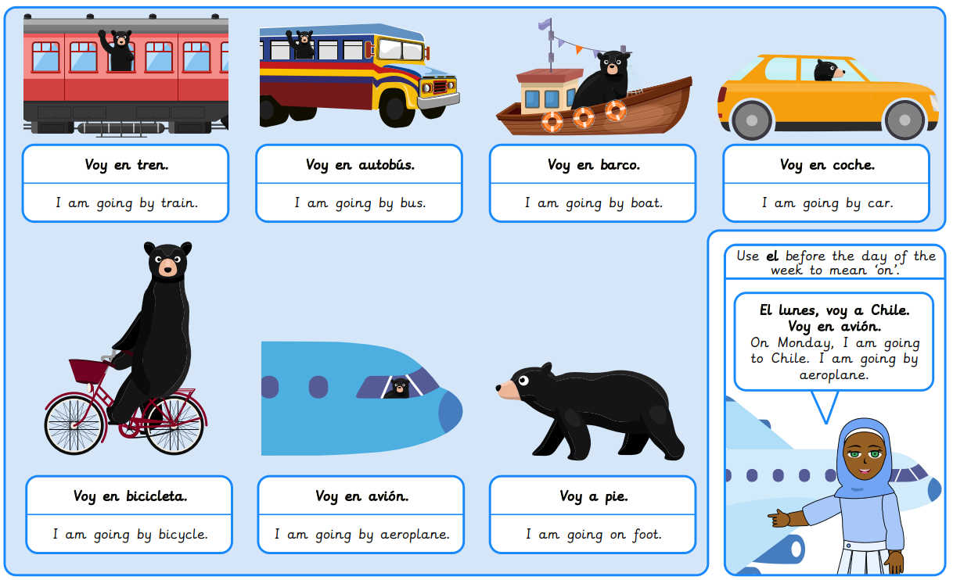
What I will learn next:
To identify and say the numbers 13 to 31. To ask and answer questions about the months of the year. To identify and say dates. To ask and answer questions about significant dates. To identify and give the dates of specific events. To listen to and understand spoken language.

