Slide 1

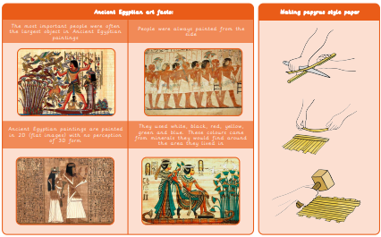
Year 3 Craft and Design: Ancient Egyptian scrolls
What I will learn now:
I can recognise and discuss the importance of Ancient Egyptian art.
I can choose a surface for drawing.
I can record colours, patterns and shapes through observational drawing.
I can choose and use tools and materials confidently.
I can create a selection of sketches that show idea exploration.
I can follow instructions with minimal support.
I can discuss and evaluate the process and outcome of my work.
What I already know:
I can draw a map of my journey to school, including key landmarks and different types of mark-making.
I can follow instructions to make a piece of felt that holds together
I can decide how to place ‘jigsaw’ pieces to create an abstract composition.
I can make choices about which details from their map to include in a stained glass.
I can cut cellophane shapes with care and arrange them
I can design a print with simple lines and shapes
I can follow a process to make and print
I can evaluate my work
What I will learn next:
I can escribe objects, images and sounds with relevant subject vocabulary.
I can create drawings that replicate a selected image.
I can select imagery and colours to create a mood board with a defined theme and colour palette.
I understand the work of William Morris, using subject vocabulary to describe his work and style.
I can create a pattern using drawing, taking inspiration from mood boards and initial research to develop it.
I can identify and explain where a pattern repeats.
I can follow instructions to create a repeating pattern, adding extra detail.
I understand different methods of creating printed fabric in creative industries.
I can use sketchbooks to evaluate patterns.

Slide 2
