Slide 1
Year 5/6 Sculpture and 3D: Making memories
What I already know:
I can group images together, explaining choices.
I can answer questions about a chosen installation thoughtfully and generate questions.
I understand what installation art means.
I can create an installation plan, model or space.
I can describe how the space conveys a particular message or theme.
I can make and explain choices about materials used, arrangement of items in the space and the overall display of the installation.
What I will learn now:
I can discuss the work of artists that appreciate different artistic styles.
I can create a sculpture to express myself in a literal or symbolic way.
I can reflect verbally or in writing about creative decisions.
I can suggest ways to represent memories through imagery, shapes and colours.
I can draw a composition of shapes developed from initial ideas to form a plan for a sculpture.
I can competently use scissors to cut shapes accurately.
I can talk about artists’ work and explain what might be used in my own work.
I can produce a clear sketchbook idea for a sculpture, including written notes and drawings to show methods and materials needed.
What I will learn next:
I can successfully translate plans to a 3D sculpture.
I can work mostly independently, experimenting and trying new things.
I can identify and make improvements to my work.
I can produce a completed sculpture demonstrating experimentation, originality and technical competence.
I can competently reflect on successes and personal development.

Slide 2
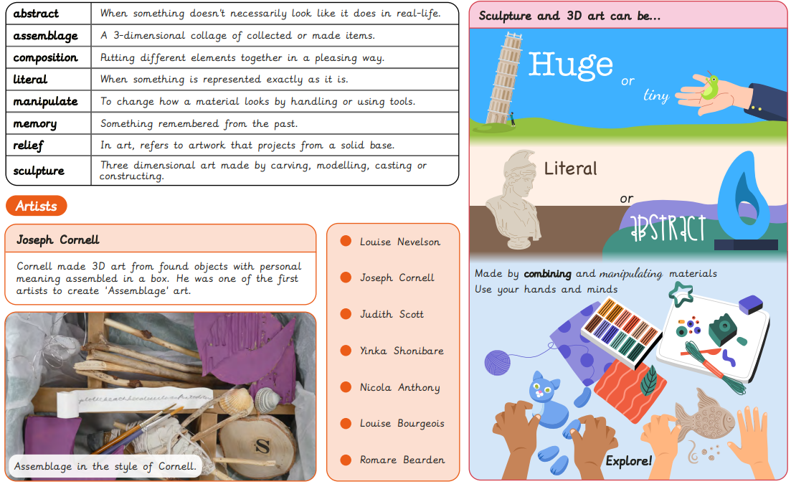
Vocabulary

