Slide 1
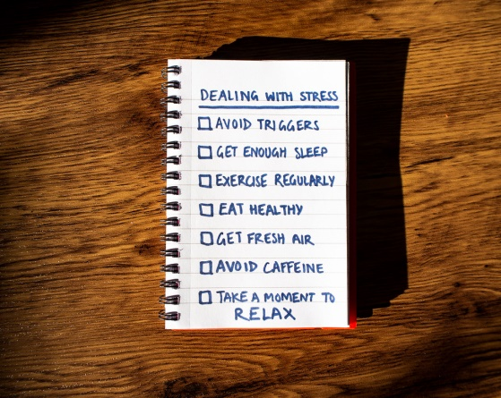
Year 5/6 Knowledge organiser- PSHE
Key Vocabulary
Jigsaw – Healthy Me
Reflective Questions
What do you do to keep yourself physically/mentally well? What helps you when you feel stressed?
What can you do if someone is putting pressure on you to do something you don’t want to do?
What Makes Our School Great?
As good citizens of Rotherhithe Primary School it is important for us to take responsibility for our own health and well-being. We can understand that we may feel stress and pressure, and need positive strategies to deal with this safely.
Puzzle Outcomes
I take responsibility for my health and make choices which benefit my health and well-being..
I know about different types of drugs and their uses and their effects on the body particularly the liver and heart. I know they are ways to be happy without taking drugs.
I understand that some people can be exploited to do things which are against the law.
I know why some people feel pressurised into joining gangs and the risks this involves.
I understand what it means to be emotionally well and can explore my own and others attitudes towards mental health/illness.
I recognise stress and pressure and can see how people may misuse may alcohol/drugs. I can use different strategies to manage stress and pressure.
Jigsaw Learning Charter
Anti-social behaviour | To act in a way that causes alarm or distress.
Criminal | Someone who breaks the law.
Exploited | To use someone unfairly for your own advantage.
Gangs | A group of young people who spend time together often behaving badly or fighting with other groups.
Illegal | Not allowed by law.
Legal highs | A drug that is taken for pleasure having the same effect as illegal drugs but is still within the law to buy.
Managing stress | A way of coping with situations that make you feel under pressure.
Mental health | The condition of your mind and how you manage this.
Over the counter | Legal drugs which can b e bought at a chemist or shop without seeing a doctor first.
Pressure | A difficult situation which makes you feel unhappy or worried about doing the right thing.
Reputation | The opinion people have about someone or something.
Strategies | A way of doing something or dealing with something.
Triggers | An event or situation which causes someone to do something.
Vulnerable | Able to be easily hurt, influenced or attacked.
Healthy me
In this Puzzle the children discuss taking responsibility for their own physical and emotional health and the choices linked to this. They talk about different types of drugs and the effects these can have on people’s bodies. The class discuss exploitation as well as gang culture and the associated risks. They also talk about mental health / illness and that people have different attitudes towards this. They learn to recognise the triggers for and feelings of being stressed and that there are strategies they can use when they are feeling stressed.

