Slide 1
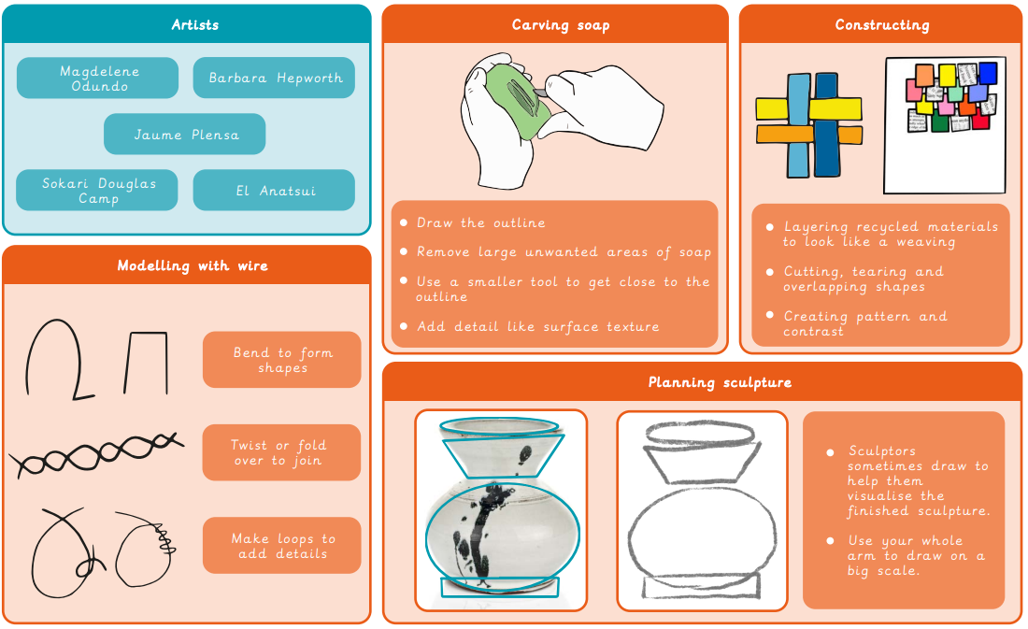
Year 3/4 Sculpture and 3D: Mega materials
What I already know:
I can roll paper tubes and attach them to a base securely.
I can make choices about their sculpture
I can shape paper strips in a variety of ways to make 3D drawings.
I can glue strips to a base in an interesting arrangement, overlapping some strips to add interest.
I can work successfully with others
What I will learn now:
I can use familiar shapes to create simple 3D drawings and describe the shapes used.
I can draw a simple design with consideration for how its shape could be cut from soap.
I can transfer a drawn idea successfully to a soap carving.
I can make informed choices about their use of tools.
I can bend wire to follow a simple template, adding details for stability and aesthetics.
I can create a shadow sculpture using block lettering in the style of Sokari Douglas Camp.
I can explore different ways to join materials to create a 3D outcome, making considered choices about the placement of materials.
What I will learn next:
I can create a sculpture to express myself in a literal or symbolic way.
I can suggest ways to represent memories through imagery, shapes and colours.
I can draw a composition of shapes developed from initial ideas to form a plan for a sculpture.
I can talk about artists’ work and explain what they might use in their own work.
I can produce a clear sketchbook idea for a sculpture, including written notes and drawings to show their methods and materials needed.
I can successfully translate plans to a 3D sculpture.
I can identify and make improvements to my work.

