Slide 1
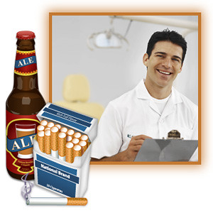
Year 3/4 Knowledge organiser- PSHE
Key Vocabulary
Jigsaw – Healthy Me
Reflective Questions
Who are your friends and how do they make you feel?
Which groups do you spend time with and how do you feel when you’re with different groups?
Tell me why alcohol and smoking effect health?
What Makes Our School Great?
As good citizens of Rotherhithe Primary School it is important for us to understand that we should choose friendship groups that make us feel happy and valued. We can understand that being assertive and addressing peer pressure can make us decide on the correct choices in life.
Puzzle Outcomes
I recognise how different friendship groups are formed and how I fit into them and who I value most as friends.
I understand that there are followers and leaders in the group and how this can impact on me.
I understand the facts about smoking and its effects on health, and some of the reasons people start smoking such as peer pressure.
I understand the facts about alcohol and its effects on health, and some of the reasons people start drinking and how I can resist pressure from others.
I can explain when people are putting me under pressure and identify the feelings of anxiety and fear associated with this.
I know myself well enough to know what is right and wrong and tap into my inner strength to be assertive.
Jigsaw Learning Charter
Advice | Guidance on what you should do about something.
Alcohol | A clear liquid which can make you drunk.
Anxiety | An uncomfortable feeling of nervousness or worry that something might happen in the near future.
Assertive | Someone who behaves confidently and is not afraid to say what they believe.
Emotions | A strong feeling such as love, anger or frustration.
Fear | An unpleasant emotion or thought when you are worried or frightened of something bad, dangerous or painful.
Follower | A person who does what someone else believes or suggests.
Friendship | A situation in which 2 or more people get along and spend time together.
Leader | A person who takes control and manages people or a situation and can influence others behaviour.
Liver | A large organ in the body that cleans blood and produces bile ( a yellow liquid to digest fat).
Opinion | A thought or belief about something or someone.
Peers | A person who is the same age as someone else in a group.
Pressure | The act of trying to make someone do something by persuading or arguing.
Healthy me
In this Puzzle the class look at the friendship groups that they are part of, how they are formed, how they have leaders and followers and how they fit into them. The children are asked to reflect on their friendships, how different people make them feel and which friends they value the most. The class also look at smoking and its effects on health, they do the same with alcohol and then look at the reasons why people might drink or smoke.

