Slide 1
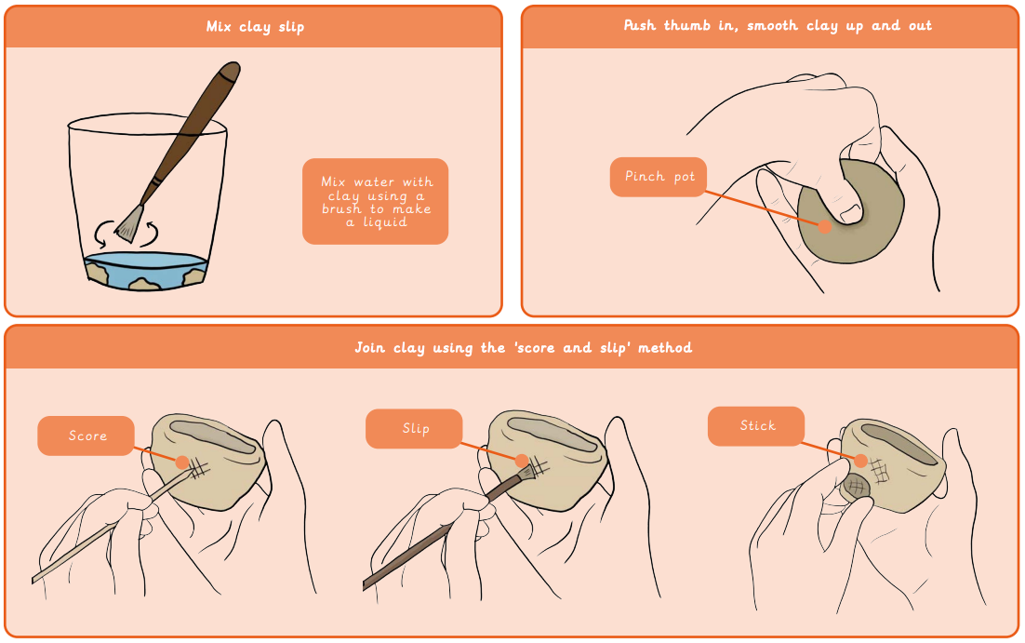
Year 2 3D Sculptures: Clay houses
What I already know:
I can roll paper tubes and attach them to a base securely.
I can make choices about their sculpture
I can shape paper strips in a variety of ways to make 3D drawings.
I can glue strips to a base in an interesting arrangement, overlapping some strips to add interest.
I can work successfully with others
What I will learn now:
I can flatten and smooth clay, rolling shapes successfully and making a range of marks in the clay.
I can make a basic pinch pot and join at least one clay shape onto the side using the scoring and slipping technique.
I can roll a smooth tile surface.
I can join clay shapes and make marks in the tile surface to create a pattern.
I can draw a house design and plan how to create the key features in clay.
I can create a clay house tile that has recognisable features made by both impressing objects into the surface and by joining simple shapes.
What I will learn next:
I can fold and curve pieces of card to join the flat shapes together.
I can make a structure that holds its 3D shape.
I can explain in simple terms the difference between 2D and 3D art.
I can combine shapes together to make an interesting free-standing sculpture.
I can draw a cardboard model from different angles, focusing on shapes in the positive and negative space to achieve an abstract effect.
I can plan an abstract sculpture based on play equipment.
I can choose appropriate methods for joining elements in sculptures.
I can think about how to improve sculptures and make choices about what to add.
I can work cooperatively in pairs

Slide 2
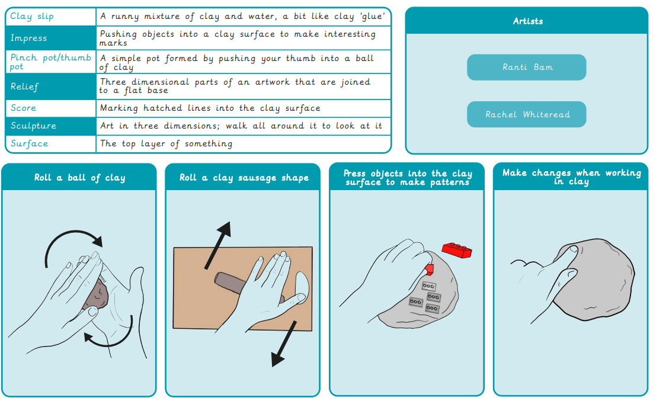
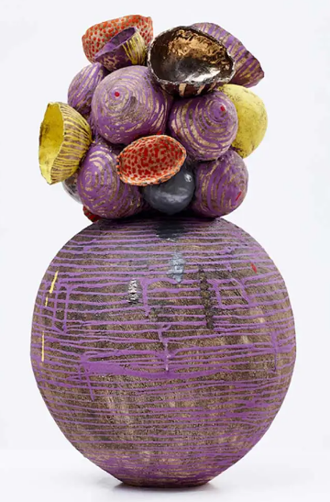
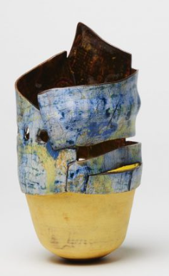
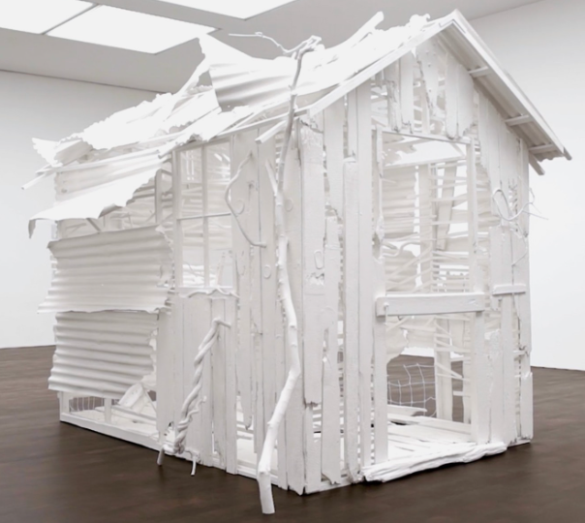
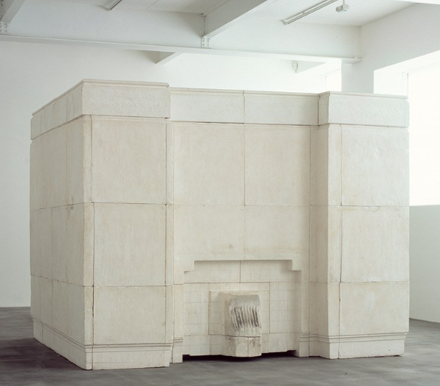
Ranti Bam
Ranti Bam
Rachel Whiteread
Rachel Whiteread

