Slide 1
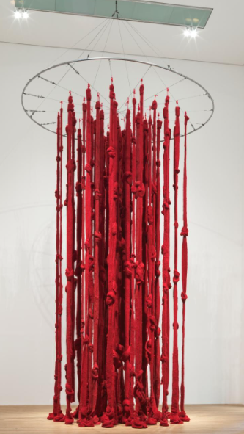
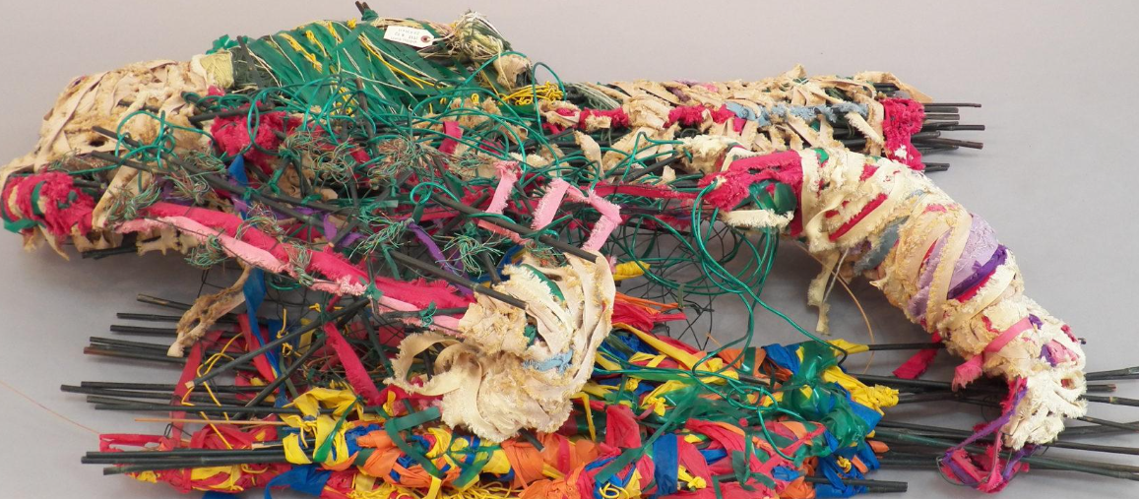
Year 1 Craft and Design: woven wonders
What I will learn next:
I can sort images into groups and give reasons for my choices
I can follow instructions to make a piece of felt holds together
I can decide how to place ‘jigsaw’ pieces to create an abstract composition.
I can cut cellophane shapes with care and arrange them into a pleasing composition.
I can design a print with simple lines and shapes
I can make and print from a polystyrene tile.
I can choose a favourite artwork and give reasons for my choice
What I already know:
I can use a range of small tools, including scissors and paint brushes and cutlery.
I am beginning to show accuracy and care when drawing
I can use colours and lines to show my ideas and feelings.
I can go back and make changes to my art work.
What I will learn now:
I can choose and measure lengths of wool and join wool sections together.
I can change how I wrap materials
I can select colours thoughtfully.
I can choose materials based on colour, thickness and flexibility.
I can find knots, plaits and weaves in Cecilia Vicuña’s work
I can weave with paper
I can describe my own weaving and compare it to Vicuna’s artwork.
Cecilia Vicuña
Judith Scott

Slide 2
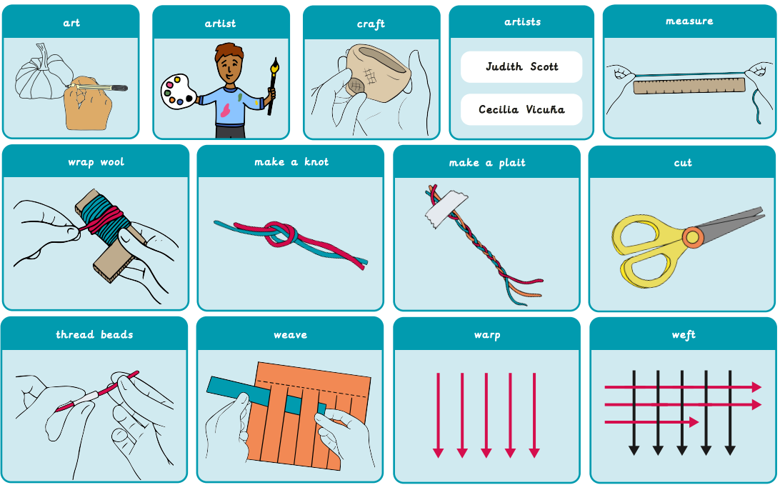
Vocabulary

