Slide 1

Read Write Inc Phonics
Parent Workshop
Aims:
To provide an overview of the Read Write Inc. phonics programme.
To introduce the key sounds that children are currently being taught.
Share phonics screening check materials.
Explain how children are tested.
Consider how parents can support at home.
Answer any questions.

Slide 2
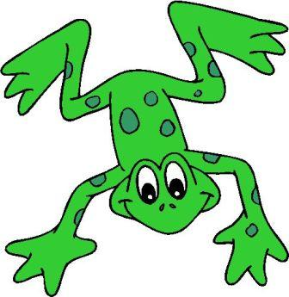
Synthetic Phonics
Read Write Inc is a synthetic phonics programme that is used in school. Research has shown that synthetic phonics is the best method/tool to teach young children to read.
Programme includes phonically decodable books that are sequenced to match the order of teaching, while ensuring continual reinforcement of earlier sounds that are taught.

Slide 3
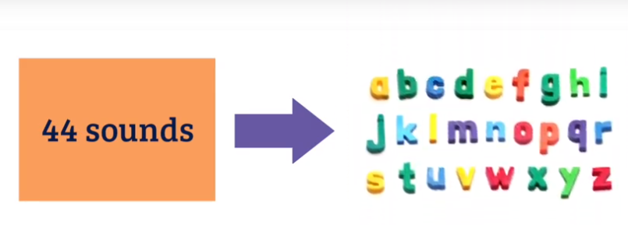
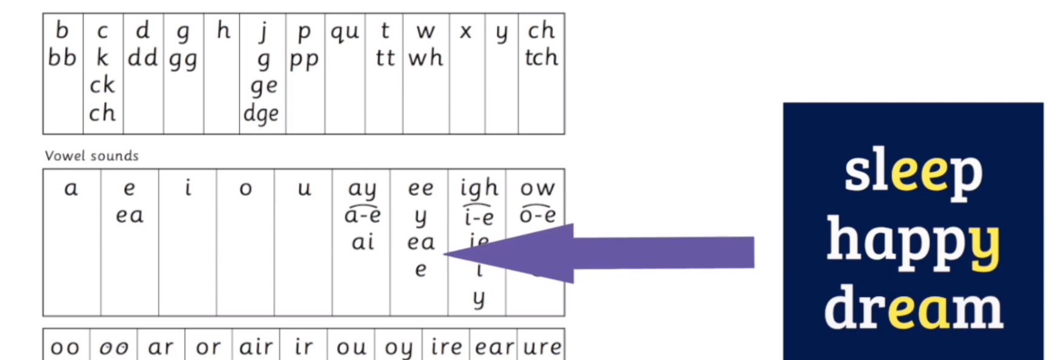

Slide 4
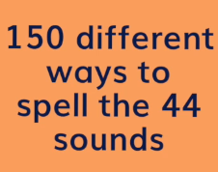
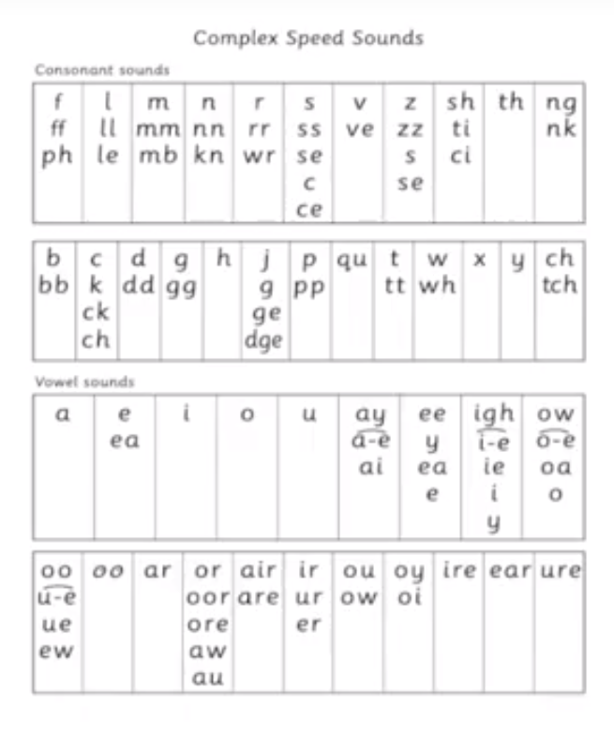
This is why learning to spell in English is far harder than for other languages

Slide 5
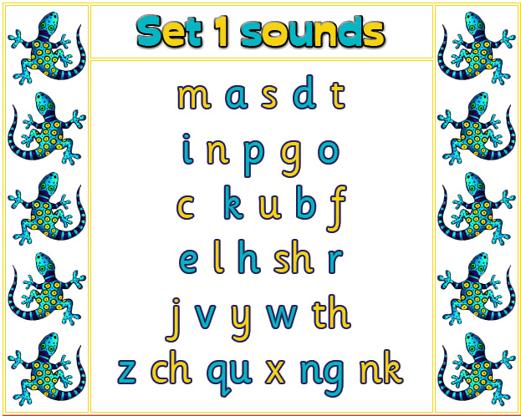
Set 1, 2 or 3 Speed Sounds
The children are taught to read sets of speed sounds. Set 1 sounds are taught first and in the following order. They are taught to read these quickly.

Slide 6

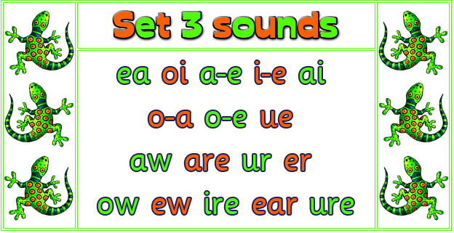



Set 2 & 3 Speed Sounds
When the children are confident with Set 1 sounds, set 2 sounds are taught and then finally set 3 sounds.
These sounds are called digraph or trigraph, because 2 or more letters represent 1 sound.
We refer to digraphs as ‘special friends’ with the children.

Slide 7
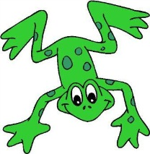



To help children to remember the speed sounds a mnemonic picture card and rhyme is used. For set 1 sounds this is linked to teaching children how to write letters accurately.
For set 2 and 3 sounds this is to help the children to remember the digraph (when 2 letters make one sound) or trigraph (3 letters make 1 sound)
e.g; for ‘ow’ the rhyme
‘blow the snow’ is taught.

Slide 8
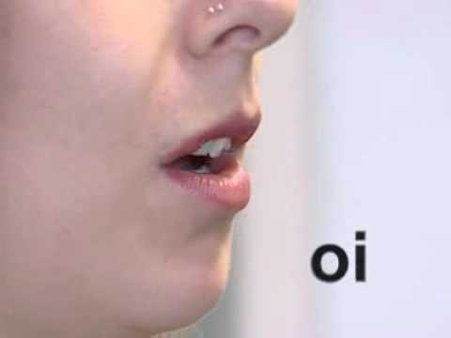
How to pronounce speed sounds
It is really important that the sounds are pronounced clearly. You may hear this referred to as using ‘pure sounds’.
Watch the following you tube link:
http://www.youtube.com/watch?v=BqhXUW_v-1s

Slide 9
Split digraph
Sometimes referred to as: silent ‘e’/ mute ‘e’/ magic ‘e’ its technical name is split digraph.
The children are taught to recognise this as 1 special sound. The ‘e’ does not make a separate sound at the end of the word but has changed the first vowel sound.
win wine man mane
tune

Slide 10
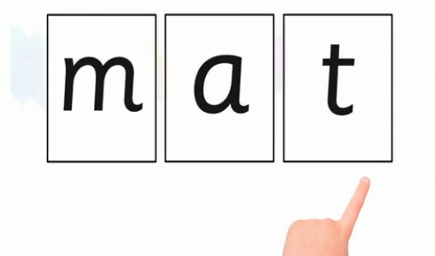
Blending
Practise making words using the cards.

Slide 11

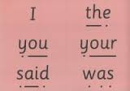
Blending/Green Cards/Red Cards
As the children are taught to blend they are presented with words to read. These are called ‘Green Words’, (words that they are able to use phonics to help them read). They have sound buttons (dots) to help cue them in.
Words that are tricky and that they cannot ‘Fred Talk’ are taught on red cards and are called ‘Red Words’.
Sound buttons

Slide 12

Fred Fingers
We teach the children to spell out words using their fingers to help them. They put out fingers for the number of sounds they can hear not the number of letters in a word.
We refer to this as ‘Fred Fingers’.
Notes:
We use Fred Fingers to help children sound out words to spell easily. This is a tool that helps them spell any word. It means children do not have to memorise lots of words before they can try writing.
Demonstrate how to use Fred Fingers with a simple word like cat. Ask parents to hold up three fingers and show how the children say cat and pinch the sounds and write them down.

Slide 13
Year 1 Phonics test
PSC will be held the week of the 10th of June
All children are tested by their teacher
32 is usually the pass mark
Includes real and nonsense words
Only tests children’s ability to read words in isolation

Slide 14
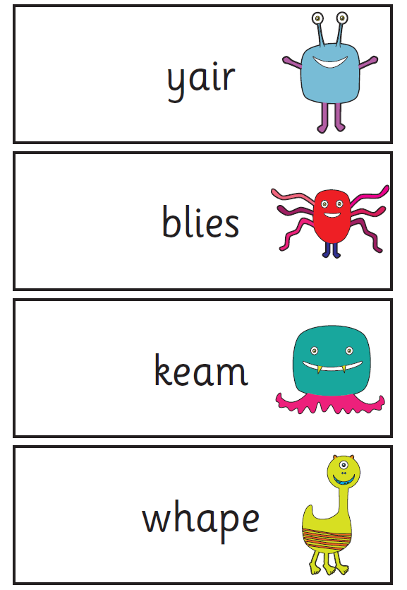
Nonsense words/Alien words
Deliberately included to check children’s ability to use phonic skills.
Half the test consists of nonsense words

Slide 15
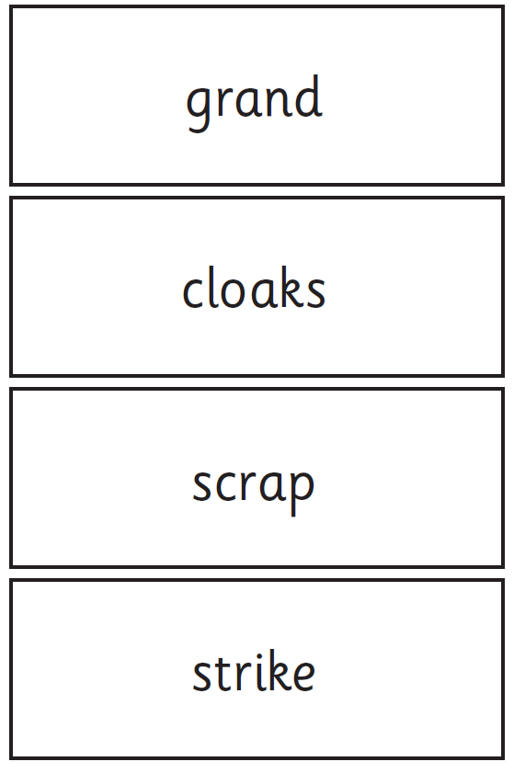
Real words
These can contain any combination of phoneme sounds taught.
Children must blend sounds accurately to be awarded a mark.

Slide 16
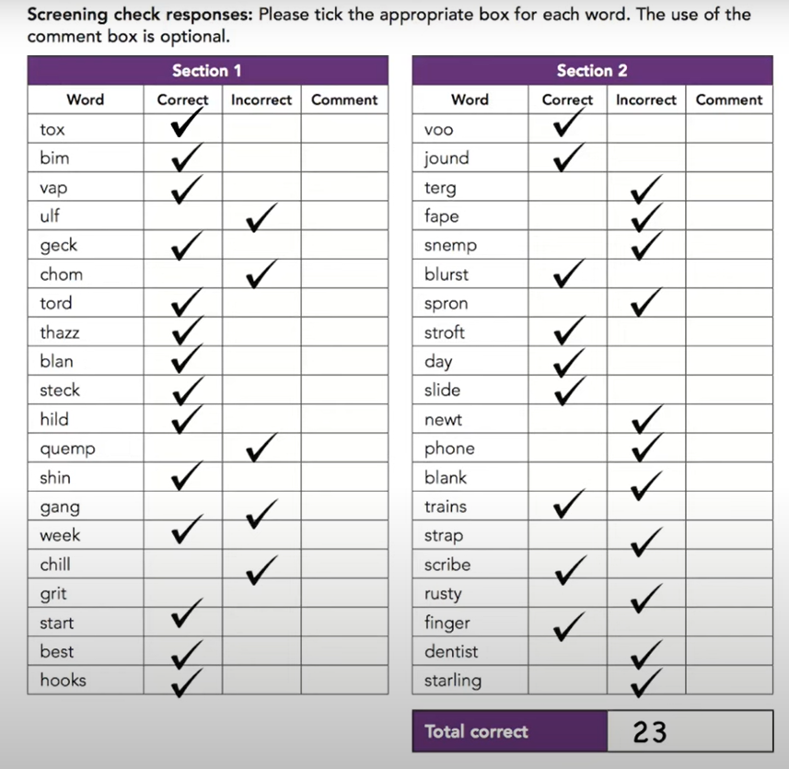
Phonics Screening Check

Slide 17
Access Arrangements
The teacher will ensure that the children's mental health is high.
If a child finds it hard to sustain concentration or needs a break then it will be given. The test has to be completed on the same day that it is started.
Children may be permitted to draw sound buttons under words if this supports their understanding

Slide 18

Training video
This short film is a teacher training film that shows how children are judged when doing the phonics screening check. Click on the picture or open the following link: https://youtu.be/W3ImrUwhzHc

Slide 19
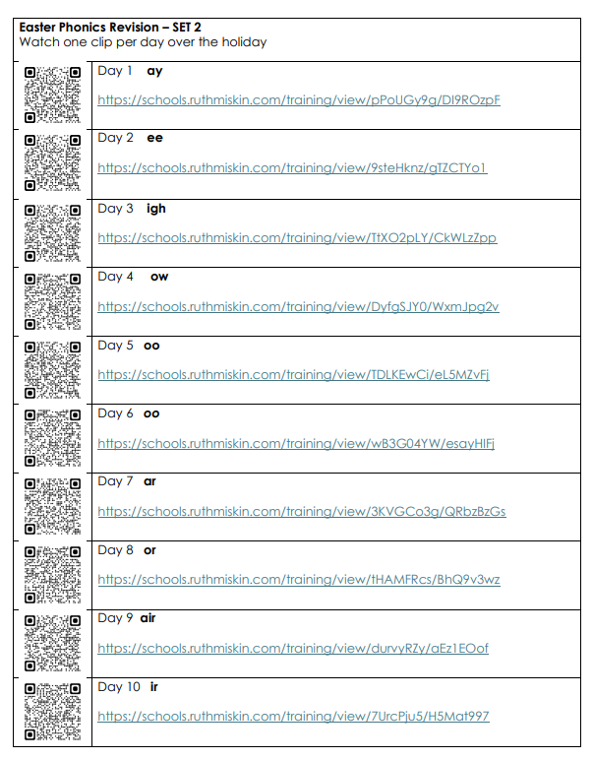
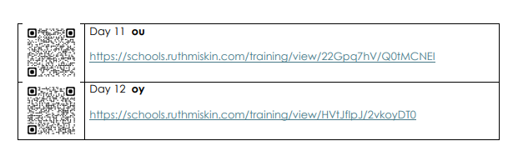
Easter Home learning
We will be sending home a revision set of RWI films that we would like children to watch during the Easter break. There is a QR code or link on the sheet to the films. These last approximately 10 minutes.
For example, this set cover the set 2 sounds.
The film models the sounds and blending words and then lets the children practice

Slide 20

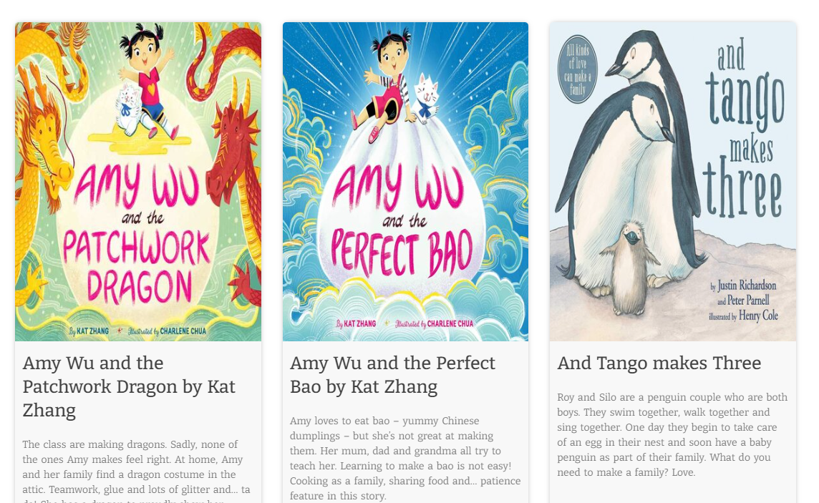
Read lots of stories to your child
Reading books to your child and talking about books helps them to build vocabulary a key predictor of success with reading.

Slide 22
Short 60 seconds of practicing sounds

Slide 23
To help children remember red words encourage them to take a photograph of the word in their mind, encourage them to practice writing the word and make the word using cards or magnetic letters.
Notes:
http://www.ruthmiskin.com/en/resources/parent-tutorial-storybook-activities-green-and-red-words/

Slide 24
Do discuss key vocabulary and the meaning of words with your child.

Slide 25
Text Reading
You can see that ‘Red Words’ are written in red. If your child struggles to read a ‘Red Word’ tell them what it is. If is a word in black then encourage them to ‘Fred Talk’ the word (sound it out).
If they still struggle then give them the word.
Don’t forget to praise them for trying and what they get right.
Notes:
https://www.youtube.com/watch?v=6QVfbYvPaAM

Slide 26
Do talk about the books children read. RWI books provide questions that you can ask about. Let children check in the book for answers. Don't treat this as a memory test.

Slide 27
For quick practice

Slide 28

To Finish then…
Any Questions?

