Slide 1
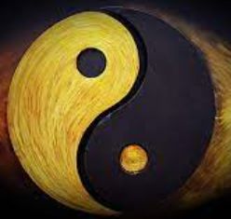
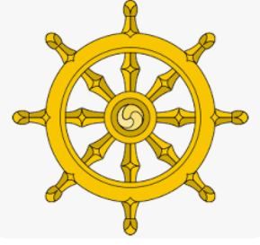
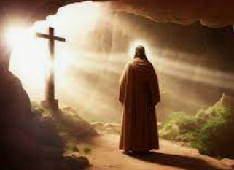
Rotherhithe Primary- Year 5/6
Big Question: How important are the similarities and differences between and within religions?
Topic: What do people believe about life after death?
What I should already know
About different beliefs about God and his character. This should be drawn on when understanding the concept of life after death as this links to the nature of God and what death means to different religions and worldviews About special artefacts and events
What will learn in this unit?
To investigate the concept of life. To consider what different religions say about life after death. To consider Hindu views about reincarnation. To consider why Christians believe in life after death. To consider Muslim views of life after death.
What I will learn next
Synthesise a range of worldviews within religions, focusing on how sacred texts are interpreted in a wide variety of ways within and across different faiths.
dharma | One’s religious duty for a Hindu person.
karma | The results of your actions.
rebirth | Buddhists believe we are made up of a life force and that life force (think of it as the atoms and molecules within you) will continue to live after your life I a new form in the world.
reincarnation | Hinduism and Sikhism believe that a soul goes through many lives, hopefully improving and becoming more perfect.
resurrection | The act of bringing something that had disappeared or ended back into use or existence, for Christians this is what made Jesus not just a prophet but proof that he was God’s son.
Topic Overview
You will to learn about and from what different religions and world views believe about the purpose and end of life.
karma
dharma
resurrection

