Slide 1
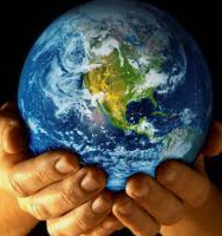
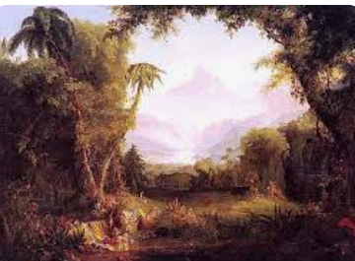
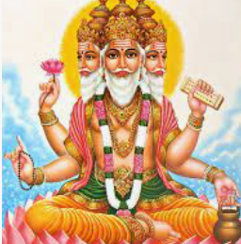
Rotherhithe Primary- Year 2
Big Question: Can stories change people?
Topic: Where does the world come from and how should we look after it?
What I should already know
How different people from different religions belong to their faith. Key beliefs about God in Christianity, Islam and Hinduism. About different holy books, and some stories within them for different religions.
What will learn in this unit?
To understand that people have different beliefs of how the world began. To know about the story of Adam and Eve and the meaning for Christians and Jews. How do Christians try to look after the world. To understand the Hindu story of creation.
What I will learn next
About more stories from the Bible that Jesus told, and how they are interpreted by Christians today. About how Hindu people celebrate the festival of Holi.
creation
Garden of Eden
Adam | According to the Old Testament, the name of the first man, created by God.
creation | The universe or the creatures in it.
Eve | According to the Old Testament, the name of the first Woman, created by God.
Garden of Eden | The garden in which Adam and Eve, the first humans, lived in a state of perfection.
Lord Brahma | Considered the creator of the universe for Hindus.
Lord Vishnu | The second member of the Hindu trinity: the preserver of the world.
Topic Overview
In this unit you are given the opportunity to learn about creation stories and beliefs in different religions.
You are given the opportunity to reflect on you own beliefs about how the world began, and how people fail and try to look after the world.
Lord Brahma

