Slide 1
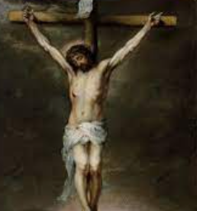
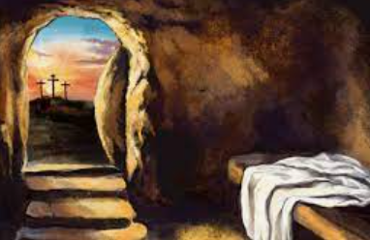
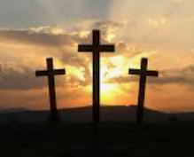
Rotherhithe Primary- Year 5-6
Big Question: How important are the similarities and differences between and within religions?
Topic: What are the sources of the story about what happened on the first Easter Sunday?
What I should already know
About the festival of Easter and the importance of the Bible in the lives of Christian people. About different beliefs about God and his character About special artefacts and events.
What will learn in this unit?
To analyse the Bible accounts of Easter. To analyse the Bible accounts of the resurrection of Jesus. To analyse images of Jesus in art. To explore symbols of Easter. To consider the importance of the ascension.
What I will learn next
The importance of leadership within religions and worldviews Synthesise a range of worldviews within religions, focusing on how sacred texts are interpreted in a wide variety of ways within and across different faiths.
crucifixion
resurrection
crucifixion | Painful method of death created by the Romans, where someone would drown in their own blood which gradually filled the lungs. It was the punishment for very bad criminals.
resurrection | The belief that Christians have that Jesus came back to life after this death 3 days later.
Topic Overview
Work in this unit will enable you to focus on different accounts of the resurrection stories found in the gospels in the New Testament, and allow you to explore what took place. Time is also given to Jesus’ ascension and the sending of the Holy Spirit and the beginnings of the early church.
Easter

