Slide 1
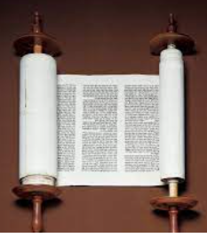
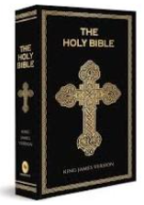
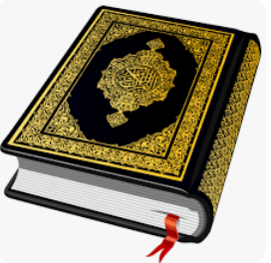
Rotherhithe Primary- Year 2
Big Question: Can stories change people?
Topic: Why are different books special for different people?
What I should already know
How different people from different religions belong to their faith. The key beliefs about God in Christianity, Islam and Hinduism.
What will learn in this unit?
To know why some books are more special than others. Why the Bible special and who for. What is the Torah and Why it is special. Why the Qu’ran is a special book.
What I will learn next
More stories from the Bible that Jesus told, and how they are interpreted by Christians today. Stories that are important today to Buddhist, Hindu and Sikhi people.
Torah
Bible
Topic Overview
In this unit, you will reflect on what books are special for you and why. You will then learn about the important place of books in religious traditions – Christianity, Islam and Judaism – and how people’s attitudes to these books are shown in how they treat them.
Bible | The Holy Book of the Christians, contains the Hebrew Scriptures (Old Testament), the New
special | Something that is better or greater than something else.
Torah | The law of God as revealed to Moses and recorded in the first five books of the Hebrew scriptures
Qu’ran | The Islamic sacred book, believed to be the word of God as dictated to Muhammad by the archangel Gabriel and written down in Arabic.
Qu’ran

