Slide 1
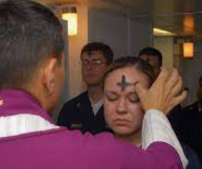
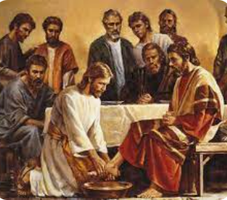
Rotherhithe Primary- Year 2
Big Question: Can stories change people?
Topic: What special stories are told at Easter?
What I should already know
About how different people from different religions belong to their faith. About key beliefs about God in Christianity and have learnt about the Christian festival of Christmas.
What will learn in this unit?
To know why Easter is important to Christians. To know the Easter story and sequence it. To know what happens on Ash Wednesday. To know what happens on Maundy Thursday.
What I will learn next
About more stories from the Bible that Jesus told, and how they are interpreted by Christians today. About how Christmas is celebrated by different Christians around the world. About how Christians treat the Bible and what it teaches them about living in 21st century. About how Christians around the world celebrate Easter in different ways living in 21st century.
Topic Overview
In this unit you will be learning about the various events leading up to Easter. Easter is the most important festival for Christians across all different denominations (types of churches). It is a time where by the death and resurrection of Jesus is remembered and celebrated. For Christians, through Jesus’ death there is a belief that all their wrong doing (sin) can be taken away (cleansed), and through Jesus’ resurrection they can receive the gift of eternal life.
Ash Wednesday
Easter
Ash Wednesday | The first day of lent.
Easter | Is the most important Christian festival as it marks the belief in the death and resurrection of Jesus.
Maundy Thursday | Is the commemoration of the Last Supper of Christ and the Apostles, before which he washed their feet.
Resurection | It was Jesus coming back to life (after dying on the cross)
Maundy Thursday

