Slide 1
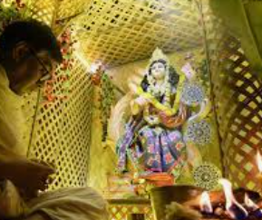
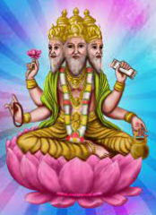
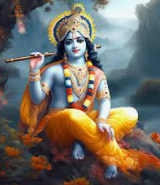
Rotherhithe Primary- Year 1
Big Question: What does it mean to belong?
Topic: What does it mean to be Hindu?
What I should already know
How different families celebrate different festival’s and why they are important in their tradition. Christian traditions that take place in the home. Sikhi traditions that take place in the home. What different families do together around their religion
What will learn in this unit?
To know belonging can help us through the journey of life. To know what karma is. To know who Brahman and Krishna are. To identify how Puja helps Hindus lead a good life.
What I will learn next
About what it means to be a Muslim person of faith. About Hindu scriptures and the Hindu story of creation. Hindu people’s traditions and practices in their homes.
Aum/Om
Puja
Aum/Om | The main symbol of Hinduism. It is the sound heard in deepest meditation and is said to be the name most suited for God.
Brahman | The god of creation.
Karma | The Hindu law of cause and effect.
Krishna | The god Vishnu in human form.
Puja | Hindu worship. It can take place in the home or at the mandir (Hindu temple). At home, they would be a shrine and the family would worship together.
Topic Overview
In this unit, you will investigate the concept of belonging and then relate it to how the key beliefs and practices in Hinduism help Hindus to feel like they belong to their religion. You will look at how the daily life and actions of a Hindu are influenced by the religion they belong to.
Brahman
Krishna

