Slide 1
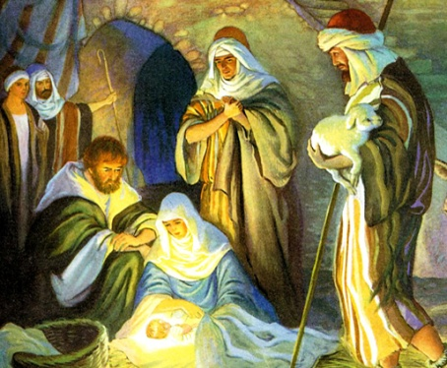
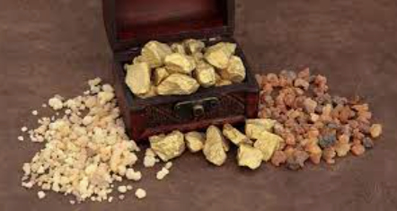
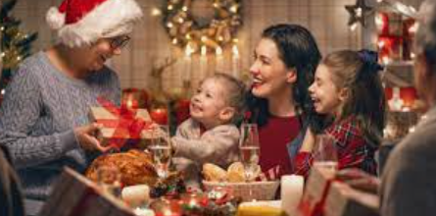
Rotherhithe Primary- Year 1
Big Question: What does it mean to belong?
Topic: How do Christians celebrate Christmas?
What I should already know
To know how Christians belong to their religion. To know what happens at a Christening. To identify key Christian symbols.
What will learn in this unit?
To know why gifts are given at Christmas. To know why gifts are special. To know the Christmas story. To explain why Christmas is special for Christians.
What I will learn next
Why Easter is important What happens on Ash Wednesday What happens on Maundy Thursday and Good Friday What we can we learn from Jesus’ death
Christmas story
frankincense, gold and myrrh
Topic Overview
This unit focuses on what Christians do to celebrate the birth of Jesus. You will discuss and learn why people give gifts at Christmas. In this unit you will explore the Christian belief that Jesus is God’s gift to the world. At the end of the unit there will be a Christmas celebration at school.
Advent | The word "advent" means "arrival" or "coming,"
Advent candle | A candle with numbers 1 to 25 on it , that is lit each day in the lead up to Christmas.
celebration | An important day to get together to enjoy
Christmas | The festival which celebrates the birth of Jesus.
messiah | Jesus is know to Christian’s as the chosen one.
three wise men | Three people who took gifts to Jesus
Christmas celebrations

