Slide 1


Phonics Workshop

Slide 2
Early Reading
Nursery & Reception
General Sound discrimination – environmental, instrumental sounds, body percussion
Rhythm and rhyme
Alliteration
Voice sounds
Oral blending and segmenting
Two Main Skills
Phonics – decoding by blending the sounds in words to read them
Language comprehension – understands what the words means within the context
Language development and phonics working together supports reading development.

Slide 3
What is phonics?
Letter recognition: to see a letter and know the linking sound
Sound discrimination: to hear a sound and be able to link it to a letter
Segmenting: to break a word into sounds ie. c-a-t
Blending: to put sounds together to make a word ie c-a-t = cat
3

Slide 4
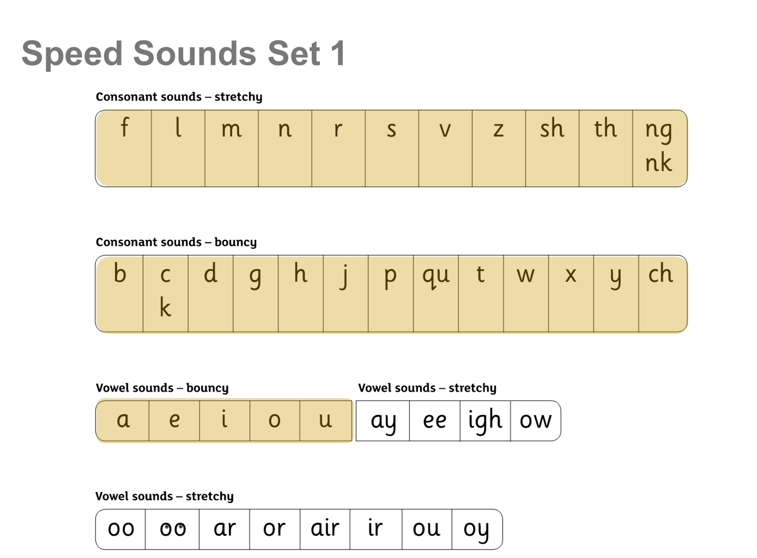
Sound Charts
Red Words are tricky words which cannot be sounded out.
4

Slide 5
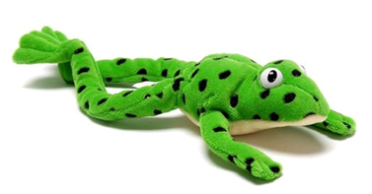
Who is Fred?
Fred can only sound out words – if they can understand him then they can blend (necessary for reading)
We use Fred Fingers for spelling. Fred encourages the children to stretch words to hear the sounds and the use fingers to sound them out.
5

Slide 6
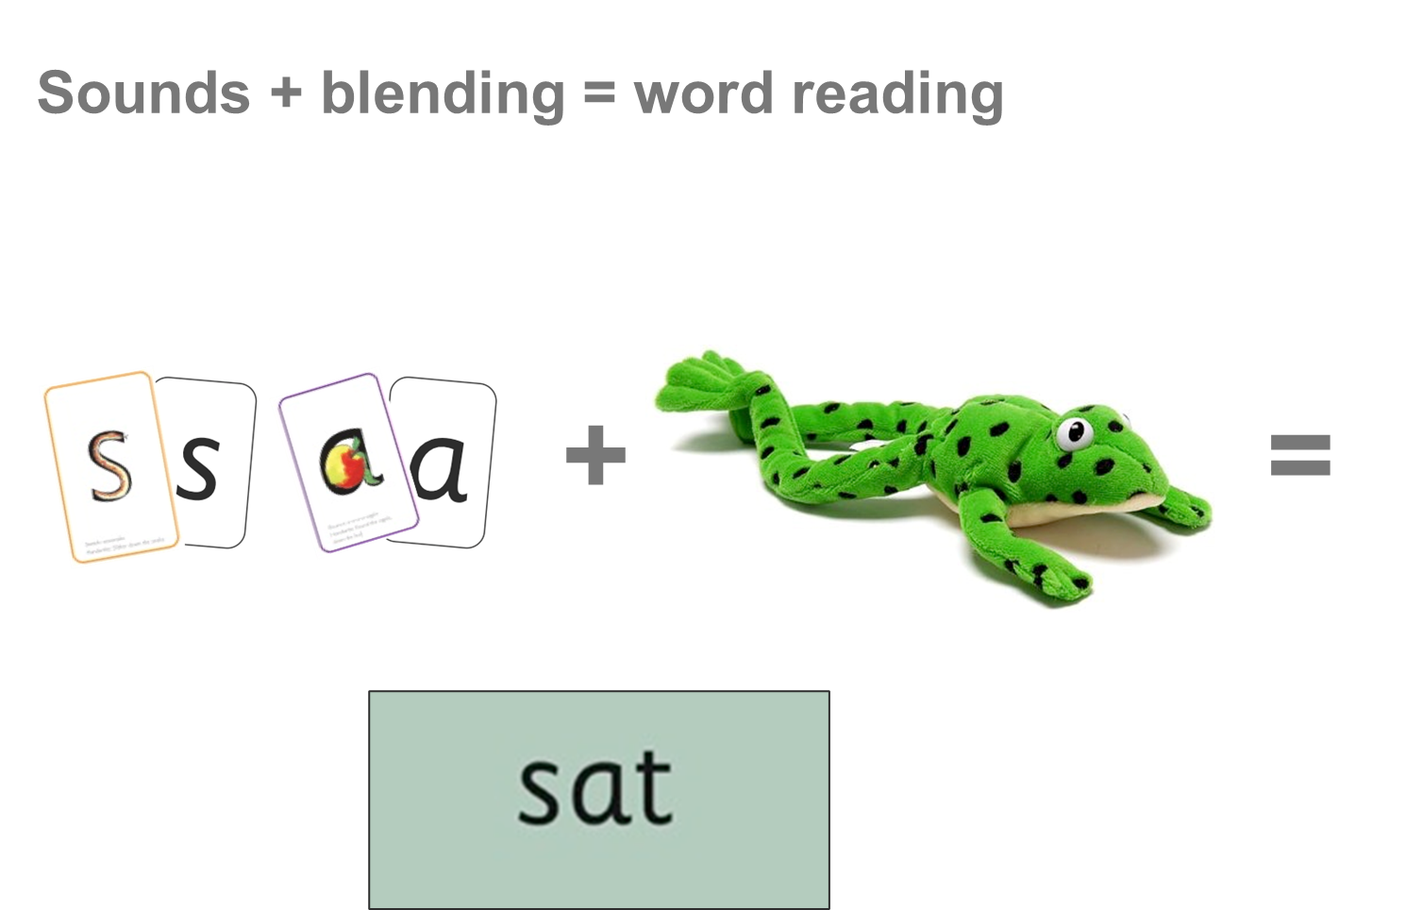

Slide 7
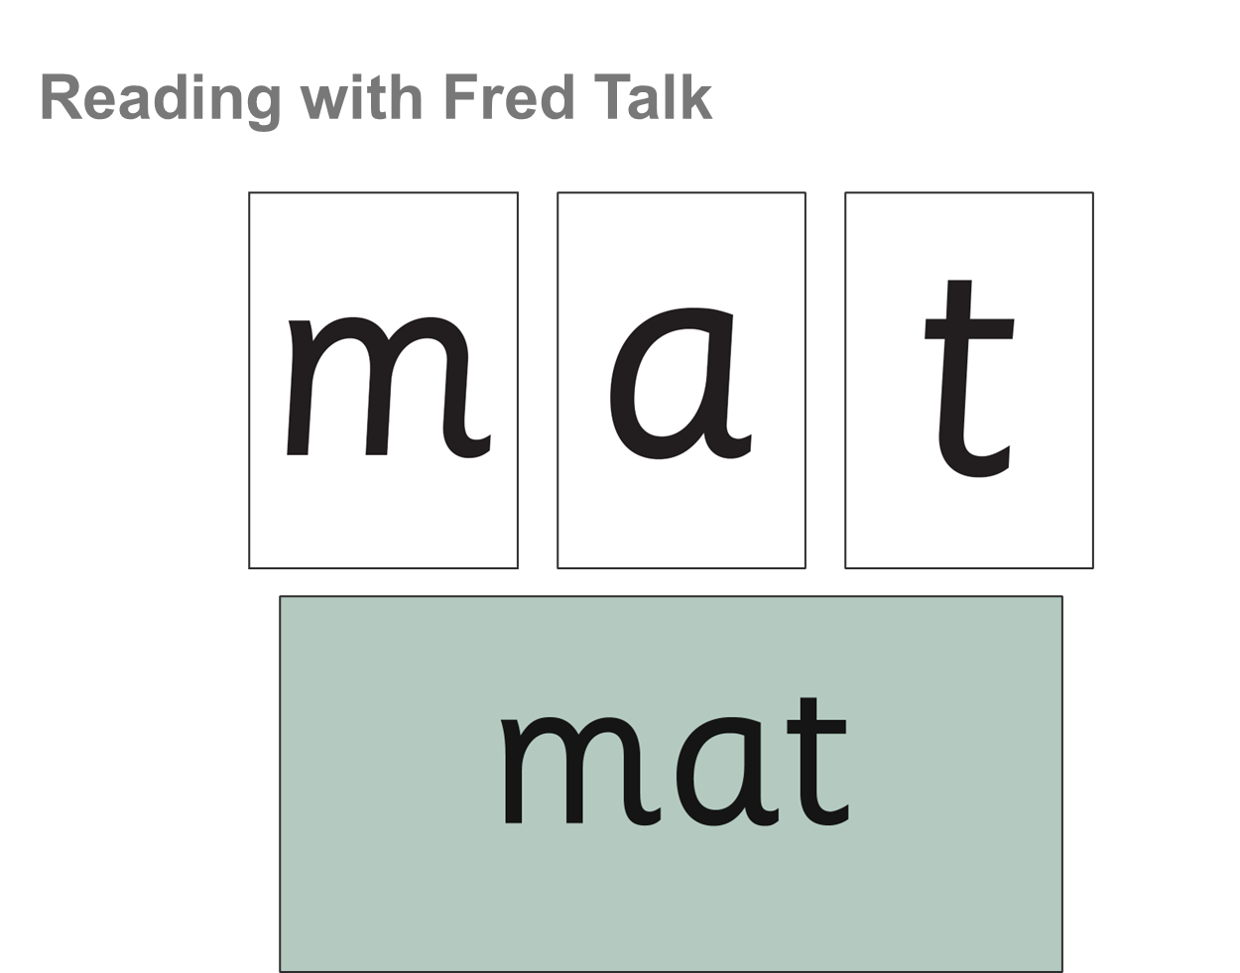

Slide 8
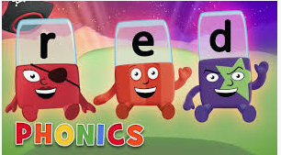
Phonics at home
Easy Games:
I spy games
Fred Talk
Looking at print in the environment
Comprehension of what was read
Alpbhablocks
Video links via Tapestry
Notes:
Reading ELG:
Children read and understand simple sentences. They use phonic knowledge to decode regular words and read them accurately. They also read some common irregular words. They demonstrate understanding when talking with others about what they have read
Writing ELG:
Children use their phonics knowledge to write words in ways which match their spoken sounds. They also write some irregular common words. They write simple sentences which can be read by themselves and others. Some words are spelt correctly and other are phonetically plausible.

Slide 9
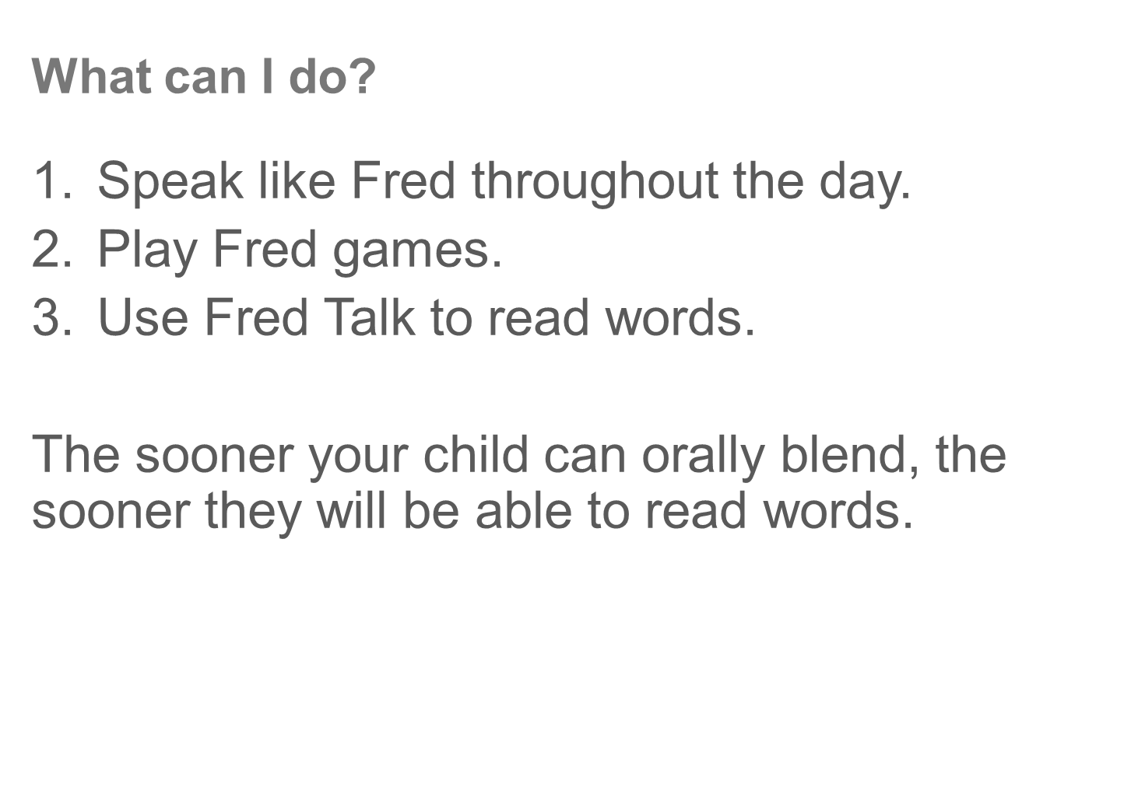

Slide 10
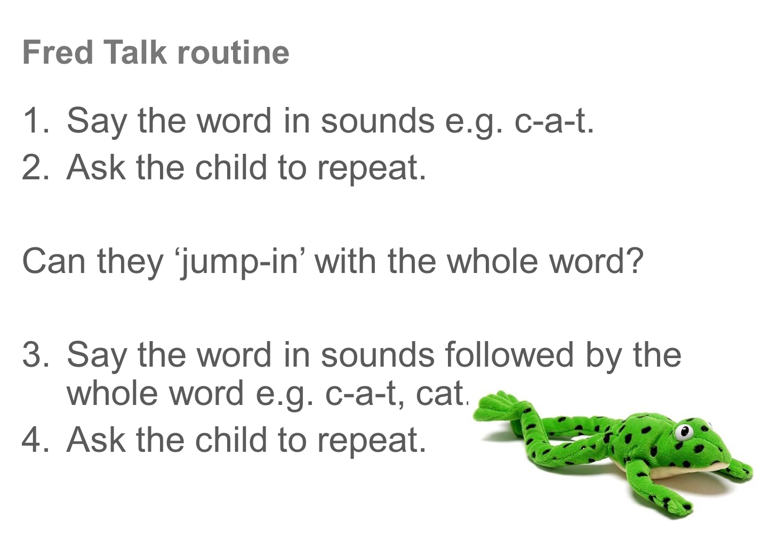

Slide 11
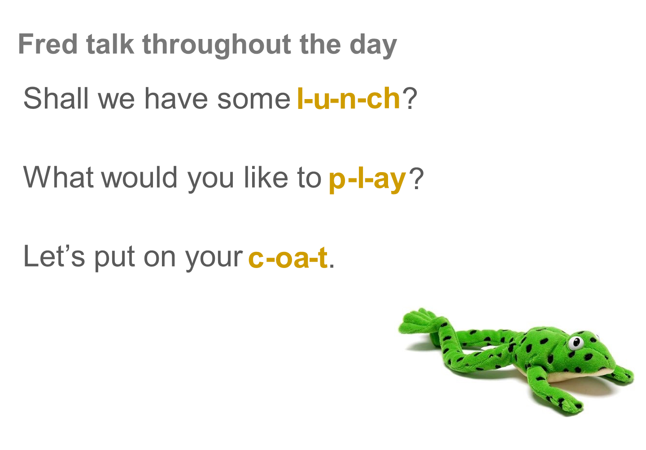

Slide 12
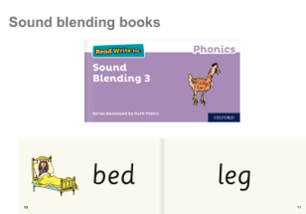

Slide 13
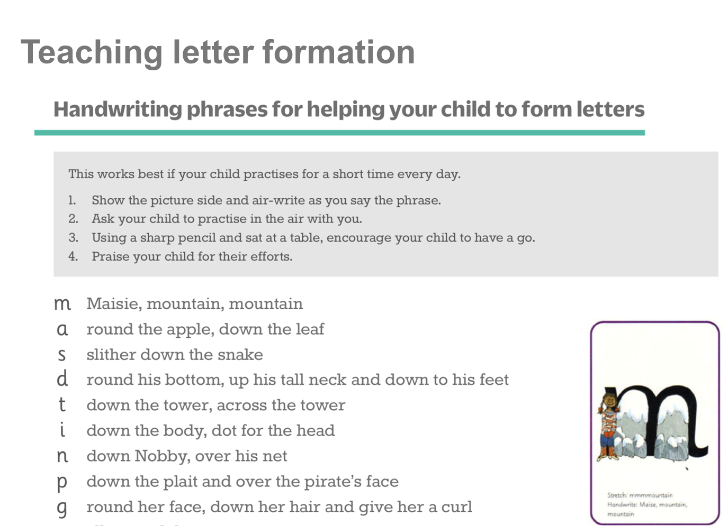

Slide 14
Thank you for attending our Phonics Workshop
Any questions?

Slide 15
Other reading strategies
Prior Knowledge: discuss the front cover – give key vocabulary if needed
Contextual cues: what is the story about?
Picture cues: look at the initial sound and look at the picture
Omitting a word: leave it out and the come back – what makes sense?
Re-reading : read a second time
Pre-reading: story walk look through the whole story at the pictures.
Text decoding: I can’t blend it, is it a red word?
15
15

