Slide 1
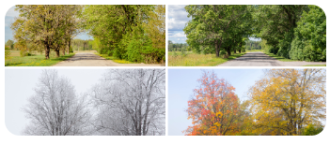
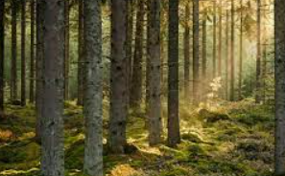
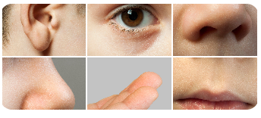
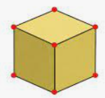
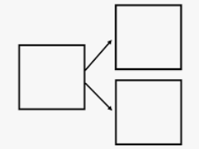
Autumn 2 Star Words Woodland Wonders and Celebrations
Topic
Celebration Diwali Christmas Hannukkah Charity Diwali woodland adventure creatures journey
Science
Rain snow winter summer spring autumn wind sun
senses eyes sight taste touch smell sound hearing taste
Measure
full empty half full
heavy heavier
light lightest
vertex vertices face edge
over under above below top bottom side on in in front behind beside next to between
Maths
fewer greater more less before after first next nothing none part whole plus altogether subtract minus equal
PSE
Unique special friendship similar different patience brain
Tier 2 words
Actions: perform explore balance
Descriptors: interesting bright less more
Concepts: difference similarity safe

