Slide 1
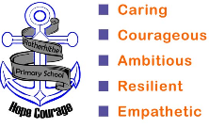
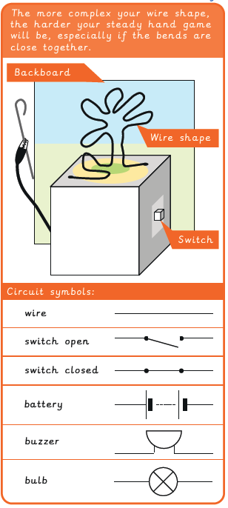
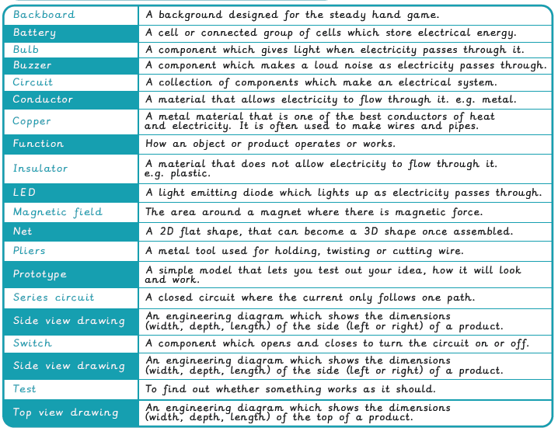
Vocabulary
Year 5/6 Electrical Systems – Steady hand game
Key Facts
Check it out!

Slide 2
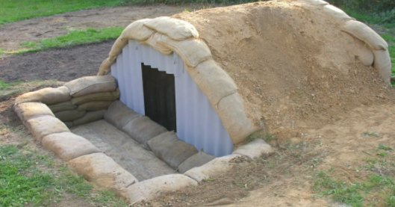
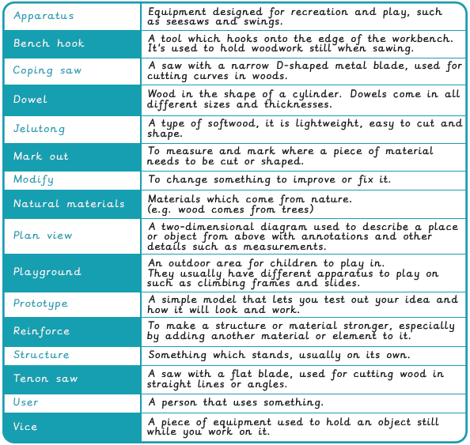
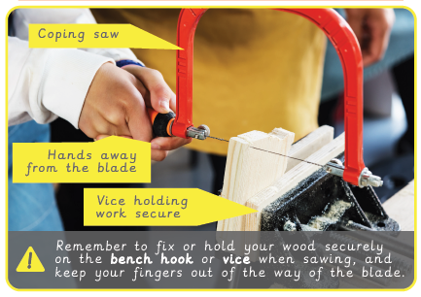
Vocabulary
Year 5/6 Structures – Andersen Shelter
Key Facts
Anderson Shelters were designed to protect families when there were bombs dropping. They used earth as well as sandbags, wood and metal to build the structure.

Slide 3
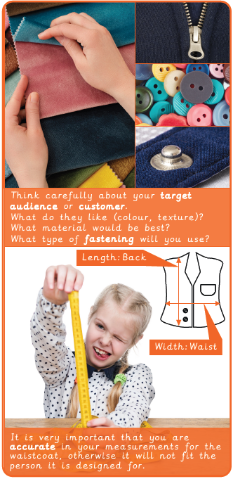
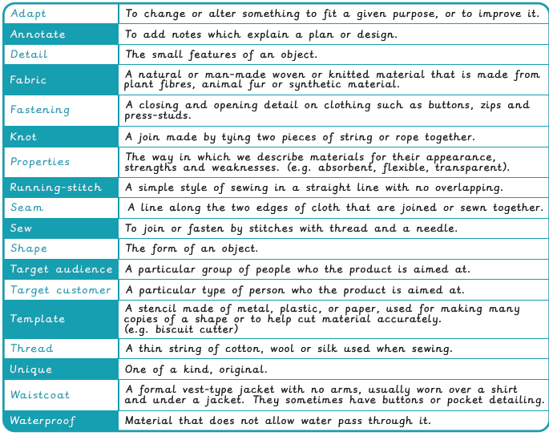
Vocabulary
Year 5/6 Textiles – Waistcoats
Key Facts

Slide 4
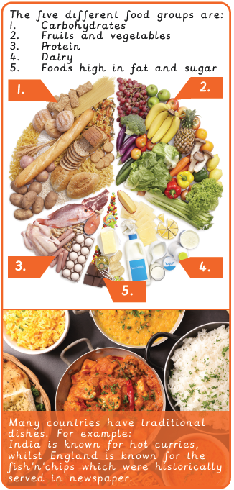
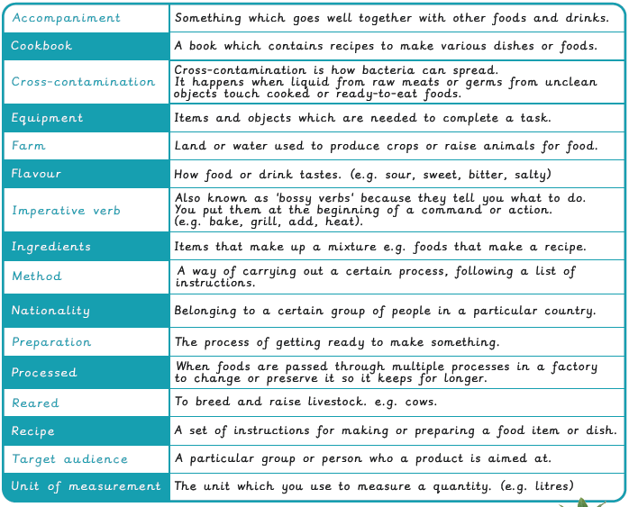
Vocabulary
Year 5/6 Food – Come dine with me
Key Facts
Did you know?

