Slide 1
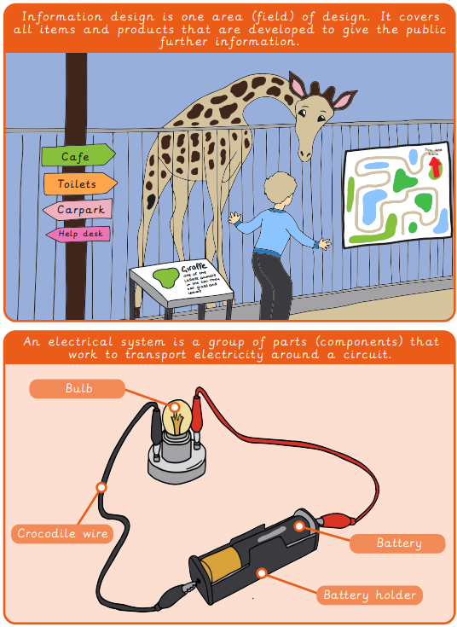
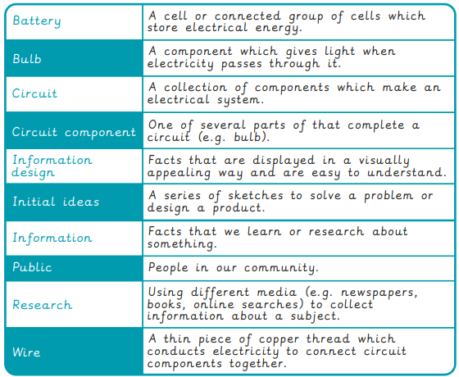
Vocabulary
Year 3/4 Electrical Systems - Torches
Key Facts

Slide 2
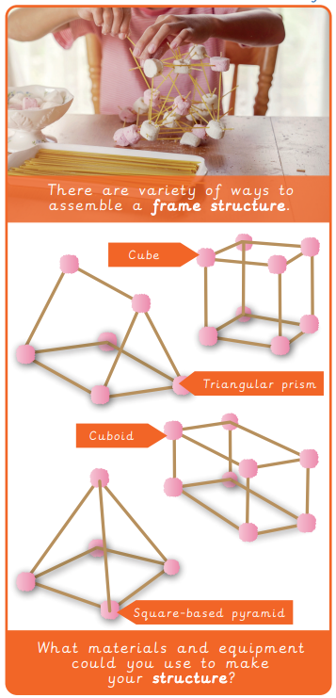
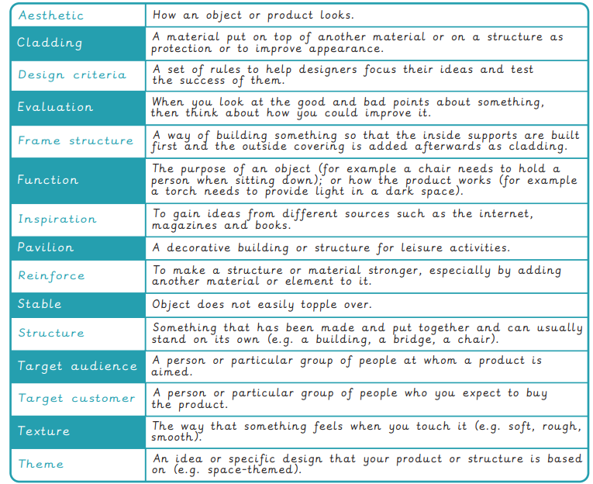
Vocabulary
Year 3/4 Structure -
Key Facts

Slide 3
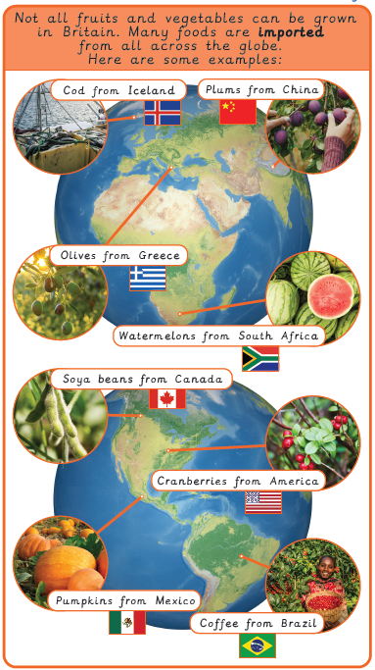
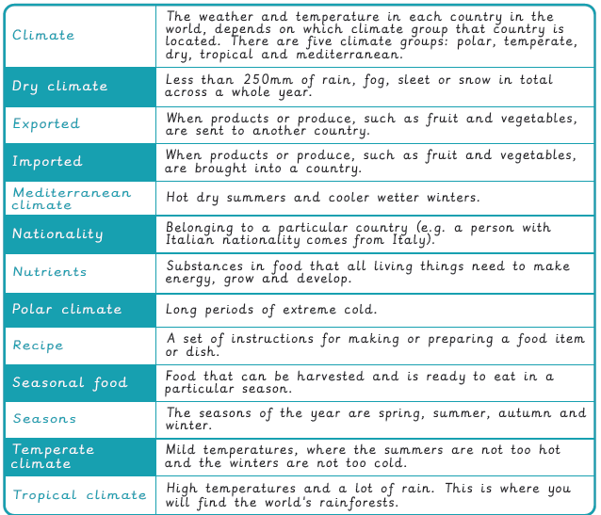
Vocabulary
Year 3/4 Food – Eating Seasonally
Key Facts

