Slide 1
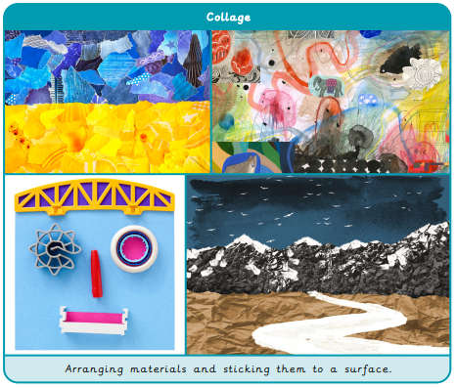
Year 2 Painting and Mixed Media – Colour Splash
What I already know:
I can combine primary coloured materials to make secondary colours.
I can mix secondary colours in paint.
I can choose suitable sized paint brushes.
I can clean a paintbrush to change colours.
I can print with objects, applying a suitable layer of paint to the printing surface.
I can overlap paint to mix new colours.
I can use blowing to create a paint effect.
I can make a paint colour darker or lighter
What I will learn now:
I can mix a variety of shades of a secondary colour.
I can make choices about amounts of paint to use when mixing a particular colour.
I can match colours seen around me.
I can create texture using different painting tools.
I can make textured paper to use in a collage.
I can choose and shape collage materials eg cutting, tearing.
I can compose a collage, arranging and overlapping pieces for contrast and effect.
I can add painted detail to a collage to enhance/improve it.
What I will learn next:
I can mix a tint and a shade by adding
black or white.
I can use tints and shades of a colour to create a 3D effect when painting.
I can apply paint using different techniques eg. stippling, dabbing, washing.
I can choose suitable painting tools.
I can arrange objects to create a still life composition.
I can plan a painting by drawing first.
I can organise painting equipment independently, making choices about tools and materials.

Slide 2
